Slide 1
CMSC 611: Advanced Computer Architecture
Parallel Computation
Most slides adapted from David Patterson. Some from Mohomed Younis

Slide 2
Parallel Computers
Definition: “A parallel computer is a collection of processing elements that cooperate and communicate to solve large problems fast.”
  Almasi and Gottlieb, Highly Parallel Computing,1989
Parallel machines have become increasingly important since:
  Power & heat problems grow for big/fast processors
  Even with double transistors, how do you use them to make a single processor faster?
  CPUs are being developed with an increasing number of cores

Slide 3
Questions about parallel computers:
How large a collection?
How powerful are processing elements?
How do they cooperate and communicate?
How are data transmitted?
What type of interconnection?
What are HW and SW primitives for programmers?
Does it translate into performance?

Slide 4
Level of Parallelism
Bit-level parallelism
  ALU parallelism: 1-bit, 4-bits, 8-bit, ...
Instruction-level parallelism (ILP)
  Pipelining, Superscalar, VLIW, Out-of-Order execution
Process/Thread-level parallelism
  Divide job into parallel tasks
Job-level parallelism
  Independent jobs on one computer system

Slide 5
Applications
Scientific Computing
  Nearly Unlimited Demand (Grand Challenge):
  Successes in some real industries:
    Petroleum: reservoir modeling
    Automotive: crash simulation, drag analysis, engine
    Aeronautics: airflow analysis, engine, structural mechanics
    Pharmaceuticals: molecular modeling
App | Perf (GFLOPS) | Memory (GB)
48 hour weather | 0.1 | 0.1
72 hour weather | 3 | 1
Pharmaceutical design | 100 | 10
Global Change, Genome | 1000 | 1000

Slide 6
Commercial Applications
Transaction processing
File servers
Electronic CAD simulation
Large WWW servers
WWW search engines
Graphics
  Graphics hardware
  Render Farms

Slide 7
Framework
Extend traditional computer architecture with a communication architecture
  abstractions (HW/SW interface)
  organizational structure to realize abstraction efficiently
Programming Model:
  Multiprogramming: lots of jobs, no communication
  Shared address space: communicate via memory
  Message passing: send and receive messages
  Data Parallel: operate on several data sets simultaneously and then exchange information globally and simultaneously (shared or message)

Slide 8
Communication Abstraction
Shared address space:
  e.g., load, store, atomic swap
Message passing:
  e.g., send, receive library calls
Debate over this topic (ease of programming, scaling)
  many hardware designs 1:1 programming model

Slide 9
Taxonomy of Parallel Architecture
Flynn Categories
  SISD (Single Instruction Single Data)
  MIMD (Multiple Instruction Multiple Data)
  MISD (Multiple Instruction Single Data)
  SIMD (Single Instruction Multiple Data)

Slide 10
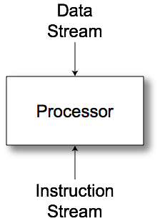
SISD
Uniprocessor

Slide 11
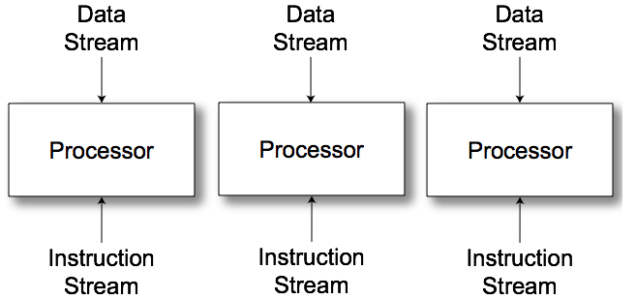
MIMD
Multiple communicating processes

Slide 12
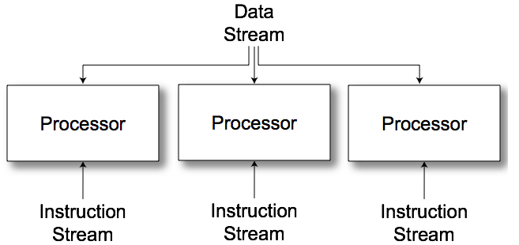
MISD
No commercial examples
Different operations to a single data set
  Find primes
  Crack passwords

Slide 13
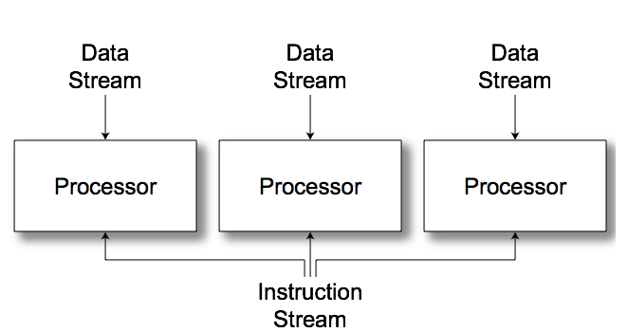
SIMD
Vector/Array computers

Slide 14
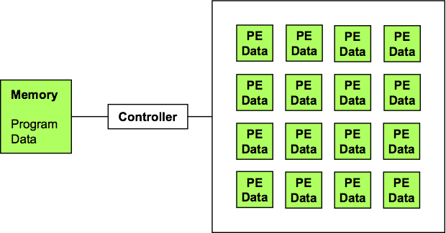
SIMD Arrays
Performance keys
  Utilization
  Communication

Slide 15
Data Parallel Model
Operations performed in parallel on each element of a large regular data structure, such as an array
  One Control Processor broadcast to many processing elements (PE) with condition flag per PE so that can skip
For distributed memory architecture data is distributed among memories
  Data parallel model requires fast global synchronization
  Data parallel programming languages lay out data to processor
  Vector processors have similar ISAs, but no data placement restriction

Slide 16
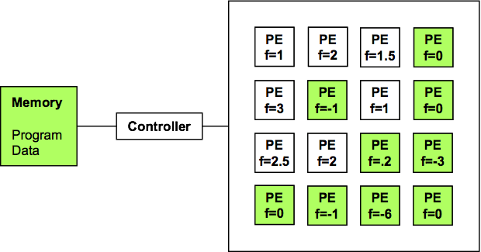
SIMD Utilization
Conditional Execution
  PE Enable
    if (f<.5) {...}
  Global enable check
    while (t > 0) {...}

Slide 17
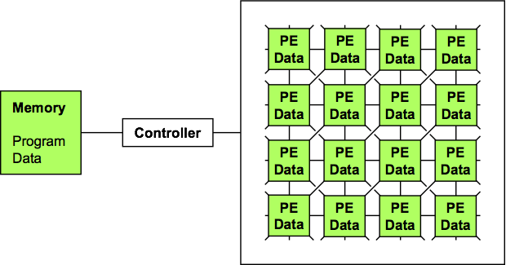
Communication: MasPar MP1
Fast local X-net
Slow global routing

Slide 18
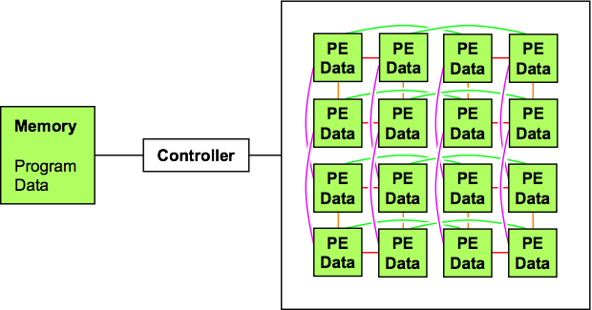
Communication: CM2
Hypercube local routing
Wormhole global routing

Slide 19
Data Parallel Languages
SIMD programming
  PE point of view
  Data: shared or per-PE
    What data is distributed?
    What is shared over PE subset
    What data is broadcast with instruction stream?
  Data layout: shape [256][256]d;
  Communication primitives
  Higher-level operations
    Scan/Prefix sum: [i]r = ∑_{j≤i} [j]d
      1,1,2,3,4 → 1,1+1=2,2+2=4,4+3=7,7+4=11

Slide 20
Single Program Multiple Data
Many problems do not map well to SIMD
  Better utilization from MIMD or ILP
Data parallel model ⇒ Single Program Multiple Data (SPMD) model
  All processors execute identical program
  Same program for SIMD, SISD or MIMD
  Compiler handles mapping to architecture

Slide 21
MIMD
Message Passing
Shared memory/distributed memory
  Uniform Memory Access (UMA)
  Non-Uniform Memory Access (NUMA)
Can support either SW model on either HW basis

Slide 22
Message passing
Processors have private memories, communicate via messages
Advantages:
  Less hardware, easier to design
  Focuses attention on costly non-local operations

Slide 23
Message Passing Model
Each PE has local processor, data, (I/O)
  Explicit I/O to communicate with other PEs
  Essentially NUMA but integrated at I/O vs. memory system
Free run between Send & Receive
  Send + Receive = Synchronization between processes (event model)
    Send: local buffer, remote receiving process/port
    Receive: remote sending process/port, local buffer

Slide 24
History of message passing
Early machines
  Local communication
  Blocking send & receive
Later: DMA with non-blocking sends
  DMA for receive into buffer until processor does receive, and then data is transferred to local memory
Later still: SW libraries to allow arbitrary communication

Slide 25
Parallel System Examples
Connection Machine 5
SGI Origin
Graphics Processors

Slide 26
Thinking Machines CM5 (1993)
MIMD, SPARC processors
Fat Tree communication network
D. Hillis and L. Tucker, “The CM-5 Connection Machine: A Scalable Supercomputer,” Communications of the ACM, v36n11, November 1993

Slide 27
SGI Origin (1998)
MIPS R10000 processor
Hypercube connected
ccNUMA / directory protocol

Slide 28
SGI Origin Node
Ammon, "Hypercube Connectivity within ccNUMA Architecture", Silicon Graphics, 1998.

Slide 29
Origin Communication
Level | Latency (ns)
L1 cache | 5.1
L2 cache | 56.4
local memory | 310
4P remote memory | 540
8P avg. remote memory | 707
16P avg. remote memory | 726
32P avg. remote memory | 773
64P avg. remote memory | 867
128P avg. remote memory | 945
Laudon and Lenoski, "SGI Origin: A ccNUMA Highly Scalable Server", Proceedings of Computer Architecture 1997

Slide 30
Graphics Hardware
Problem domain
Pixel-Planes 4
Pixel-Planes 5
SGI Reality Engine
Pixel Flow
NVIDIA GeForce 6
NVIDIA Maxwell

Slide 31
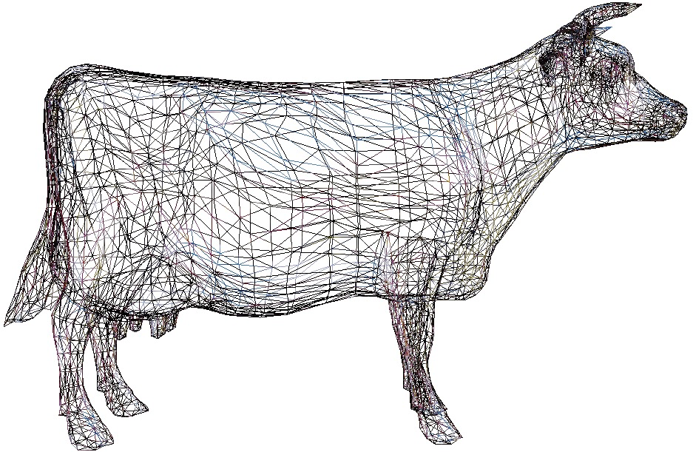
Graphics Rendering
Just model the surfaces
  (that’s all you can see)
Approximate them with a mesh of triangles
Get really good at rendering triangles

Slide 32
Graphics Pipeline
Transform: find where each vertex goes on the screen
Transform
Rasterize
Shade
Visibility/Blend
Display

Slide 33
Graphics Pipeline
Rasterize: find which pixels are inside the triangle
Transform
Rasterize
Shade
Visibility/Blend
Display

Slide 34
Graphics Pipeline
Shade: compute the color for each pixel
Transform
Rasterize
Shade
Visibility/Blend
Display

Slide 35
Graphics Pipeline
Visibility: throw out pixels covered by opaque stuff that’s already rendered
Blend: Combine colors for partially transparent objects
Both read existing pixel data, modify it, then write the changed data.
Transform
Rasterize
Shade
Visibility/Blend
Display

Slide 36
Graphics Pipeline
Display: Show results to user
Transform
Rasterize
Shade
Visibility/Blend
Display

Slide 37
Graphics Pipeline
vertex
Transform
Rasterize
Shade
Visibility/Blend
Display
triangle
pixel
frame

Slide 38
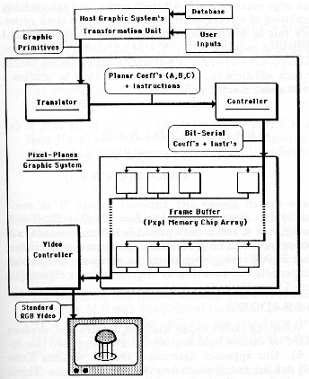
UNC Pixel-Planes 4 (1985)
DSP vertex processor
Custom rasterizer
512x512 SIMD array
  Full screen
Fuchs et al., ”Fast spheres, shadows, textures, transparencies, and image enhancements in pixel-planes", SIGGRAPH 1985

Slide 39
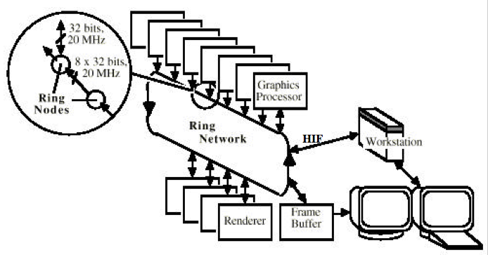
UNC Pixel-Planes 5 (1989)
~40 i860 CPUs for vertex processing
~20 128x128 SIMD arrays for pixel processing
Fuchs et al., ”Pixel-Planes 5: a heterogeneous multiprocessor graphics system using processor enhanced memory", SIGGRAPH 1989

Slide 40
SGI Reality Engine (1993)
Vertices
Triangles
Pixels
Akeley, ”Reality Engine Graphics", SIGGRAPH 1993

Slide 41
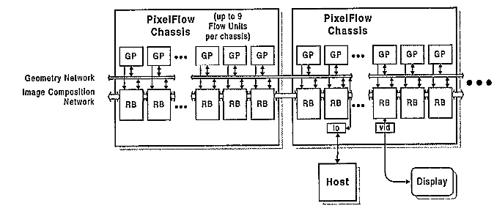
Pixel-Flow (1992-1997)
~35 nodes, each with
  2 HP-PA 8000 CPUs
  128x64 SIMD array (~160 tiles/screen)
Eyles, et al., "PixelFlow: The Realization", Graphics Hardware 1997

Slide 42
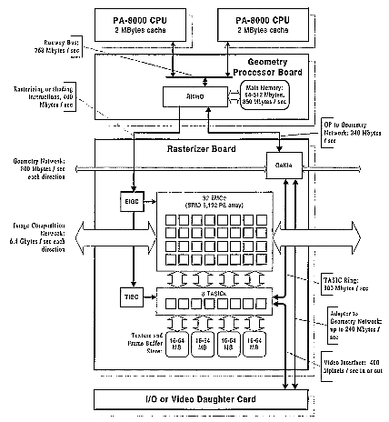
Pixel-Flow
Eyles, et al., "PixelFlow: The Realization", Graphics Hardware 1997

Slide 43
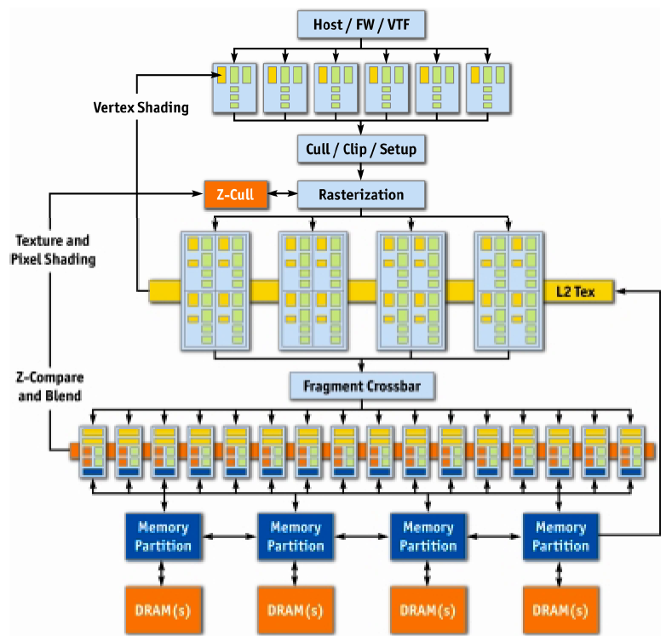
NVIDIA GeForce 6 (2004)
Kilgariff and Fernando, ”The GeForce 6 GPU Architecture", GPU Gems 2, 2005

Slide 44
GeForce 6 Parallelism
Data Parallel
More Parallel
Vertex
…
Triangle
Pixel
Pipeline
More Parallel
More Pipeline

Slide 45
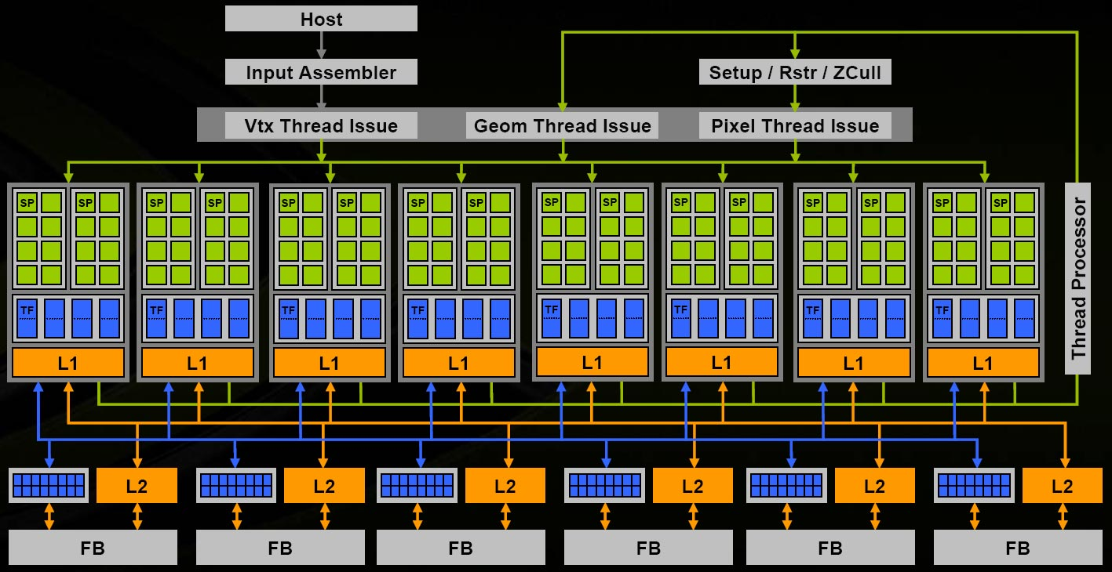
NVIDIA G80/Tesla (2006)
NVIDIA, “NVIDIA GeForce 8800 GPU Architecture Overview”, TB-02787-001_v01, November 2006

Slide 46
NVIDIA Volta (2017)
NVIDIA, NVIDIA Tesla V100 GPU Architecture, 2017

Slide 47
Volta Streaming
Multiprocessor (SM)
4 SIMD blocks
Share L1 Caches
Share memory
Share graphics HW
NVIDIA, NVIDIA Tesla V100 GPU Architecture, 2017

Slide 48
Warps & Threads
2048 Threads / SM
Warp (Nvidia)
= Wavefront (AMD)
  Threads run together
  64 / SM
Interleaved Warps
  Hide memory latency
  Up to 32
NVIDIA, NVIDIA Tesla V100 GPU Architecture, 2017

Slide 49
Volta SIMD Processing Block
Flexible Registers
  Trade registers for
  warps
16 Integer ALUs
16 float ALUs
8 double ALUs
8 Load/Store
32 FP16*FP16 + FP32
NVIDIA, NVIDIA Tesla V100 GPU Architecture, 2017

