Slide 1
Game Budgets

Slide 2
Costs
Developers
Software
Computers
Marketing
Legal

Slide 3
Rules of Thumb
~$10k per developer-month
  Includes hardware, licenses, overhead, …
~$1M per AAA developer per game
www.altdevblogaday.com/2011/11/13/10000-is-the-magic-number

Slide 4
AAA
Limited data available
  Game press
  Post-mortems
Team size ~50-150 (growing)
Time ~3-5 years
Game cost ~$60 (publisher gets back ~$30)
= 2-5M copies to break even

Slide 5
Social
Team size ~12
Time ~2 months
  + continuous updates after launch ($12-40k/month)
Development ~$100-300k
  Marketing 50-100% of development cost
    Viral only works if you’re already successful
Free, with in-game “monetization”
  Ads
  Buy out of playing time / failure
  Unique items for purchase
www.slideshare.net/Bitfold/social-facebook-game-space-at-a-glance
socialtimes.com

Slide 6
Social Users
appdata.com
  Daily Active Users (DAU)
  Monthly Active Users (MAU)
  Engagement (~MAU/DAU)
Average Return Per User (ARPU)
  Percentage Paying Users * Return per Paying User
Lifetime Value (total $ per user)
Customer Acquisition Cost (CAC)

Slide 7
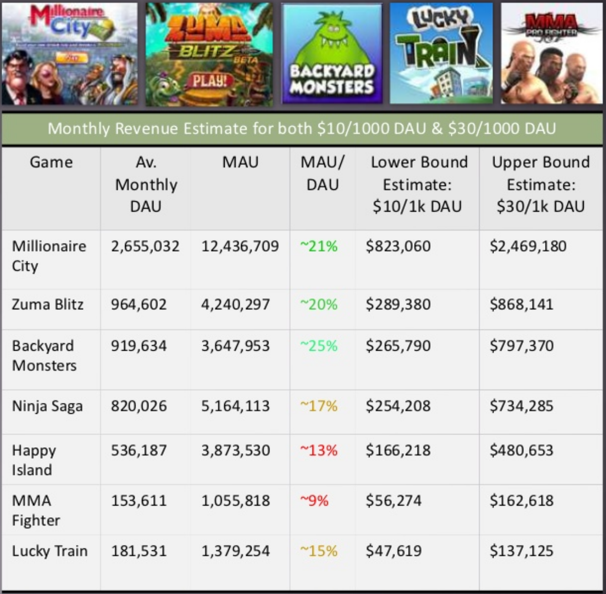
Social
www.slideshare.net/Bitfold/social-facebook-game-space-at-a-glance

Slide 8
Social Metrics
Log & Measure your game
What sells, when do players buy?
Test on subset of users

Slide 9
Indie
Varies a TON
  Team size
  Kind of game
  Platform
Lots of public info
  Developer blogs mostly
  Indies give back to the community

Slide 10
Sample Budget (people)
ITEM |  | COST | TOTAL
PROGRAMMING |  |  | 0
Lead Programmer |  | 7000 x 24 | 168000
Assistant Programmer |  | 3000 x 24 | 96000
Program Testing |  | 12000 | 12000
ART AND GAME DESIGN
Producer |  | 10000 x 24 | 240000
Deisgner |  | 3000 x 24 | 96000
3D Artist |  | 3500 x 24 | 84000
Level Designer |  | 3500 x 24 | 84000
Animator |  | 1500 x 24 | 36000
2D Artist |  | 1500 x 24 | 36000
MANAGEMENT
Business Manager |  | 5000 x 24 | 12000
Accounting |  |  | 6000
Legal |  |  | 5000
www.gamasutra.com/view/feature/3083/budgeting_and_scheduling_your_game.php

Slide 11
Sample Budget (stuff)
ITEM |  | COST | TOTAL
3D ENGINE LICENSE |  |  | 50000
SOUND
Sound FX |  | 10000 | 10000
Music |  | 5000 | 5000
PCs
6 PC Workstations |  | 4000 x 6 | 24000
SOFTWARE
3D Studio Max | 3000 x 3 | 9000 | 9000
Photoshop | 500 x 3 | 1500 | 1500
OFFICE EXPENSES
Office Equipment |  |  | 24000
Rent |  | 1300 x 24 | 31200
TOTAL |  | $1,137,700
www.gamasutra.com/view/feature/3083/budgeting_and_scheduling_your_game.php

Slide 12
Mobile games
Averages are depressing
  Cost $35k
  Sales 11k
    @ 99¢ = 70¢ per copy
  Return ~$7.5k
altdevblogaday.com/2011/04/24/indie-project-budgets

Slide 13
Mobile Strategies
Playing the lottery
  Lots of games
  Most at a loss
  Run with the game that hits
Not just a lottery
  Experience helps
  Marketing, press

Slide 14
Mobile Strategies
Make a splash
Angry Birds
  $140k development
  $70M return
Infinity Blade
  “millions” development
  $30M return

Slide 15
More links
bentspoongames.com/blog/?p=143
altdevblogaday.com/2011/04/24/indie-project-budgets
altdevblogaday.com/2011/04/11/indies-how-do-you-make-a-living
  Includes even more links

Slide 16
Live Sample Budget
Google spreadsheet
  Chris Olytan, ZeeGee games

