Slide 1
Modeling
CMSC 435/634

Slide 2
Modeling?
Modeling
  Create a model of an object, usually out of a collection of simpler primitives
Primitive
  A basic shape directly handled by the renderer

Slide 3
Primitives
Triangles & Polygons
  Most common, usually the only choice for interactive
Patches, Spheres, Cylinders, ...
  Often converted to simpler primitives within the renderer
Volumes
  What's at each point in space?
  Often with some transparent material
  Usually a different rendering algorithm from surfaces

Slide 4
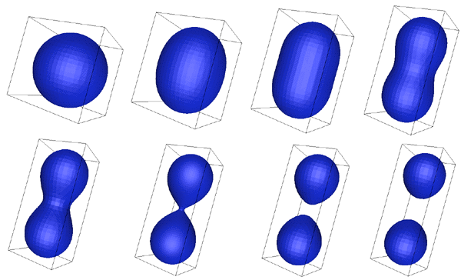
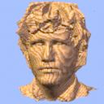



Composing Primitives
Collections of large numbers of primitives
  Sometimes called Boundary Representation (Brep)
Constructive Solid Geometry (CSG)
  Set operations (union, intersection, difference)
Implicit Models & Blobs
  Surface where f(x,y,z)=0
  Signed Distance Field where f() gives distance to surface (+ outside, – inside)
  Sum, product, min, etc. of simpler functions
Images: Friedrich Lohmueller
Images: Paul Bourke

Slide 5
Representations

Slide 6
Mesh Definitions
Vertex: all data at a point
  Position
  Normal
  Texture coordinates
  Color
  May count as new vertex if any of these differ
Edge: Line between vertices
Face: Area between a set of vertices and edges
  Assume planar
  May have fixed # vertices, may not

Slide 7
Mesh Representations
Application-friendly
  Polygon list
  (or whatever makes sense to the application)
Hardware-friendly
  Vertex list
  Vertex + Index lists
Mesh editing-friendly
  Face-Vertex
  Winged Edge
  Half Edge
Hybrid

Slide 8
Application-Friendly: Polygon List
How to make it
  Define a polygon object
  Put a bunch of them in a list
Pros
  Flexible
  Fits application needs
Cons
  Hard to figure out how polygons are connected
  Duplication of vertex data
  Inefficient to render
class Polygon {
public:
vector<Vertex> verts;
void render();
};
class PolygonList {
public:
vector<Polygon> polys;
void render();
}

Slide 9
Hardware-Friendly: Vertex Array
How to make it
  Make a list of vertices
  Every 3 form a triangle
Pros
  Relatively efficient to render
Cons
  Hard to figure out how faces are connected
  Duplication of vertex data
  Fixed number of vertices per polygon
Vertex VertexArray[] = {
{1,0,-1},{1,0,1},{.5,.8,-1},
{.5,.8,-1},{1,0,1},{.5,.8,1},
…
};

Slide 10
Hardware-Friendly: Vertex & Index Arrays
How to make it
  Make a list of vertices
  Make a list of which vertices connect into triangles
  Every 3 indices make a triangle
Pros
  Very efficient to render
  Share vertex data
  Finding vertices in a face easy
Cons
  Finding faces that use a vertex is hard
  Finding adjacent faces is hard
  Fixed number of vertices per polygon
Vertex VertexArray[] = {
{1,0,-1}, // vertex 0
{1,0,1}, // vertex 1
{.5,.8,-1}, // vertex 2
{.5,.8,1}, // vertex 3
…
};
int IndexArray[] = {
0,1,2,
2,1,3,
…
};

Slide 11
Mesh-Editing: Face-Vertex
How to make it
  Vertex: position, list of faces
  Face: list of vertices
Pros
  Finding vertices in a face easy
  Finding faces that use a vertex is easy
Cons
  Finding adjacent faces is hard
  Less efficient for rendering
class Vertex {
Vec3 Position;
vector<Face*> Faces;
};
class Face {
vector<Vertex*> Vertices;
};

Slide 12
Mesh-Editing: Half Edge
How to make it
  Half-Edge (primary structure)
    One vertex, one face
    Pointer to pair edge
    Next edge around face
  Face: pointer to (any) half-edge
  Vertex: pointer to (any) half-edge
Pros
  Easy to find adjacent faces, edges & vertices
Cons
  Lots of bookkeeping to update
  Less efficient for rendering

Slide 13
Half Edge Examples
Adjacent face
  face->edge->pair->face
Vertices around a face:
  face->edge->vert
  face->edge->next->vert
  face->edge->next->next->vert
  …
Faces around a vertex
  vert->edge->face
  vert->edge->next->pair->face
  vert->edge->next->pair->next->face
  …

Slide 14
Hybrid
Maintain multiple representations
  Separate vertex location from pointers
  Update face during edits
Delayed updates
  Do mesh updates, then rebuild index/vertex list
  Do other partial updates, then rebuild
  Traverse and build

Slide 15
Modeling Approaches

Slide 16
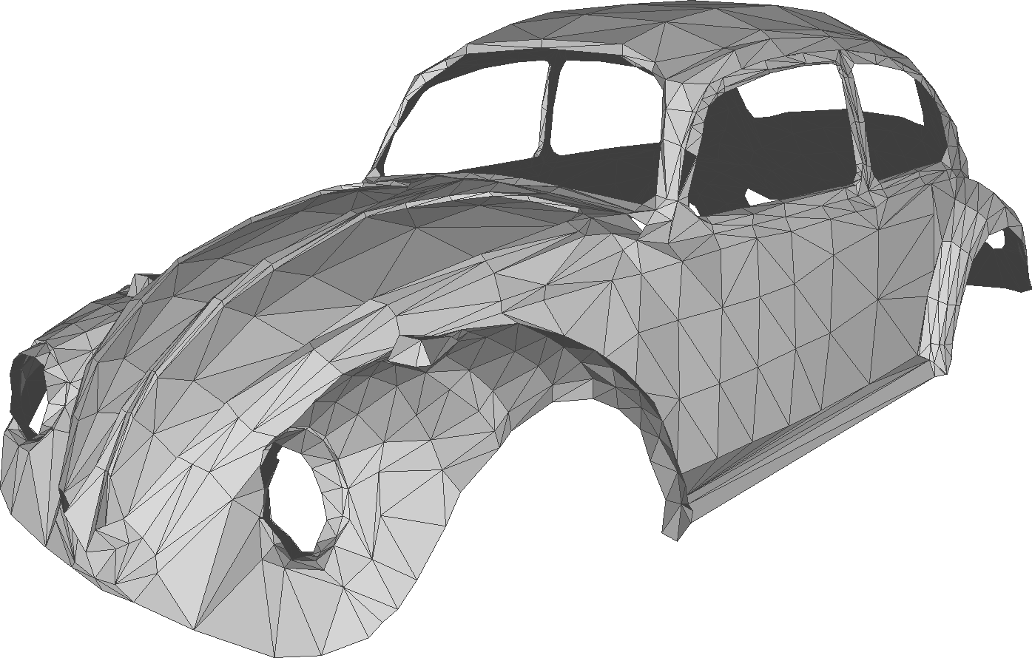
Manual
Text editor
  Only very simple primitives and scenes
High-level primitives
  Still need to combine several somehow
Modeling programs
  Maya, 3D Studio, Houdini, Autocad, Blender, ...

Slide 17
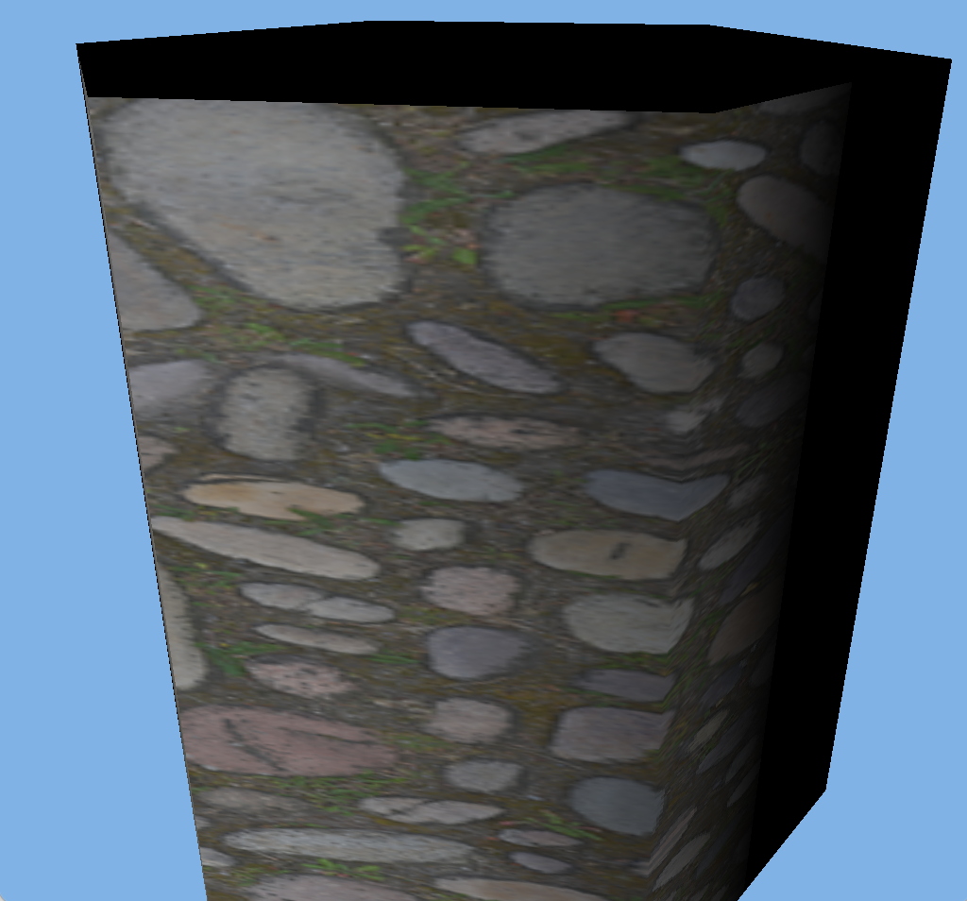
Manual
# hexagonal cylinder
v 1 0 -1
v 1 0 1
v .5 0.866025403784 -1
…
vt 0 0
vt 0 1
vt 0.166666666667 0
…
vn 1 0 0
vn .5 0.866025403784 0
vn -.5 0.866025403784 0
…
f 1/1/1 2/2/1 3/3/2
f 3/3/2 2/2/1 4/4/2
…
f 1/13/1 12/12/6 2/14/1

Slide 18
Procedural Modeling
Describe physical attributes through code
  Shape
    Output primitives
  Density
    Voxels
    Couple with a conversion or rendering algorithm
  Color, Texture
    Enhance an existing shape

Slide 19
Fractals
Complex structure through self-similarity across scales
Recursive structure
Small features look similar to larger features

Slide 20
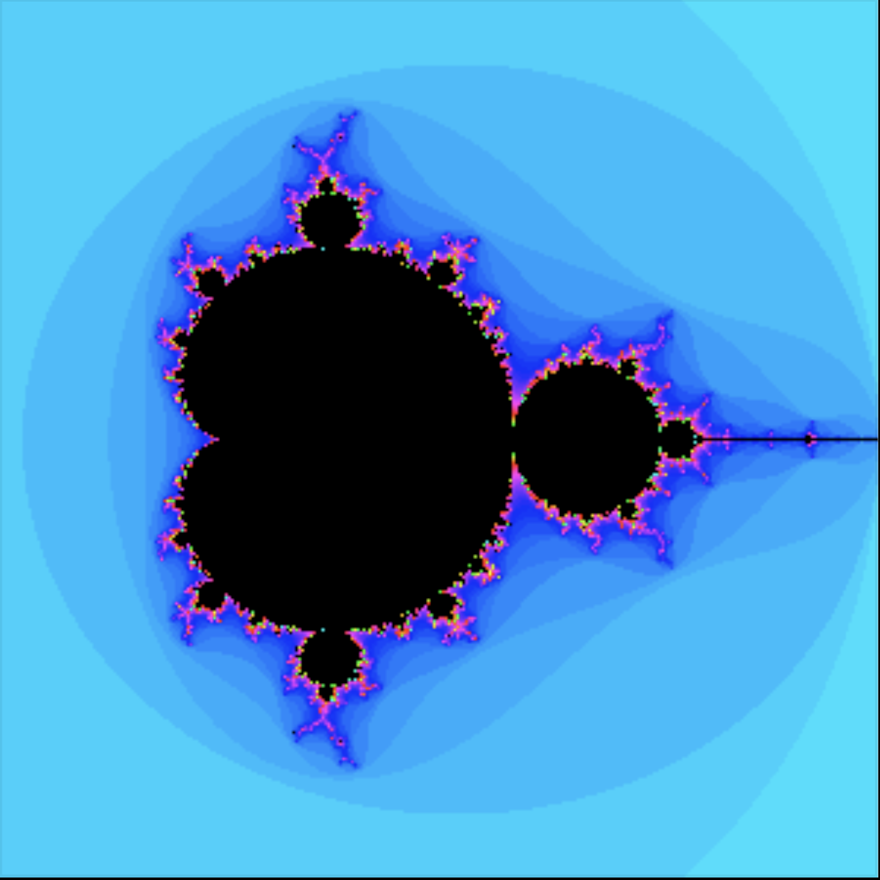
Iterated Equations / Mandelbrot Set
Image: David E. Joyce

Slide 21
Iterated Replacement / Koch Curve

Slide 22
Iterated Replacement / Mountains
Randomness in replacement rule

Slide 23
L-System Modeling
Named after original developer: biologist Aristid Lindenmayer
Use context-free grammars (CFG) to specify structural change over generations
Often used to simulate a biological growth process
  Plants
  Seashells
  ...
Variations for other applications
  Cities
  Building architecture
  Cloth weaving
  ...

Slide 24
Context-Free Grammar
A CFG is defined by G = (V, T, S, P) where
  V is a set of non-terminals (change each iteration)
  T is a set of terminals (fixed each iteration)
  S is a start symbol or string from (V ∪ T) *
  P is a set of productions (rules) of the form
    A→x, where A ∈ V and x ∈ (V ∪ T)*
L-System attaches a geometric meaning to each symbol

Slide 25
L-System Example
Non-terminals
  A,B, straight line segments
Terminals
  [ ], branch left 45°
  ( ), branch right 45°
Rules
  A → AA
  B → A[B]AA(B)
Start: B
B
A[B]AA(B)
AA[A[B]AA(B)]
AAAA(A[B]AA(B))

Slide 26
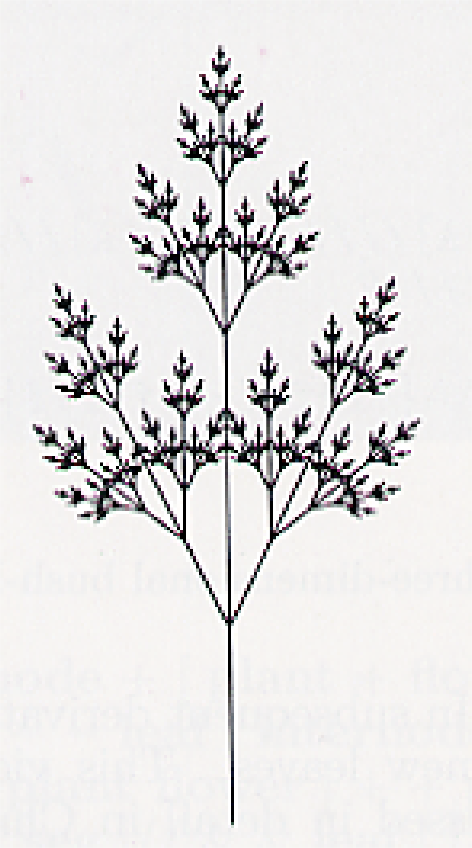
L-System Example
Symbols
  [/] = push/pop
  +/− = rotate left/right 25.7°
  A − Z = straight segment
Rules
  X → F[+X][−X]FX
  F → FF
7 generations

Slide 27
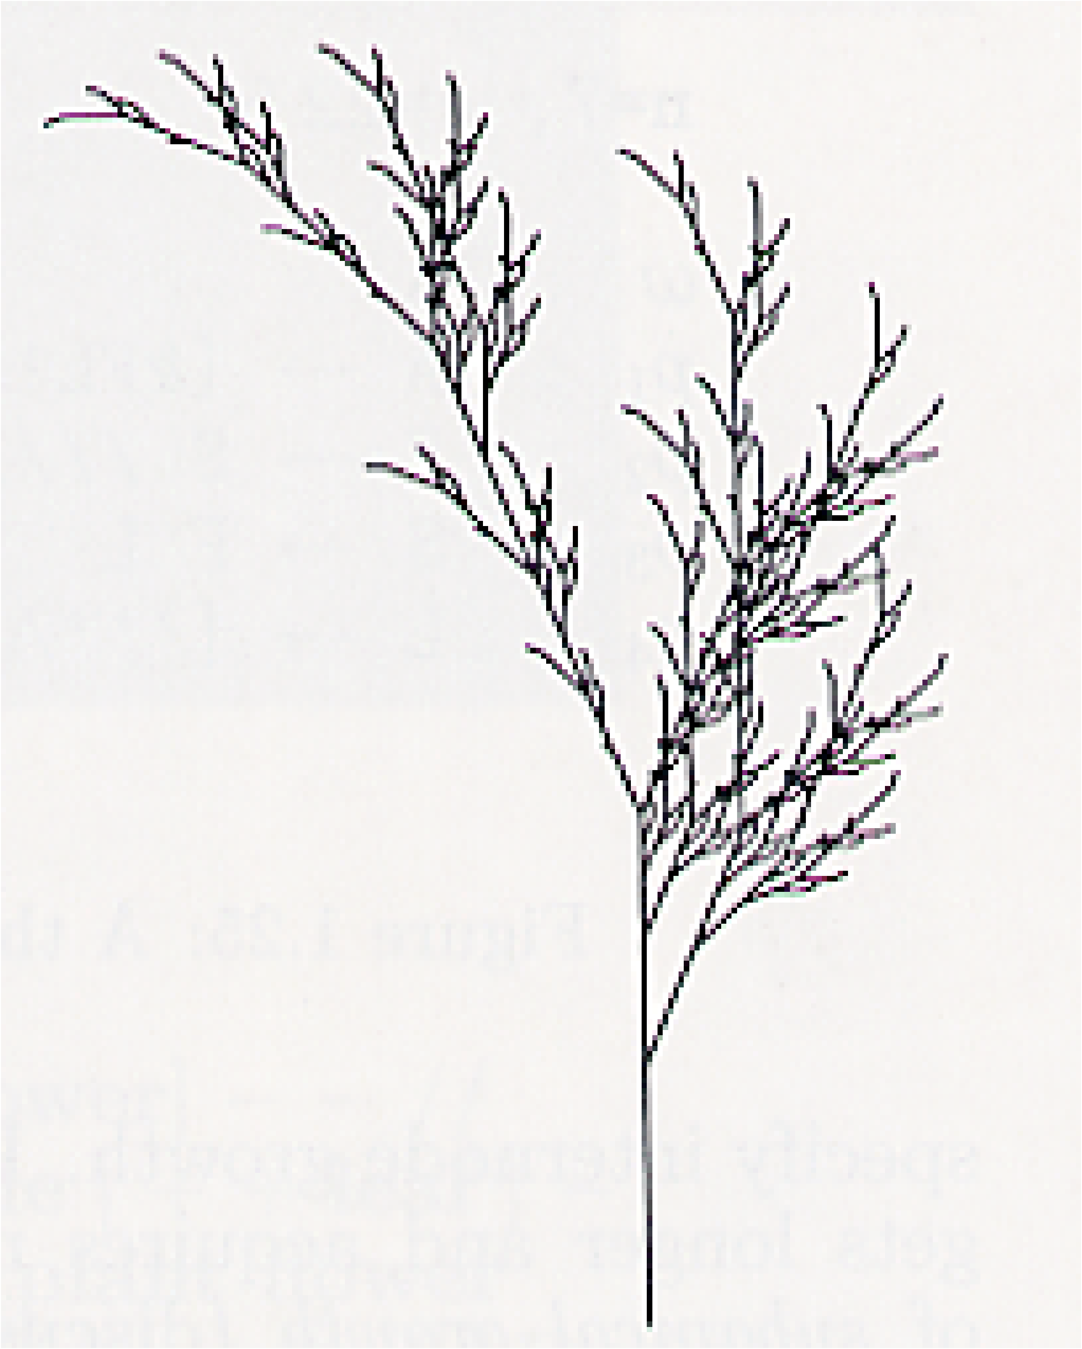
L-System Example
Symbols
  [/] = push/pop
  +/− = rotate left/right 22.5°
  A − Z = straight segment
Rules
  X →F −[[X]+X]+F[+FX]−X
  F → FF
5 generations

Slide 28
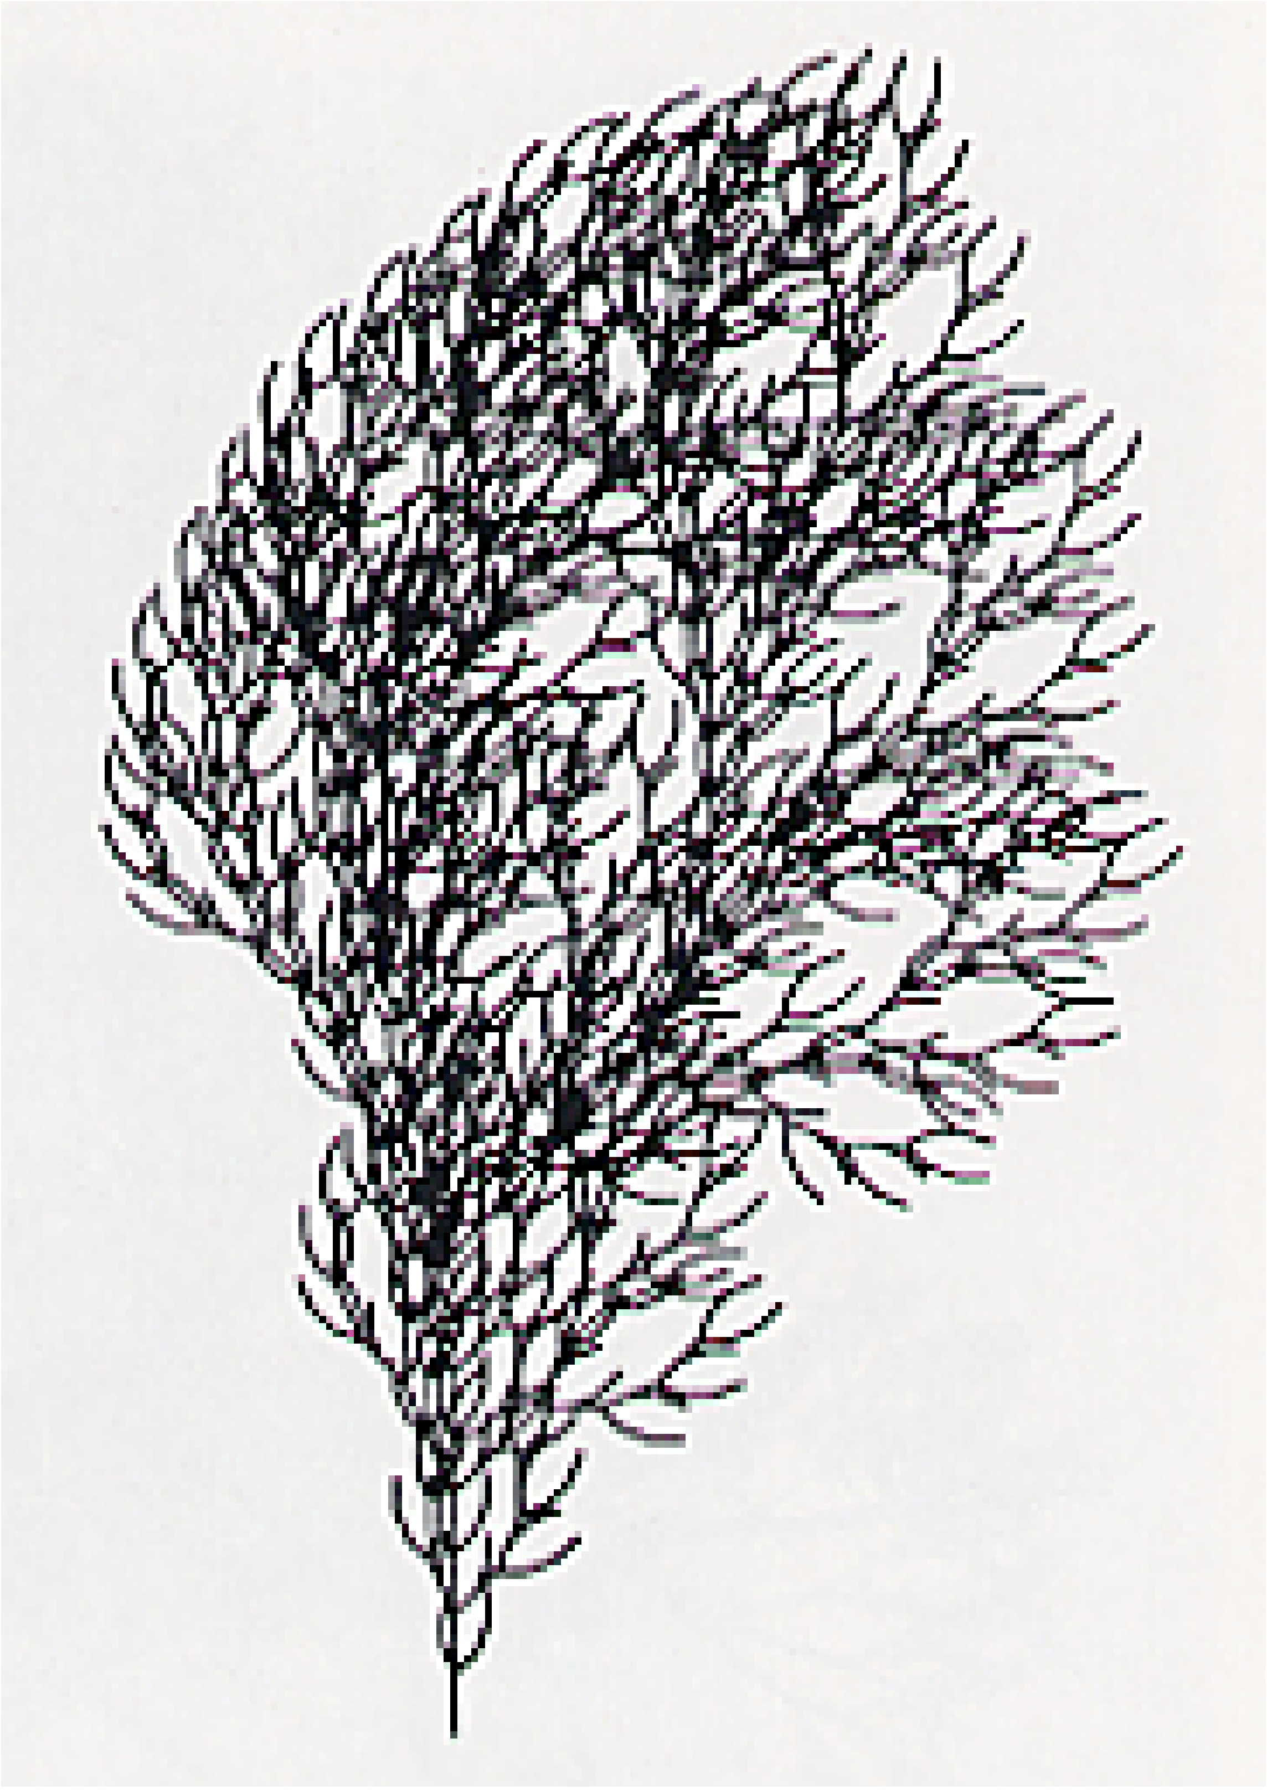
L-System Example
Symbols
  [/] = push/pop
  +/− = rotate left/right 22.5°
  A − Z = straight segment
Rules
  F →FF−[F+F+F]+[+F−F−F]
4 generations

Slide 29
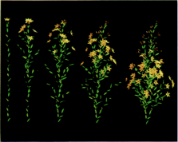
Additions
3D structure
Randomness
  Multiple rules w/ probabilities
Different shapes
  Leaves, flowers
Prusinkiewicz, et al., SIGGRAPH 88

Slide 30
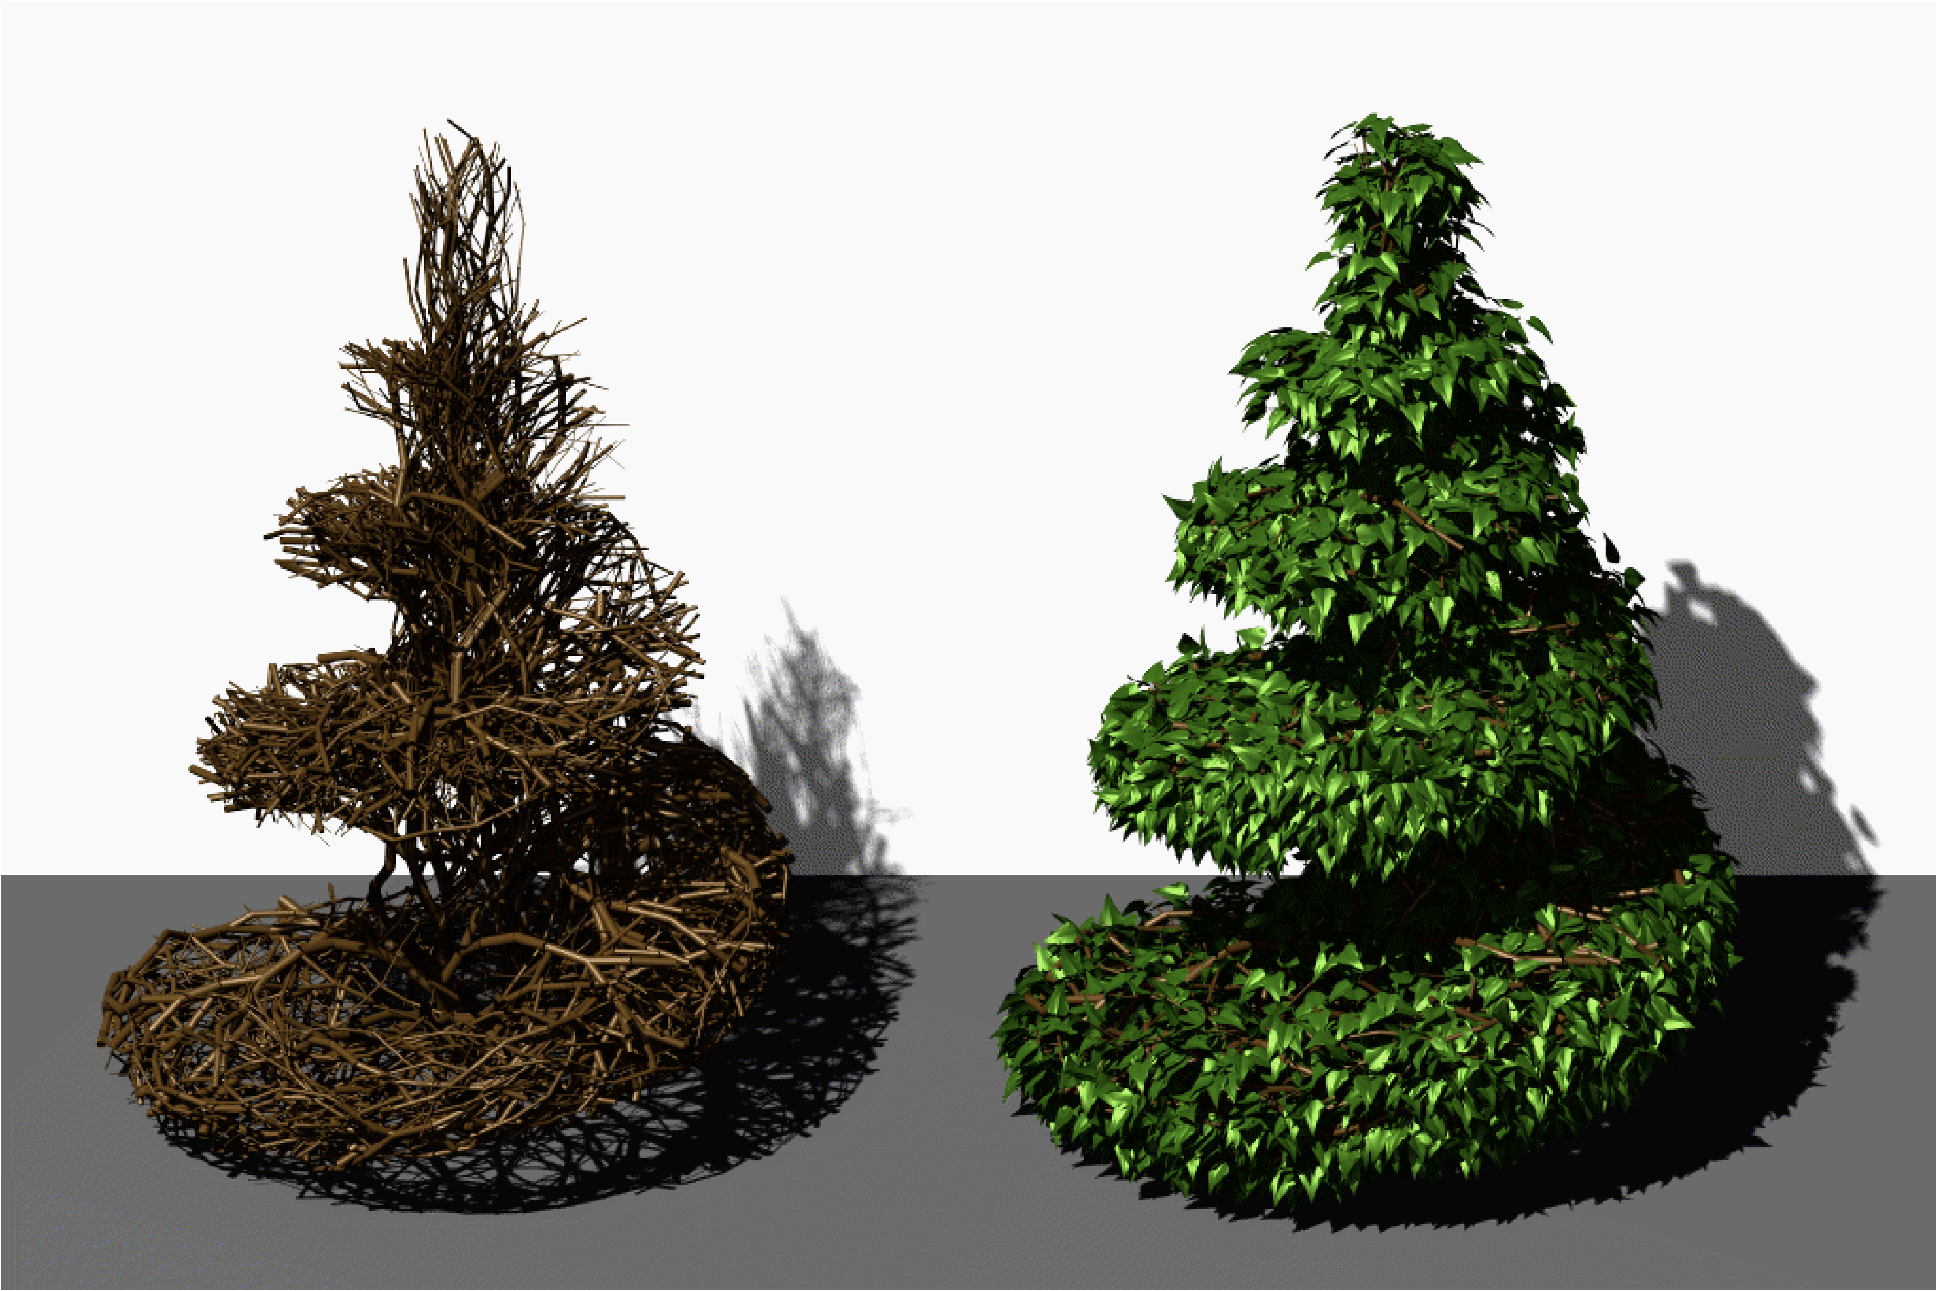
Pruning
Remove portions outside guiding shape
Prusinkiewicz, et al., SIGGRAPH 94

Slide 31
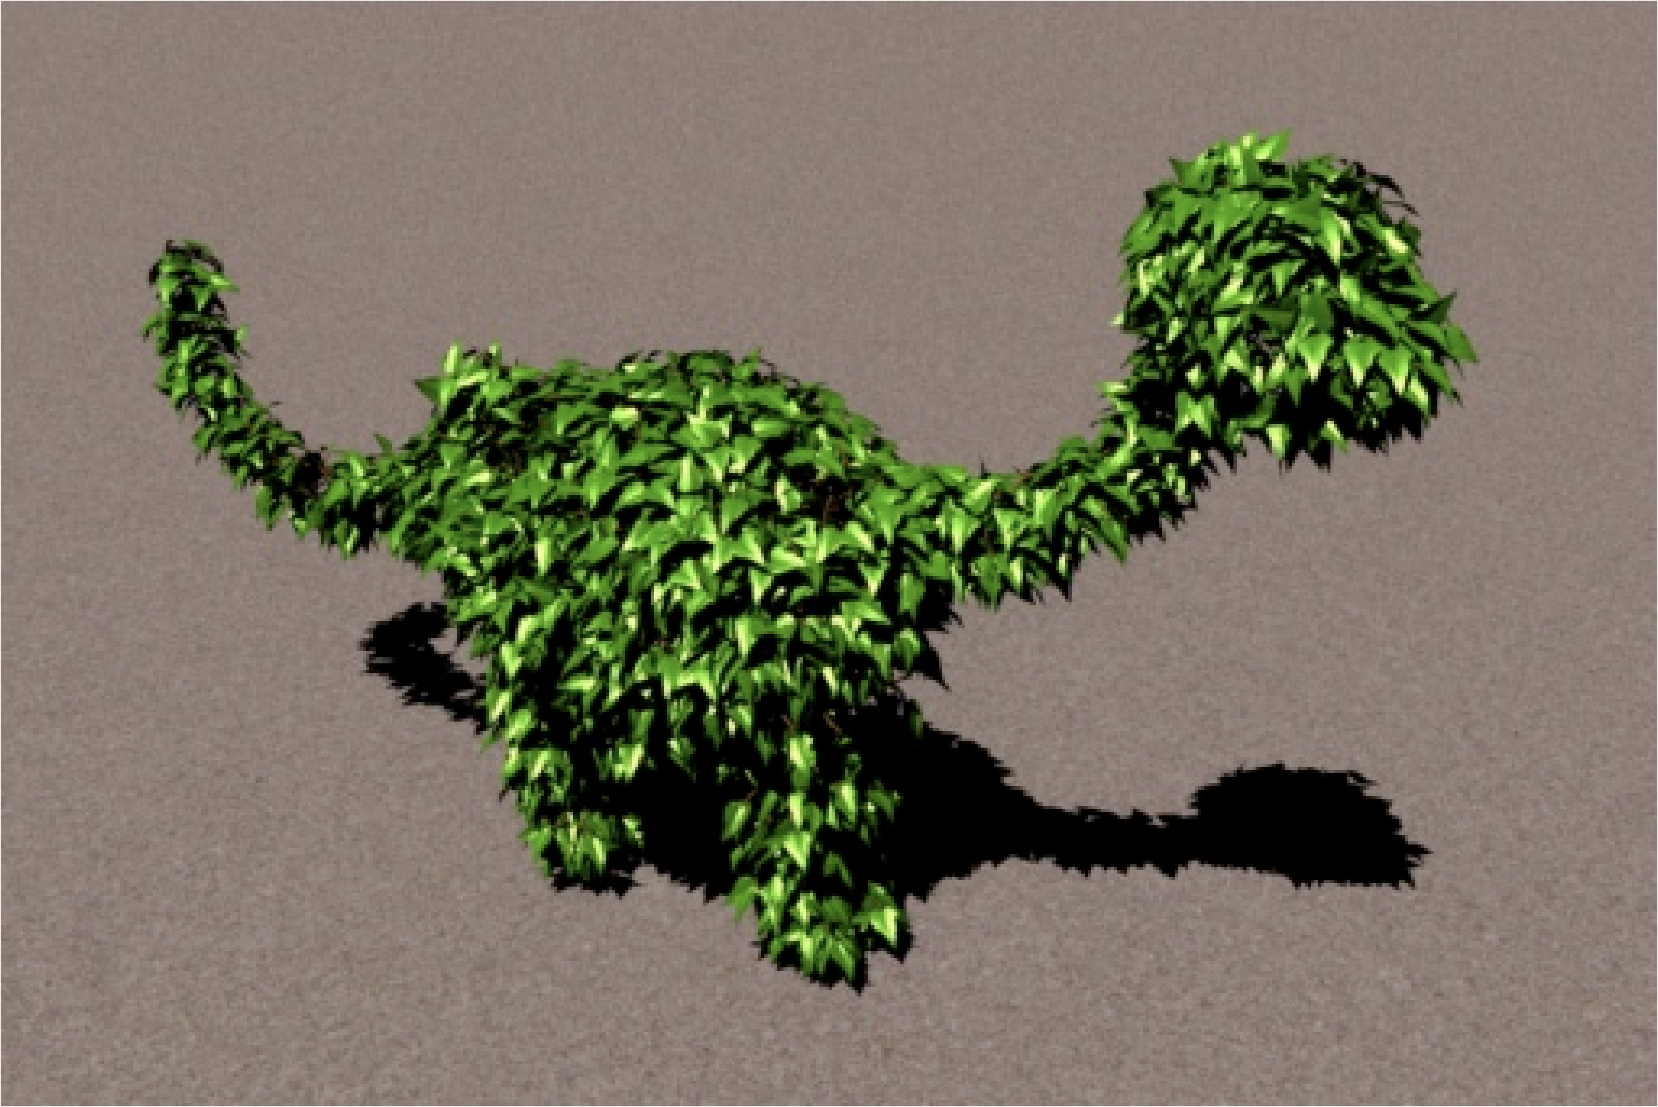
Pruning
Prusinkiewicz, et al., SIGGRAPH 94

Slide 32
Spectral Synthesis
Alternative to explicitly defining structure
  Define statistical properties
Energy a function of frequency
  Higher frequency, less energy
  Characterizes roughness of surface
  Natural phenomena tend to be 1/f

Slide 33
Noise-Based Synthesis
Band-limited Perlin noise function
  Most energy between 1/2 and 1 cycle per unit
  Average value is 0
  Random, but repeatable
  1D, 2D, 3D & 4D versions common

Slide 34
Fractional Brownian Motion (fBm)
Sum noise octaves
  n(x) + n(2 x)/2 + n(4 x)/4 + …
Stop adding when frequency too high to see

Slide 35
Fractional Brownian Motion
+
=

Slide 36
Fractional Brownian Motion
+
=

Slide 37
Fractional Brownian Motion
+
=

Slide 38
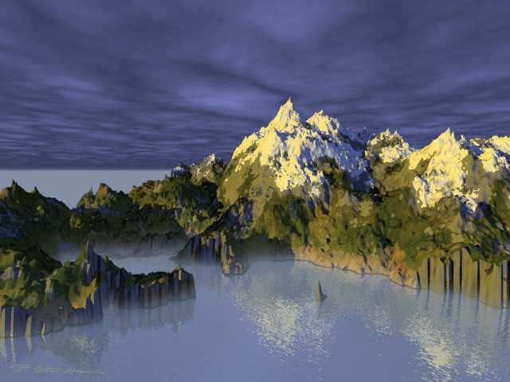
Noise-Based Landscape
Landscape height is an fBm function of x,y
  Color from elevation a few octaves before end
Image: Ken Musgrave

Slide 39
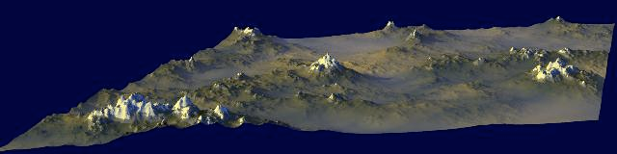
Multifractal
Change roughness across fractal
  Scaling (¹/₂, ¹/₄, ¹/₈, …) becomes a function
Here, scale is a function of altitude
Image: Ken Musgrave

Slide 40
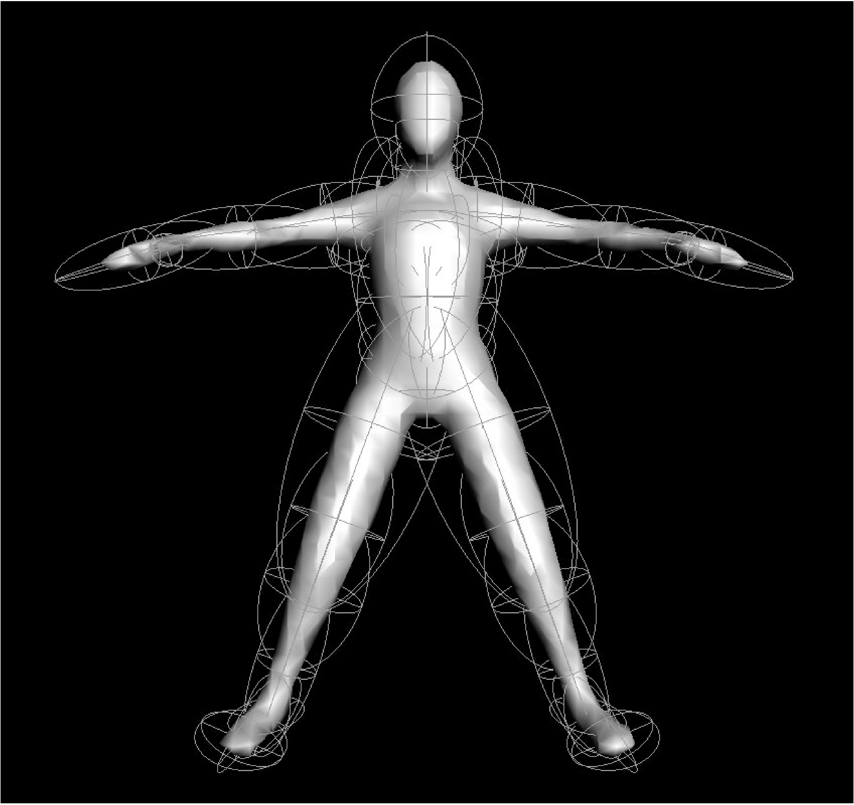
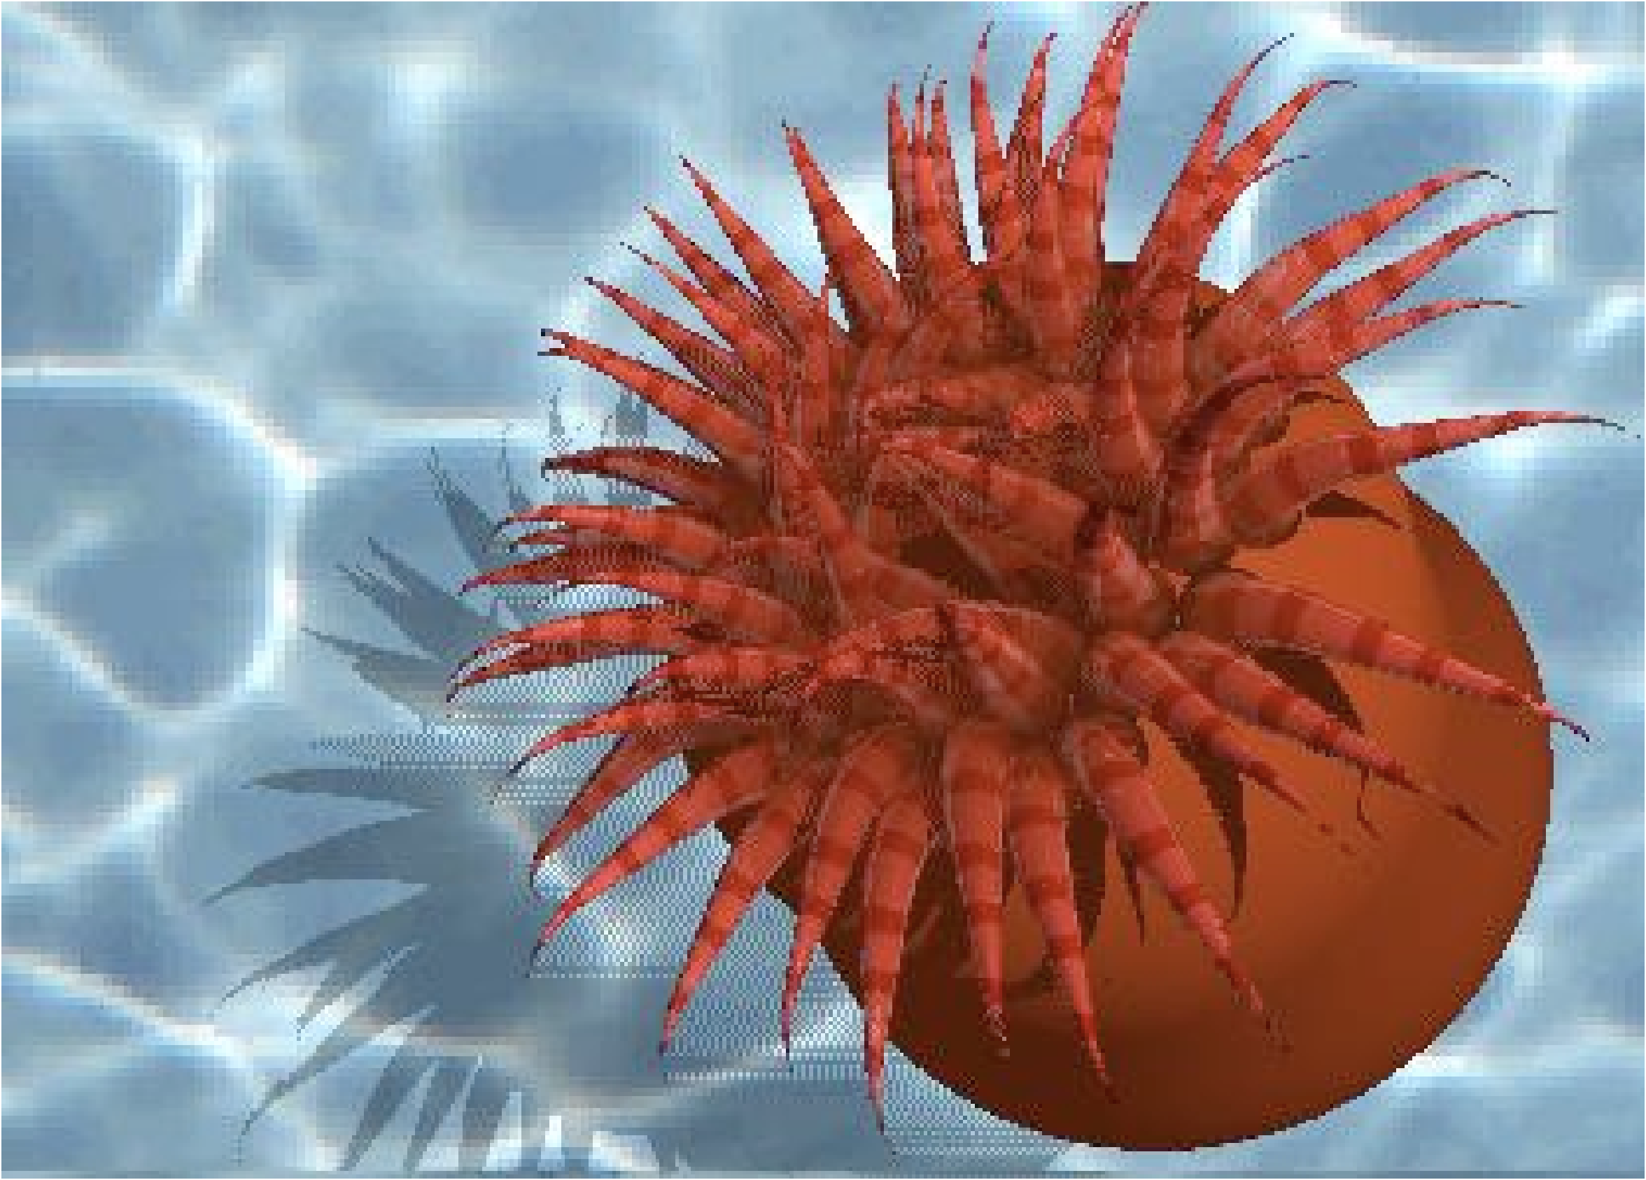
Implicit Functions or Blobby Modeling
Model as a combination of implicit functions
Surface at threshold
Liang, et al., PG'01

Slide 41
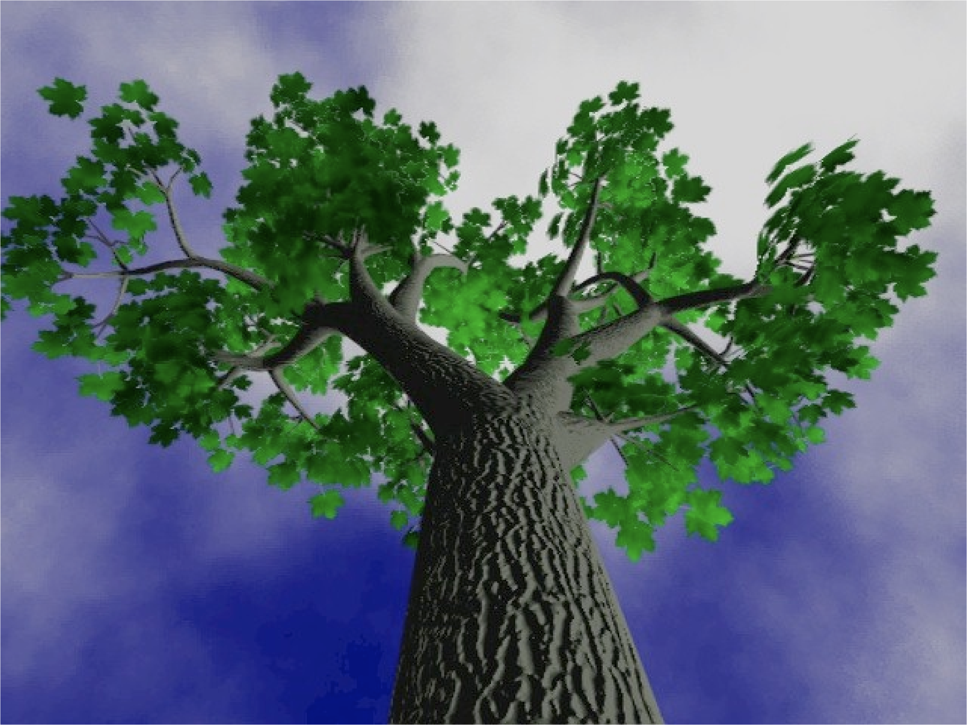
Hybrid Implicit and Polygonal
Bloomenthal, SIGGRAPH 85

Slide 42
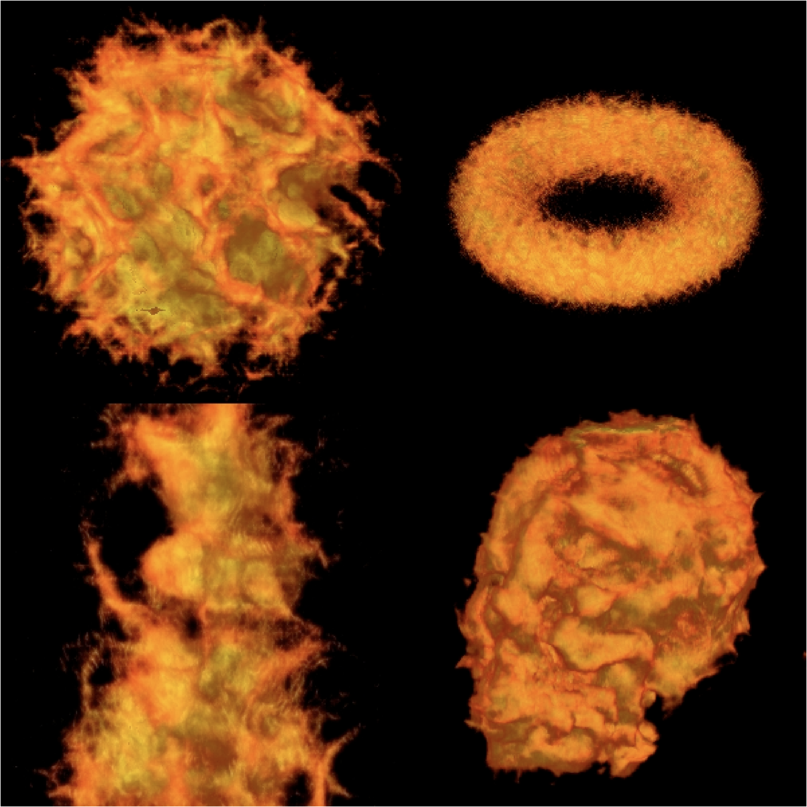
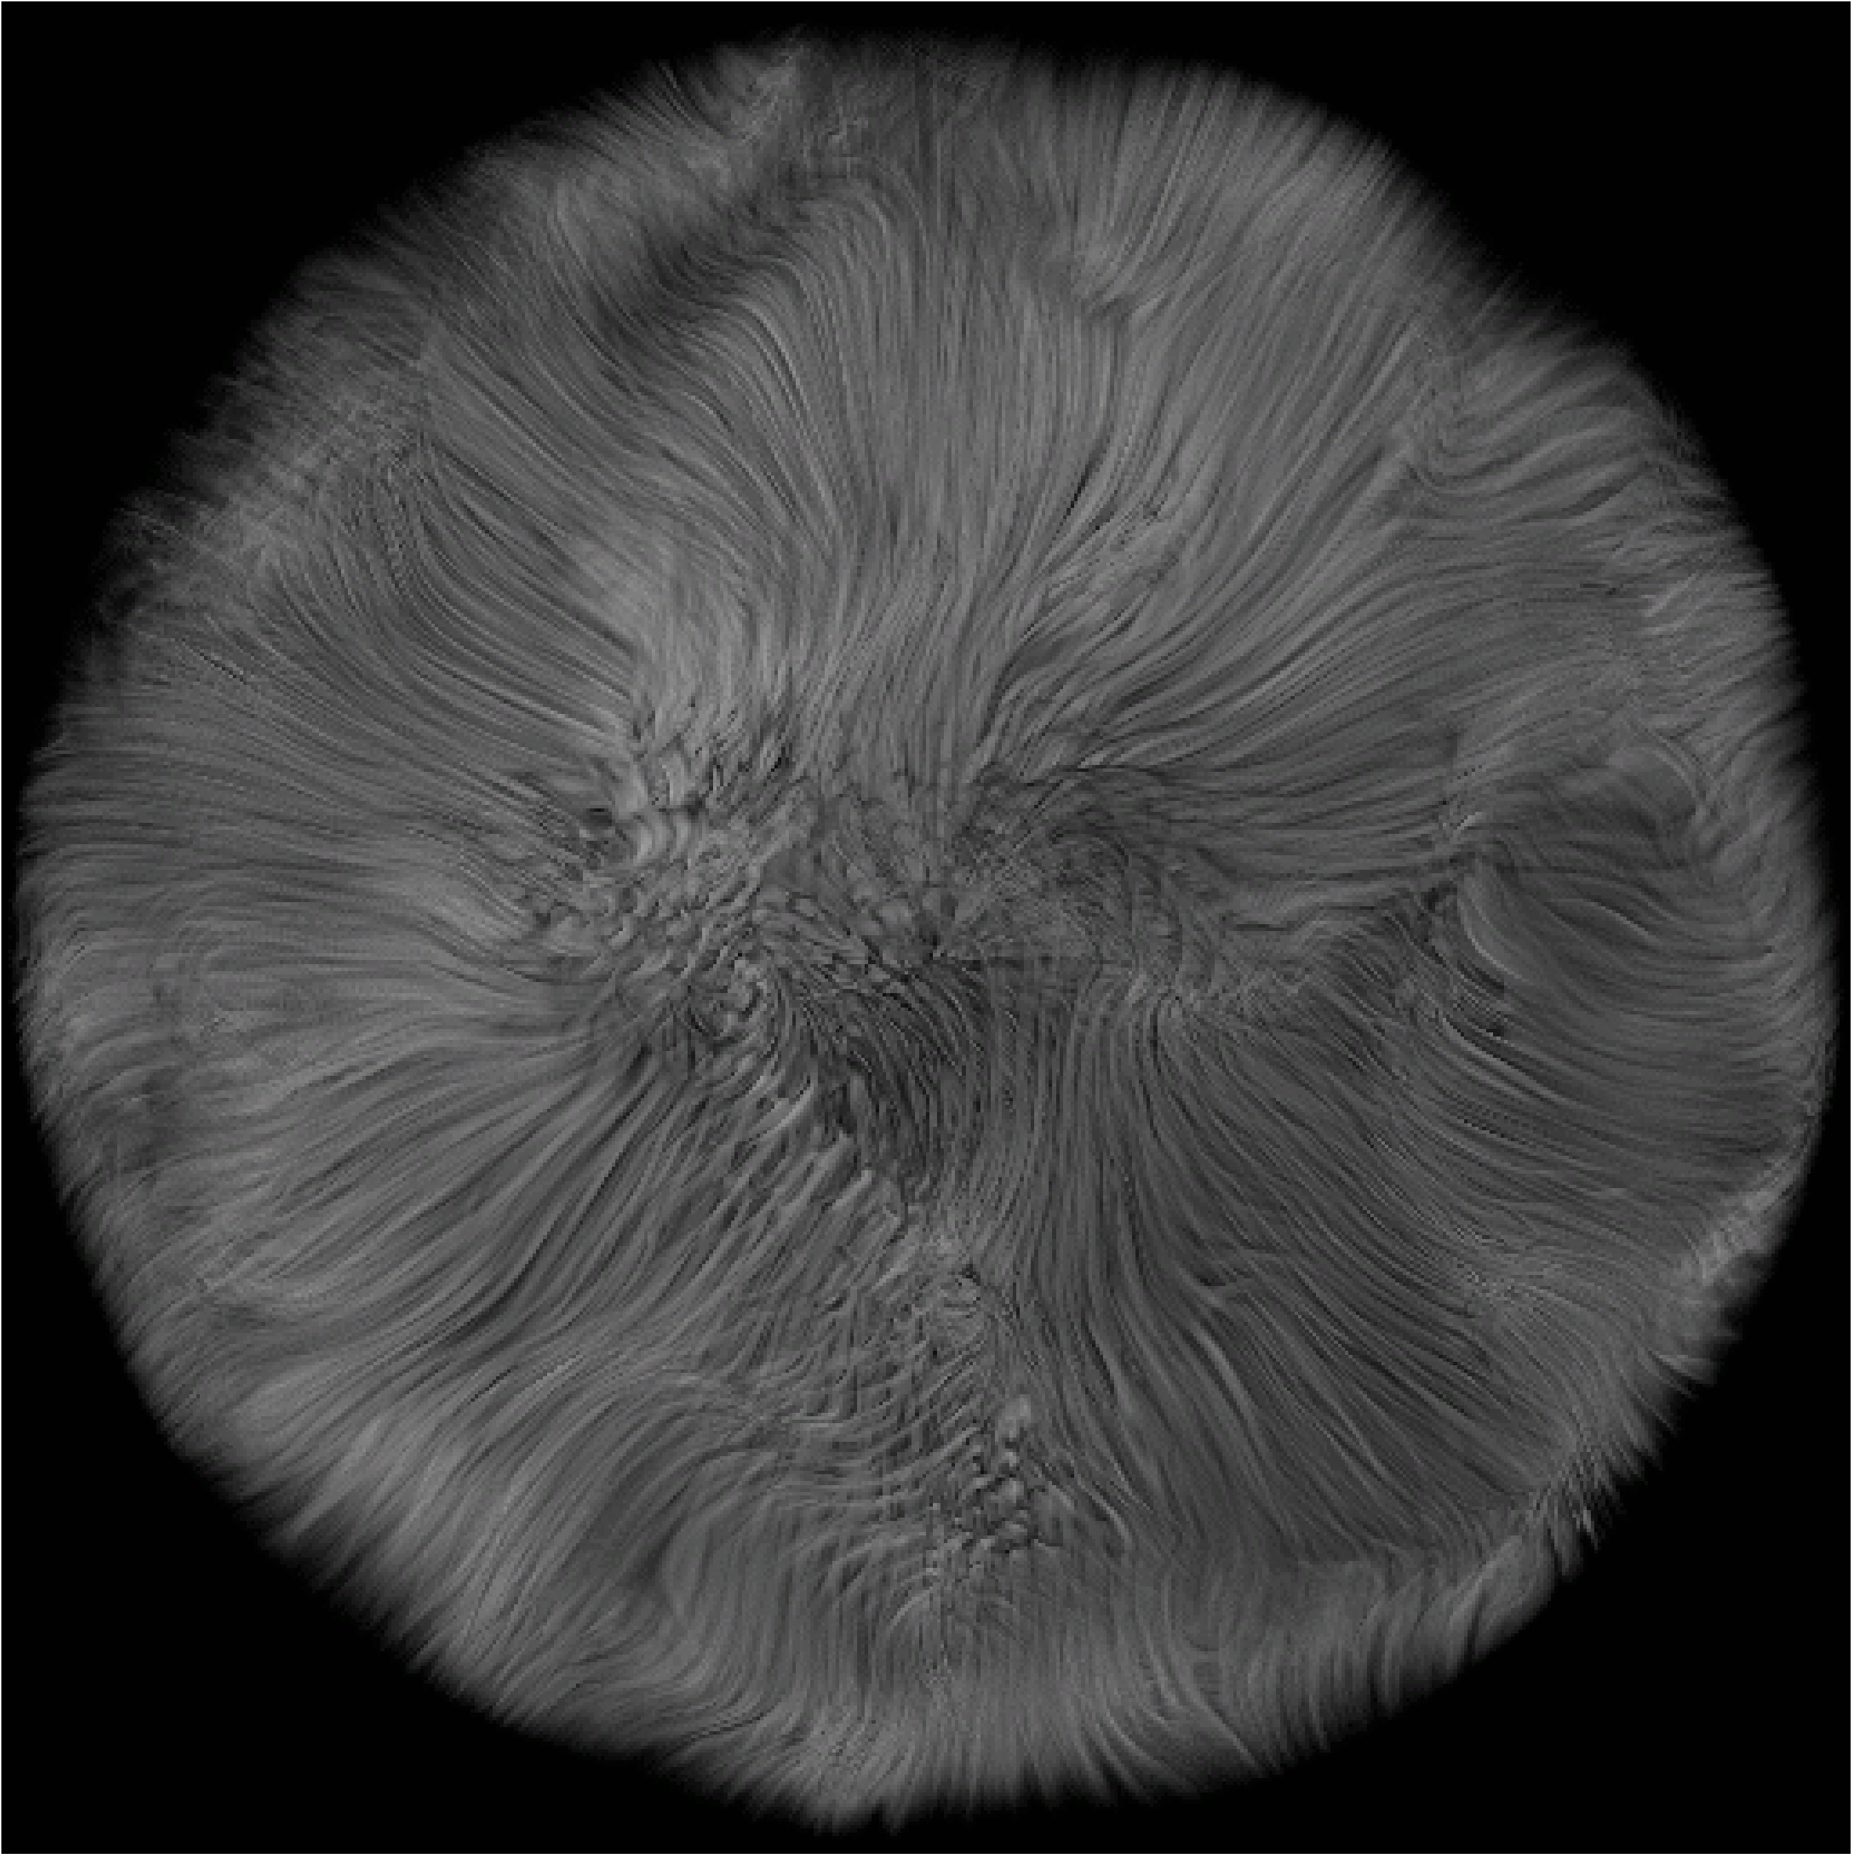
Hypertexture
Add noise to implicit functions
Perlin & Hoffert, SIGGRAPH 89

Slide 43
Simulations
Biological
  Simulate growth, development
Physical
  Simulate formation or erosion
Compare to L-system or noise, where goal is just to “look right”

Slide 44
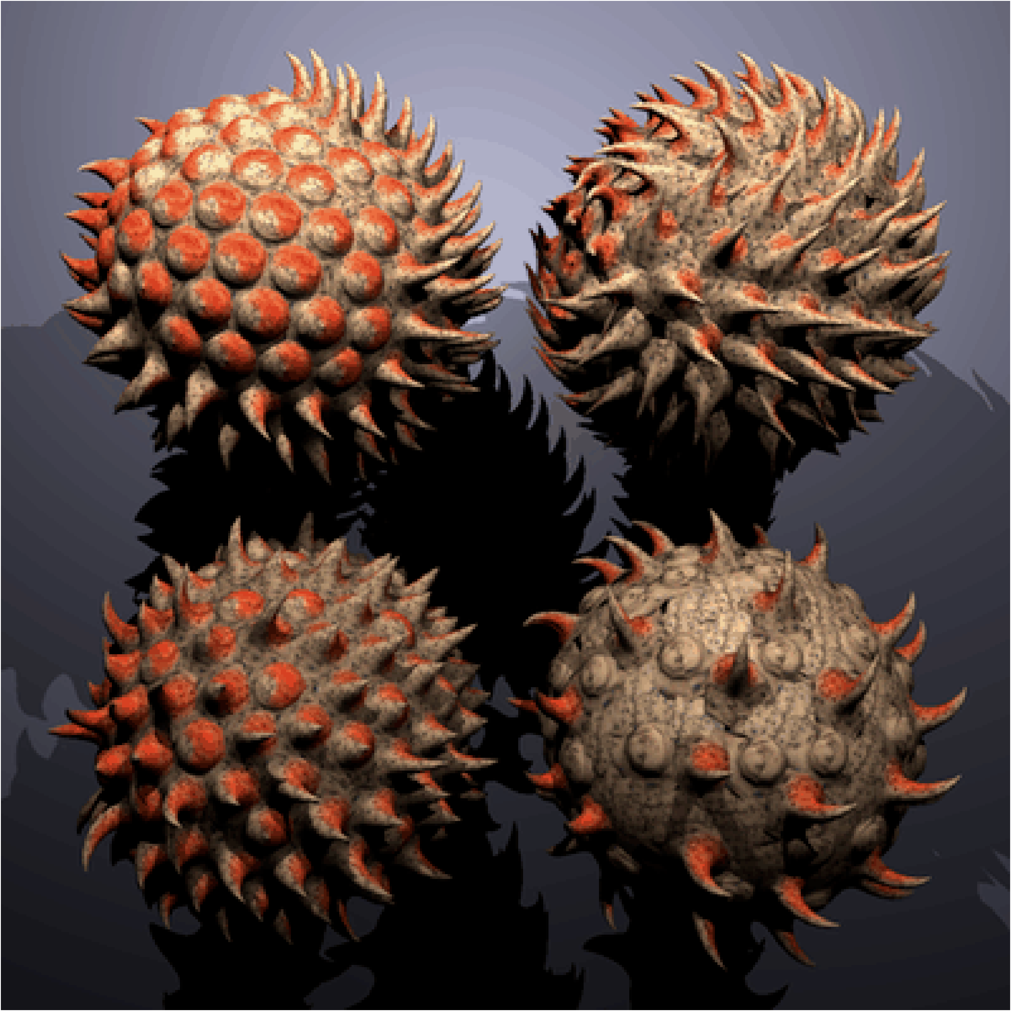
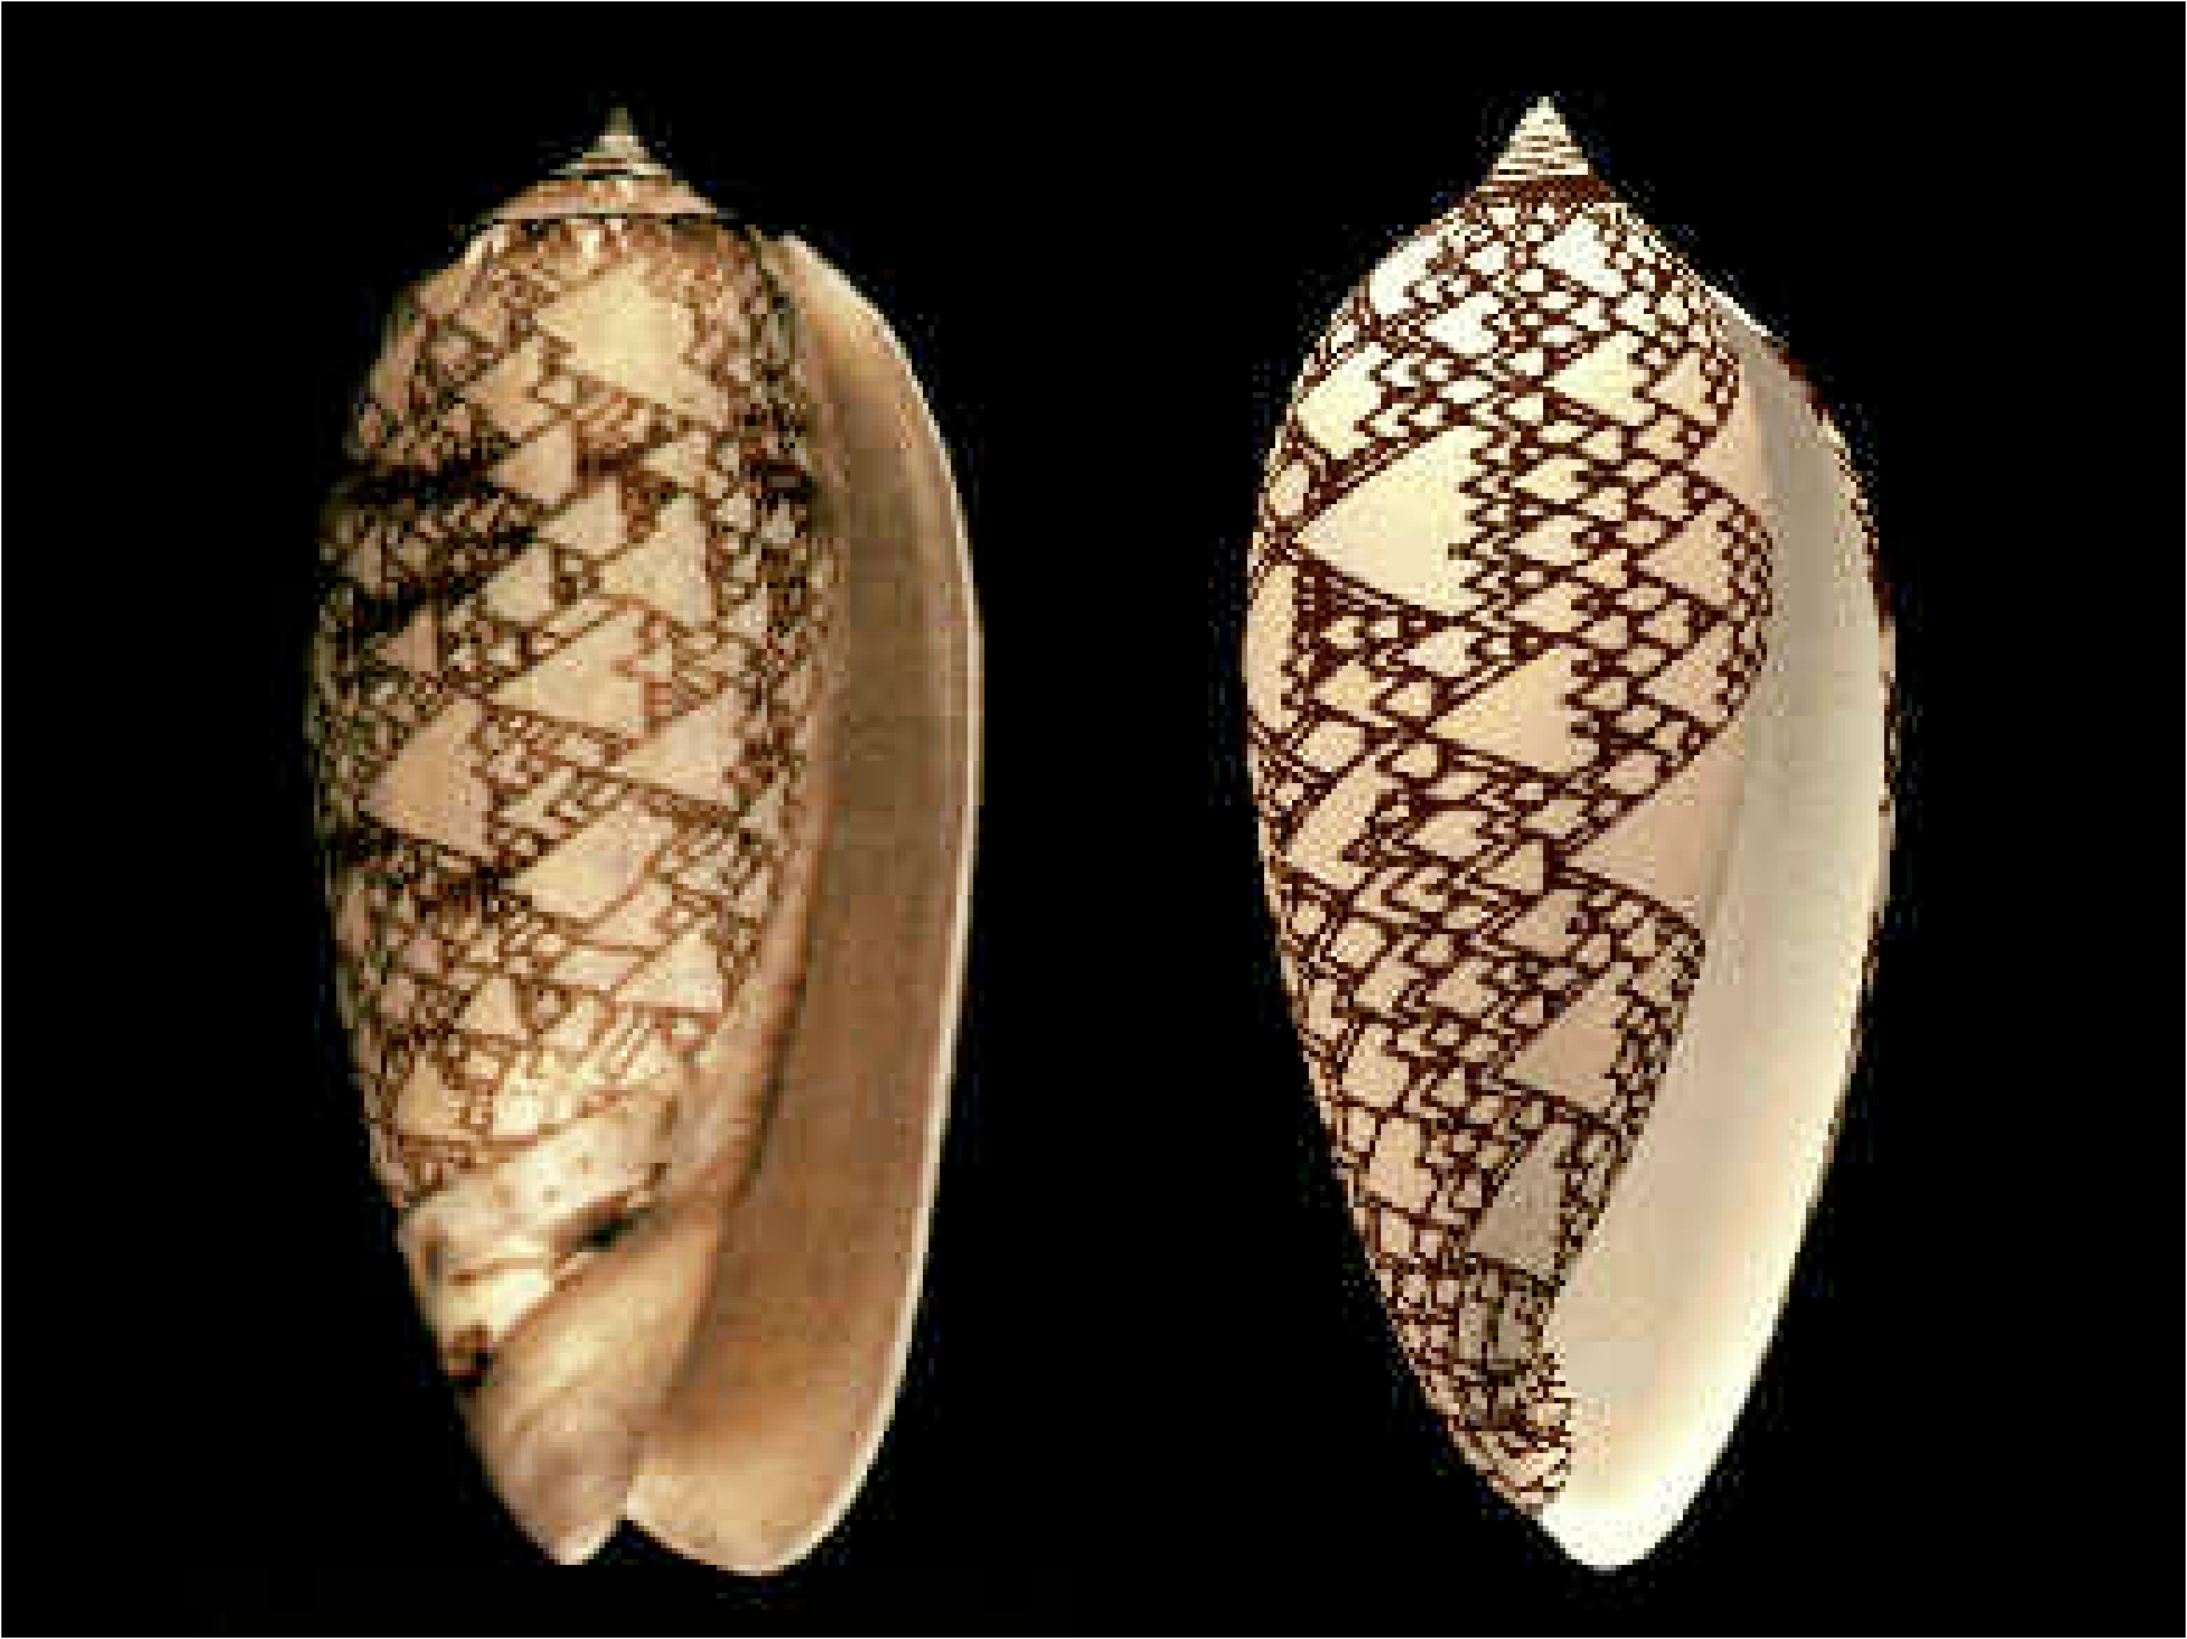
Biological Simulations
Fowler, et al., SIGGRAPH 92
Fleischer, et al., SIGGRAPH 95

Slide 45
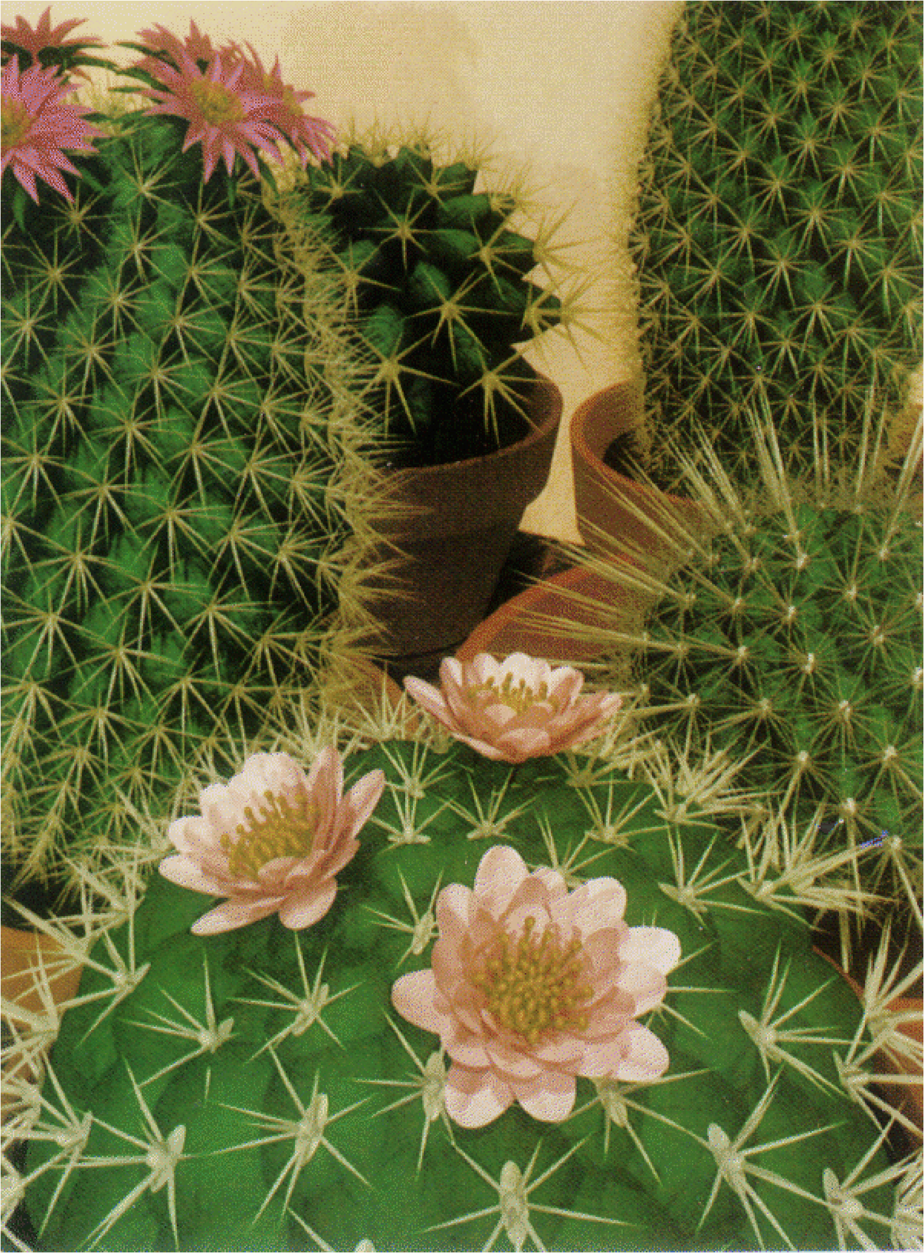
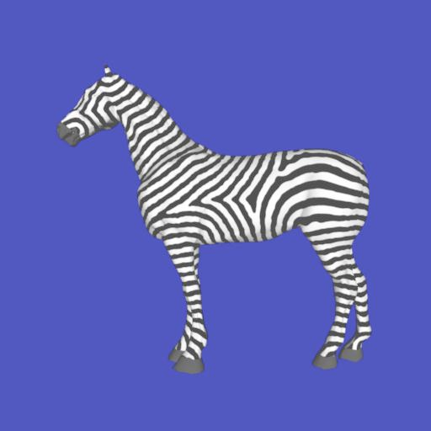
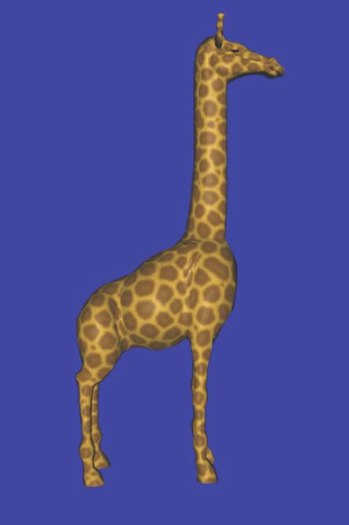
Biological Simulations
Fowler, et al., SIGGRAPH 92
Turk, SIGGRAPH 91

Slide 46

Physical Simulation
Erosion, Deposition
Kenji Nagashima, Visual Computer 1997

Slide 47
Scan from Objects
General concept
  Find points on surface
  Connect into mesh
Mechanical
Triangulation
  Laser
  Structured Light
  Multiple Cameras
CAT scan / MRI

Slide 48
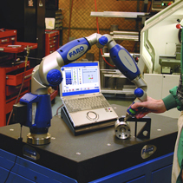
Mechanical Scan
Touch tip to surface
Measure joint angles
Compute tip location

Slide 49
Triangulation
Ray from light at A
Seen at pixel B
Point at ray intersection

Slide 50
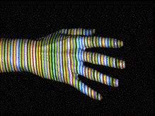
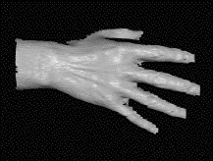
Structured Light
Intersection of edge from light source/projector and ray through camera pixel
Projected light
Zhang, Curless and Seitz, 3DPVT 2002
Resulting model

Slide 51
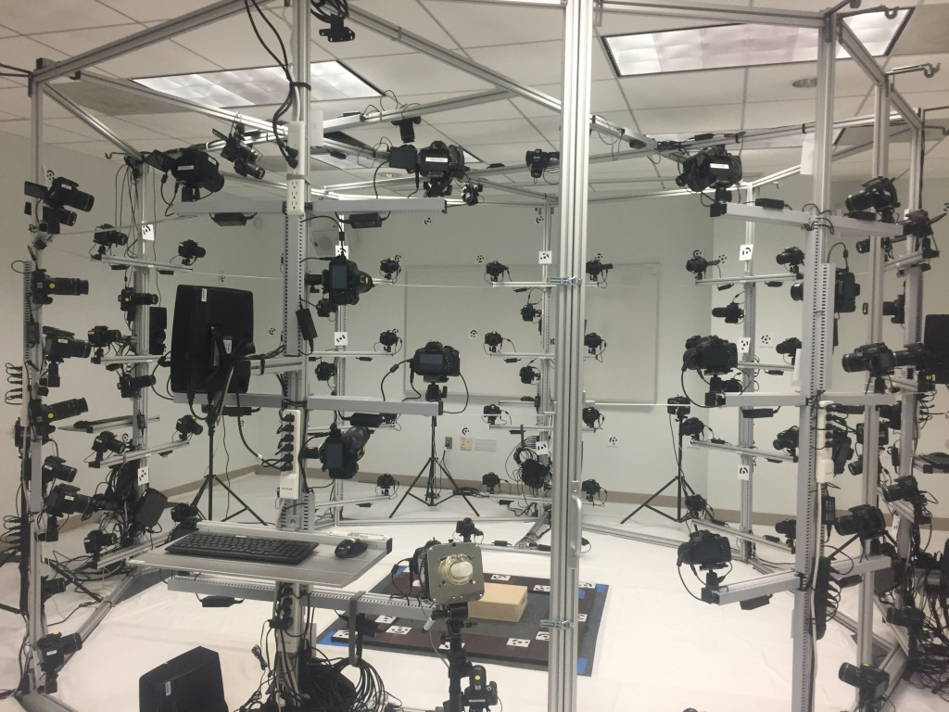
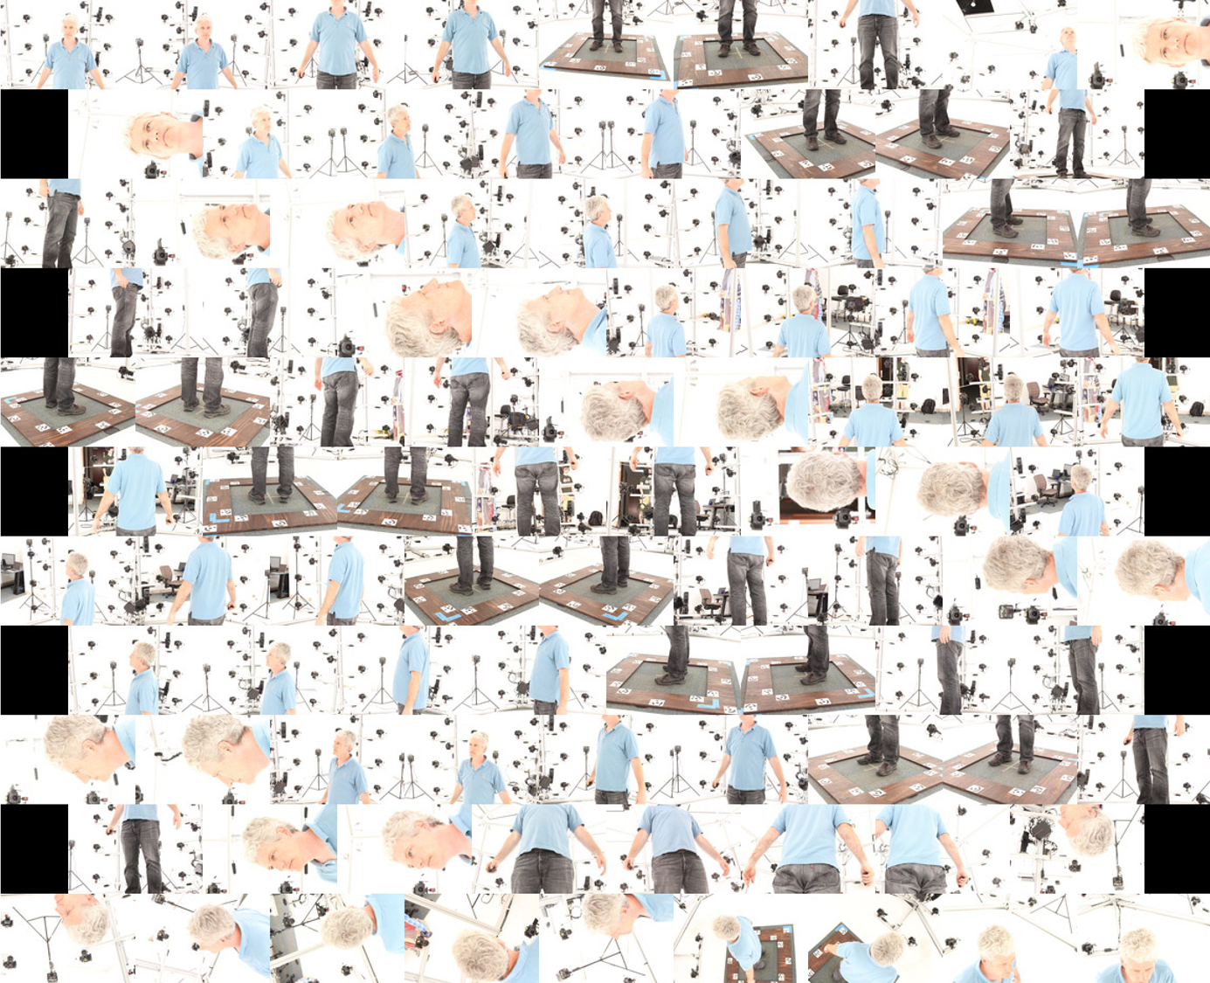
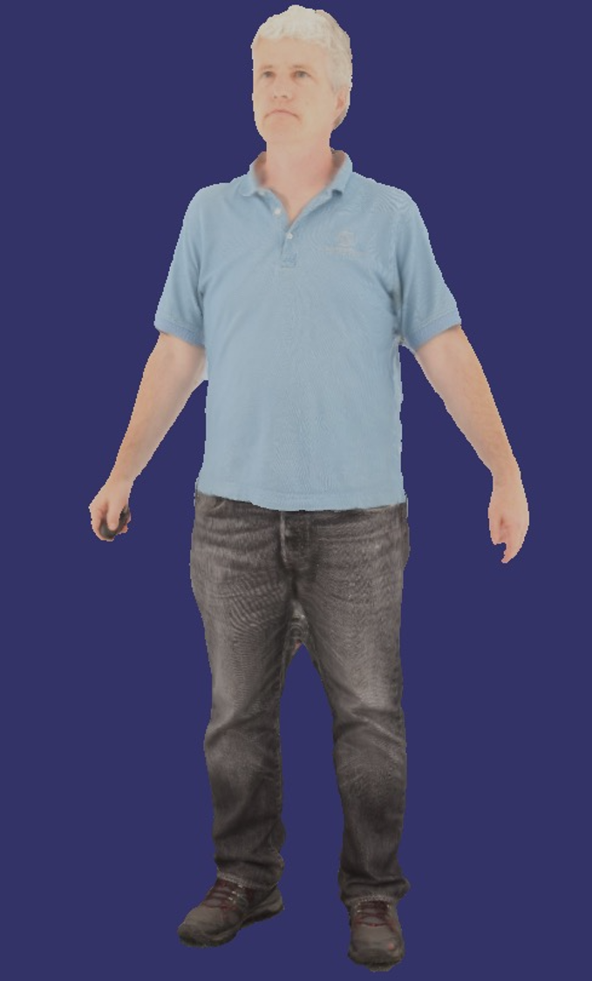
Multiple Cameras
Computer vision algorithm to find common features
Triangulate to optimize cameras and points in 3D space
Reconstruct dense mesh

Slide 52
Visualization
Present data visually
  Increase understanding, recognize patterns
  Measurements, simulation, other info

Slide 53
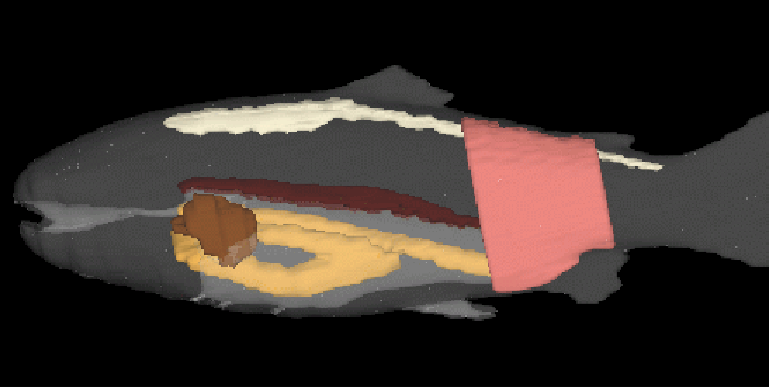
Visualization Example
Can be 3D object

Slide 54
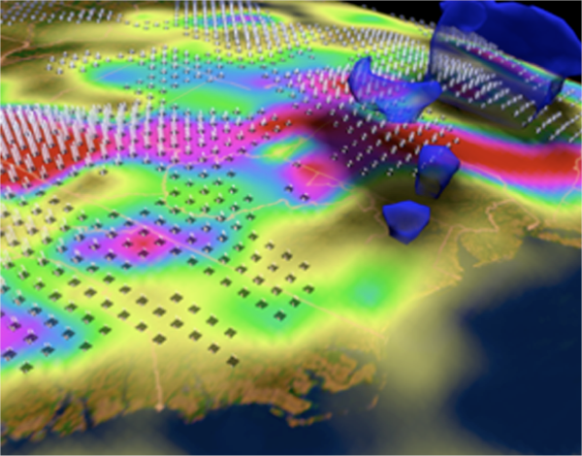
Visualization Example
Can be 3D, but showing non-visual aspects

Slide 55
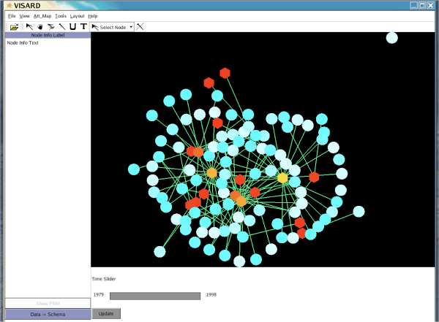
Visualization Example
Can be not traditionally 3D at all (info vis)

