Slide 1
Graphics Hardware
CMSC 435/634

Slide 2
A Graphics Pipeline
Transform
Shade
Vertex
Clip
Project
Rasterize
Triangle
Interpolate
Texture
Fragment
Z-buffer

Slide 3
Computation and Bandwidth
Based on:
• 100 Mtri/sec (1.6M/frame@60Hz)
• 256 Bytes vertex data
• 128 Bytes interpolated
• 68 Bytes fragment output
• 5x depth complexity
• 16 4-Byte textures
• 223 ops/vert
• 1664 ops/frag
• No caching
• No compression
Vertex
75 GB/s
67 GFLOPS
Triangle
13 GB/s
335 GB/s Texture
45 GB/s Fragment
Fragment
1.1 TFLOPS

Slide 4
Data Parallel
Distribute
Task
Task
Task
Task
Merge

Slide 5
Sort First
Objects
Distribute objects by screen tile
Vertex
Vertex
Vertex
Some pixels
Some objects
Triangle
Triangle
Triangle
Fragment
Fragment
Fragment
Screen

Slide 6
Sort Middle
Objects
Distribute objects or vertices
Vertex
Vertex
Vertex
Some objects
Merge & Redistribute by screen location
Triangle
Triangle
Triangle
Triangle
Some pixels
Some objects
Fragment
Fragment
Fragment
Fragment
Screen

Slide 7
Screen Subdivision
Tiled
Interleaved

Slide 8
Sort Last
Objects
Distribute by object
Vertex
Vertex
Vertex
Full Screen
Some objects
Triangle
Triangle
Triangle
Fragment
Fragment
Fragment
Z-merge
Screen

Slide 9
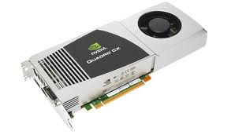
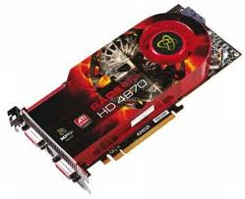
Graphics Processing Unit (GPU)
Sort Middle(ish)
Fixed-Function HW for clip/cull, raster, texturing, Ztest
Programmable stages
Commands in, pixels out

Slide 10
GPU Computation
Vertex
…
More Parallel
Parallel
Triangle
Pixel
Pipeline
More Parallel
More Pipeline

Slide 11
Architecture: Latency
CPU: Make one thread go very fast
Avoid the stalls
Branch prediction
Out-of-order execution
Memory prefetch
Big caches
GPU: Make 1000 threads go very fast
Hide the stalls
HW thread scheduler
Swap threads to hide stalls

Slide 12
Architecture (MIMD vs SIMD)
MIMD(CPU-Like)
SIMD (GPU-Like)
CTRL
ALU
CTRL
ALU
CTRL
ALU
ALU
ALU
ALU
CTRL
ALU
ALU
ALU
ALU
CTRL
ALU
ALU
ALU
ALU
Flexibility
Horsepower
Ease of Use

Slide 13
SIMD Branching
if( x ) // mask threads
// issue instructions
else // invert mask
// issue instructions
// unmask
Threads agree, issue if
Threads agree, issue else
Threads disagree, issue if AND else

Slide 14
SIMD Looping
Useful
Useless
while(x) // update mask
// do stuff
They all run ‘till the last one’s done….

Slide 15
GPU graphics processing model
CPU
Texture/Buffer
Vertex
Geometry
Rasterize
Fragment
Z-Buffer
Displayed
Pixels

Slide 16
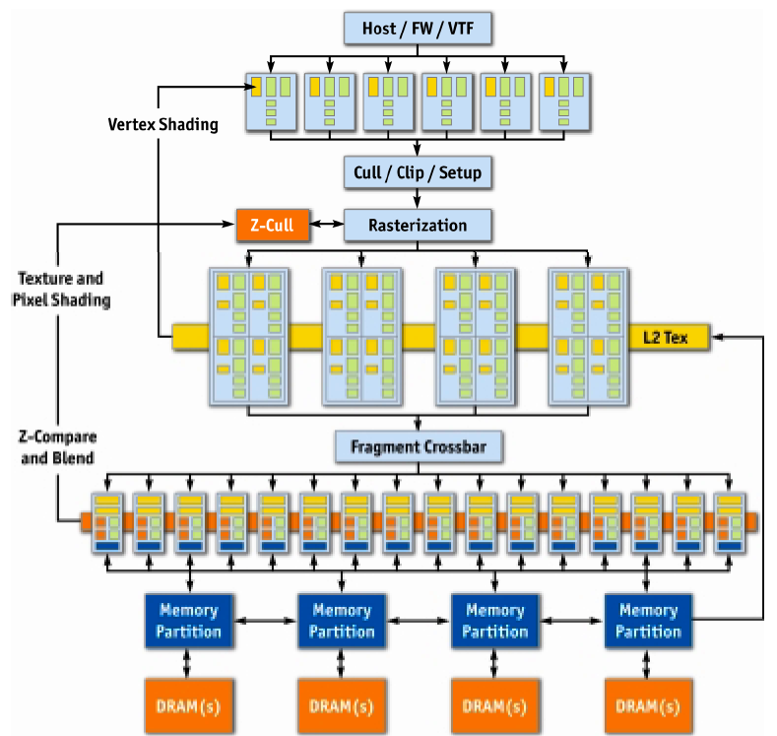
NVIDIA GeForce 6
Vertex
Rasterize
Fragment
Z-Buffer
Displayed
Pixels
[Kilgaraff and Fernando, GPU Gems 2]

Slide 17
GPU graphics processing model
CPU
Texture/Buffer
Vertex
Geometry
Rasterize
Fragment
Z-Buffer
Displayed
Pixels

Slide 18
GPU graphics processing model
CPU
Vertex
Texture/Buffer
Geometry
Fragment
Rasterize
Displayed
Pixels
Z-Buffer

Slide 19
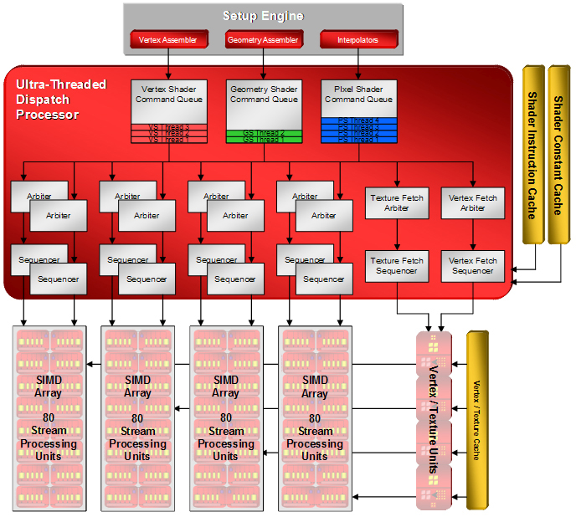
AMD/ATI R600 Dispatch

Slide 20
SIMD Units
2x2 Quads (4 per SIMD)
20 ALU/Quad (5 per thread)
“Wavefront” of 64 Threads, executed over 8 clocks
2 Waves interleaved
Interleaving + multi-cycling hides ALU latency.
Wavefront switching hides memory latency.
GPR Usage determines wavefront count.
General Purpose Registers
4x32bit
(THOUSANDS of them)

Slide 21
AMD/ATI R600
[Tom’s Hardware]

Slide 22
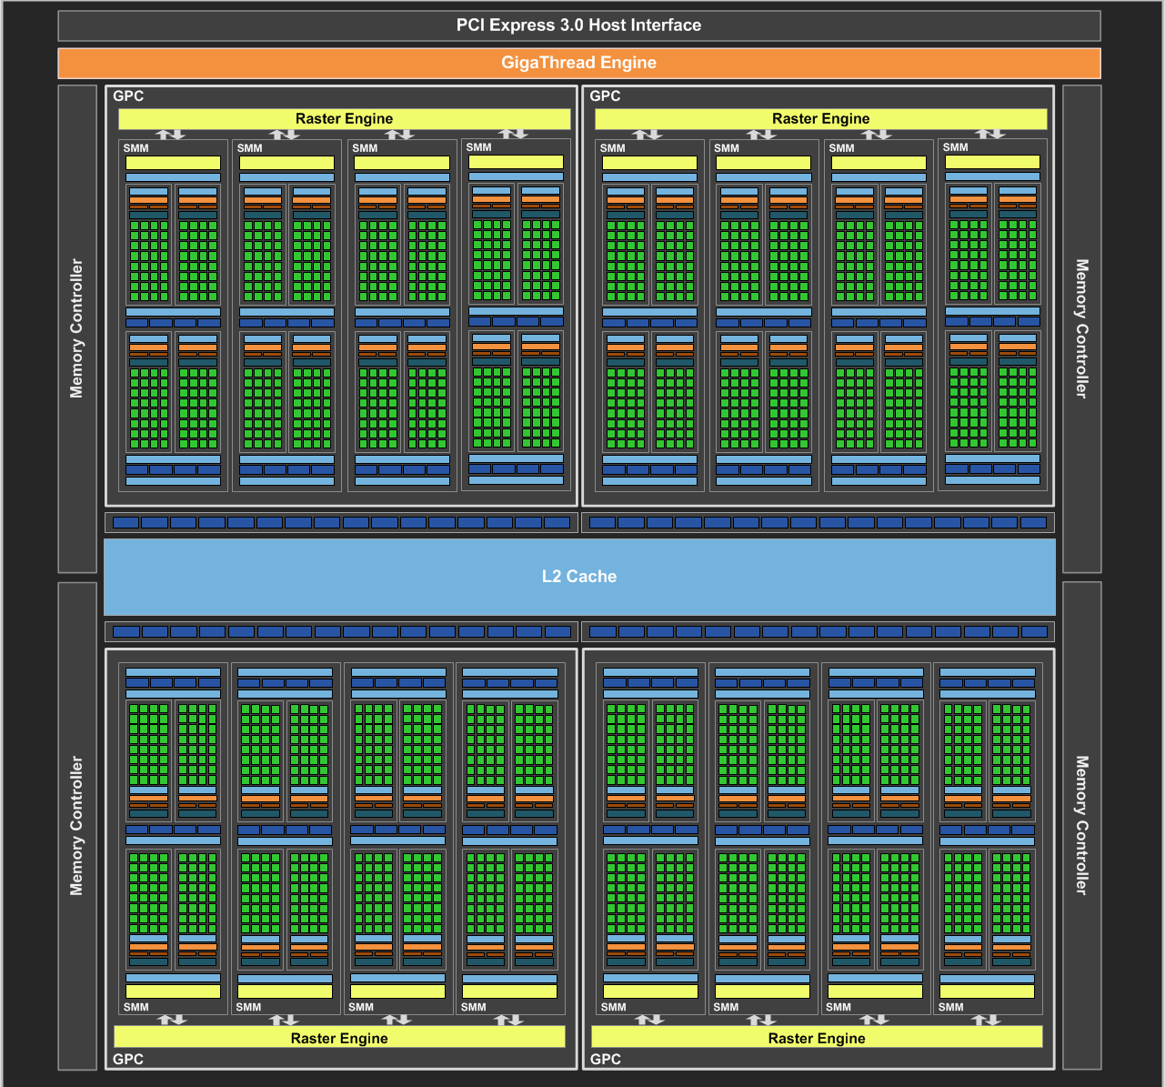
NVIDIA Maxwell
[NVIDIA, NVIDIA GeForce GTX 980 Whitepaper, 2014]

Slide 23
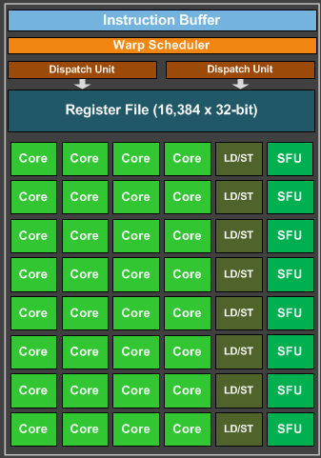
Maxwell SIMD Processing Block
32 Cores
8 Special Function
NVIDIA Terminology:
Warp = interleaved threads
Want at least 4-8
Thread Block = Warps*Cores
Flexible Registers
Trade registers for warps

Slide 24
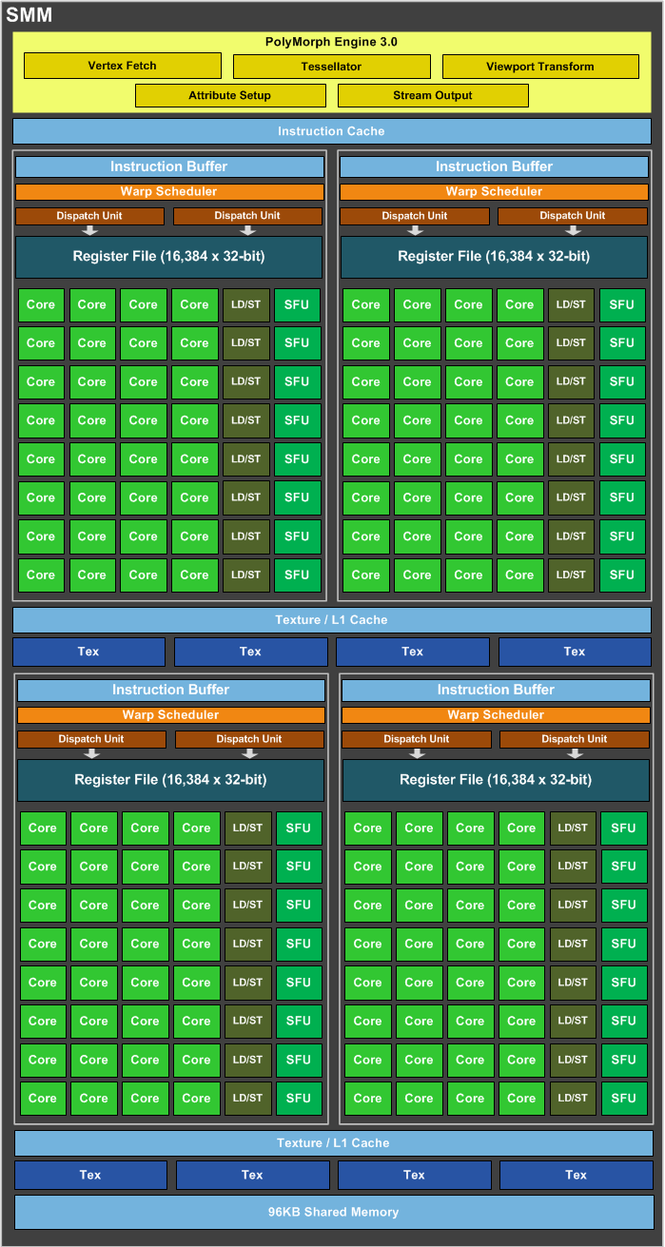
Maxwell Streaming Multiprocessor (SMM)
4 SIMD blocks
Share L1 Caches
Share memory
Share tessellation HW

Slide 25
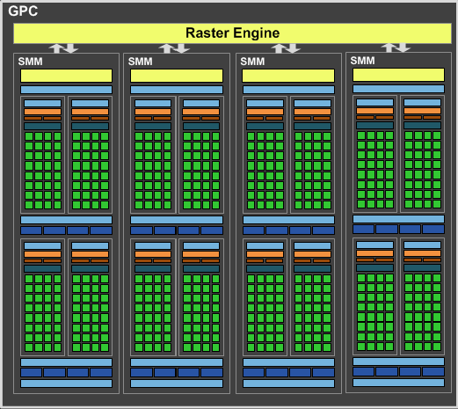
Maxwell Graphics Processing Cluster (GPC)
4 SMM
Share raster

Slide 26
Full NVIDIA Maxwell
4 GPC
Share L2
Share dispatch

Slide 27
NVIDIA Maxwell Stats
16 SM * 4 SIMD Blocks* 32 cores (2048 total)
4.6 TFLOPS, 144 Gtex/s, 224 MB/s
2MB L2 Cache
Compress between Memory and L2
Saves 25%

Slide 28
GPU Performance Tips

Slide 29
Graphics System Architecture
Your Code
Display
GPU
GPU
GPU(s)
API
Driver
Produce
Consume
Current Frame
(Buffering Commands)
Previous Frame(s)
(Submitted, Pending Execution)

Slide 30
GPU Performance Tips
API and Driver
Reading Results Derails the train…..
Occlusion Queries → Death
When used poorly ….
Framebuffer reads ➔ DEATH!!!
Almost always…
CPU-GPU communication should be one way
If you must read, do it a few frames later…

Slide 31
GPU Performance Tips
API and Driver
Minimize shader/texture/constant changes
Minimize Draw calls
Minimize CPU→GPU traffic
glBegin()/glEnd() are EVIL!
Use static vertex/index buffers if you can
Use dynamic buffers if you must
With discarding locks…

Slide 32
GPU Performance Tips
Shaders, Generally
NO unnecessary work!
Precompute constant expressions
Div by constant → Mul by reciprocal
Minimize fetches
Prefer compute (generally)
If ALU/TEX < 4+, ALU is under-utilized
If combining static textures, bake it all down…

Slide 33
GPU Performance Tips
Shaders, Generally
Careful with flow control
Avoid divergence
Flatten small branches
Prefer simple control structure
Double-check the compiler
Shader compilers are getting better…
Look over artists’shoulders
Material editors give them lots of rope….

Slide 34
GPU Performance Tips
Vertex Processing
Use the right data format
Cache-optimized index buffer
Small, 16-byte aligned vertices
Cull invisible geometry
Coarse-grained (few thousand triangles) is enough
“Heavy” Geometry load is ~2MTris and rising

Slide 35
GPU Performance Tips
Pixel Processing
Small triangles hurt performance
2x2 pixel quads ➔ Waste at edge pixels
Respect the texture cache
Adjacent pixels should touch adjacent texels
Use the smallest possible texture format
Avoid dependent texture reads
Do work per vertex
There’s usually less of those (see small triangles)

Slide 36
GPU Performance Tips
Pixel Processing
HW is very good at Z culling
Early Z, Hierarchical Z
If possible, submit geometry front to back
“Z Priming” is commonplace
Render with simple shader to z-buffer
Then render with real shader

Slide 37
GPU Performance Tips
Blending/Backend
Turn off what you don’t need
Alpha blending
Color/Z writes
Minimize redundant passes
Multiple lights/textures in one pass
Use the smallest possible pixel format
Consider clip/discard in transparent regions

