Slide 1
NoSQL Databases
An Overview
Dr. Kalpakis, Introduction to Data Science, Fall 2017

Slide 2
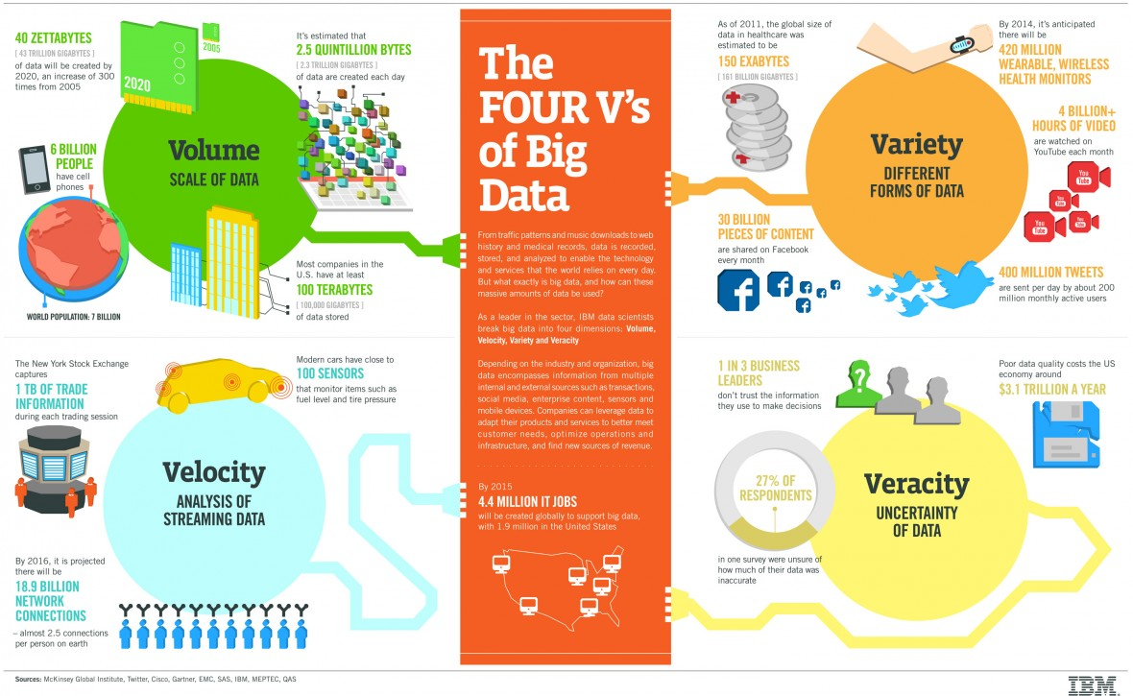
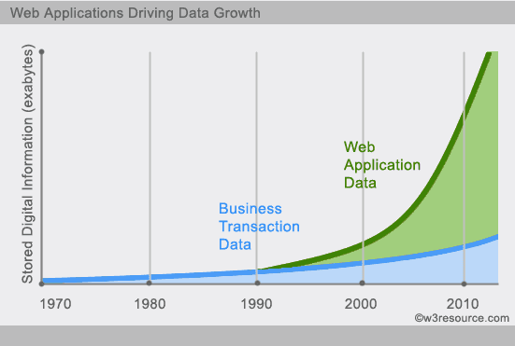
The need

Slide 3
Scaling Relational Databases
Vertically (or up)
  Can be achieved by hardware upgrades (e.g., faster CPU, more memory, or larger disks)
  Limited by the amount of CPU, RAM and disk that can be configured on a single machine
Horizontally (or out)
  Can be achieved by adding more machines
  Requires database sharding and probably replication
  Limited by the Read-to-Write ratio and communication overhead
  ACID requirements constrain scalability

Slide 4
Data Sharding
Data is typically sharded (or striped) to allow for parallel accesses
Amdahl’s Law gives the speedup due to sharding
  Real speedup is less due to communication overhead and workload imbalance
Input data: A large file
Machine 1
Machine 2
Machine 3
Chunk1 of input data
Chunk3 of input data
Chunk5 of input data
Chunk2 of input data
Chunk4 of input data
Chunk5 of input data
E.g., parallel access to chunks 1, 3 and 5

Slide 5

Data Replication
Replicating data across servers helps
  Avoid performance bottlenecks
  Avoid single point of failures
  Enhance scalability and availability
Main Server
Replicated Servers

Slide 6
Relational Databases & ACID properties
Execution of DB code blocks (aka transactions) ensure
  Atomicity: either all instructions or none of them are excuted
  Consistency: at the end, it leaves database in consistent state
  Isolation: oblivious to other concurrent manipulations of database
  Durability: upon completion, modifications to DB are permanent
Consistency in distributed relational databases is often done using 2-phase commit protocol (2PC)
When sharding and replicating relational databases, ensuring consistency is costly since real-life distributed systems are unreliable
  even worse, when network partitions
  AID are relatively easier to support in distributed systems

Slide 7

2-Phase Commit protocol (2PC)
Phase I: Voting
1. VOTE_REQUEST
2. VOTE_COMMIT
Participant 1
DB Server 1
DB Server 2
Coordinator
Participant 2
Phase II: Commit
3. GLOBAL_COMMIT
DB Server 3
Participant 3
4. LOCAL_COMMIT

Slide 8
The CAP Theorem
“Of three properties of a shared data system: data consistency, system availability and tolerance to network partitions, only two can be achieved at any given moment.”
  Conjectured by Eric Brewer (2000) and proven by Nancy Lynch and Seth Gilbert (2002)
  “CAP prohibits only a tiny part of the design space: perfect availability and consistency in the presence of partitions, which are rare.” (Eric Brewer, 2012)
Consistency:
  All nodes should see the same data at the same time (strict consistency)
Availability:
  Node failures do not prevent survivors from continuing to operate
Partition-tolerance:
  The system continues to operate despite network partitions
Necessary to decide between C and A for very large systems since almost certainly will partition

Slide 9
Various Consistency types
Strong Consistency
  any subsequent access after an update will return the same updated value.
Eventual Consistency
  if no new updates are made, eventually all accesses will return the last updated value
Read-your-writes
  Upon updating an item, a process never sees an older value
Monotonic read consistency
  If a process has seen a particular value of an item, no process sees an older value afterwards
Monotonic write consistency
  serializes the writes by the same process

Slide 10
BASE antidote to ACID
Basically Available: indicates that the system does guarantee availability
Soft state indicates that the state of the system may change over time, even without input.
Eventual consistency indicates that the system will become consistent over time, when input ceases during that time.
Most NoSQL databases relax ACID and adopt BASE

Slide 11
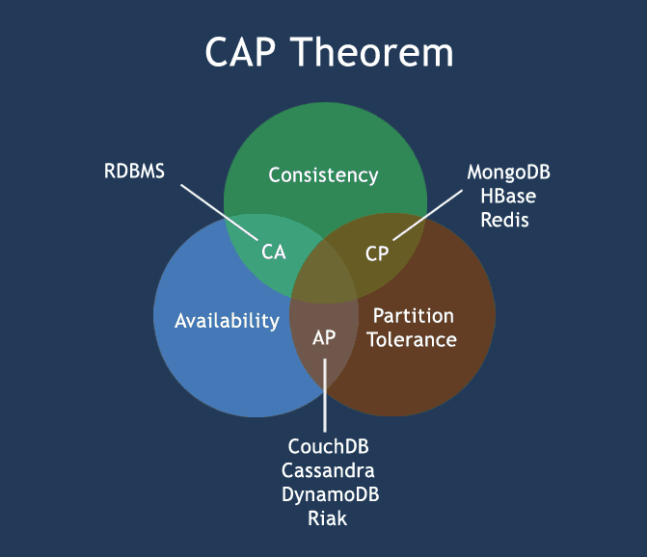
CAP and databases

Slide 12
Taxonomy of NoSQL (Not-only SQL) databases
Key-Value Stores
  Lookup a single value for a key
    Amazon’s DynamoDB
Document Stores
  Access data by key or by search of “document” data.
    MongoDB
    CouchDB
Column Stores
  Column-wise storage of tabular data
    Google’s BigTable
    Facebook’s Cassandra
Graph Stores
  Native graph storage, efficient graph algorithms
    Neo4j
    Google’s Pregel

Slide 14
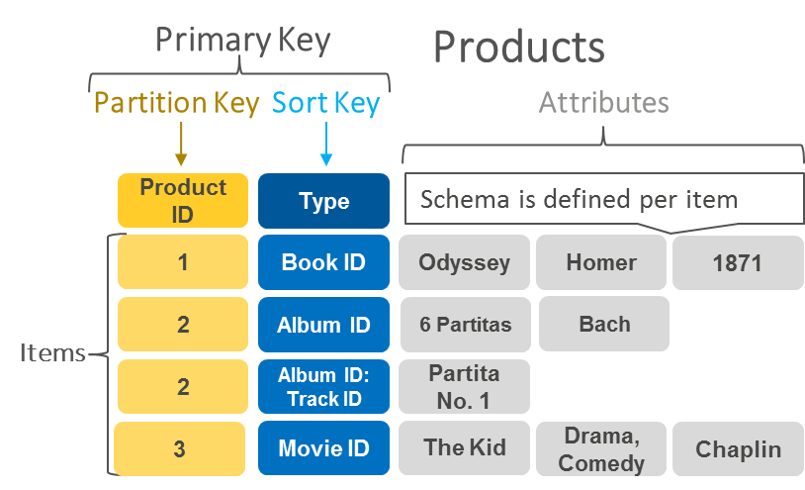
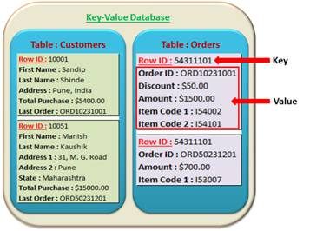
Key-Value Stores
DynamoDB Data Model
Mandatory
Key-value access pattern
Determines data distribution
Optional
Models 1:N relationships
Enables rich queries

Slide 15
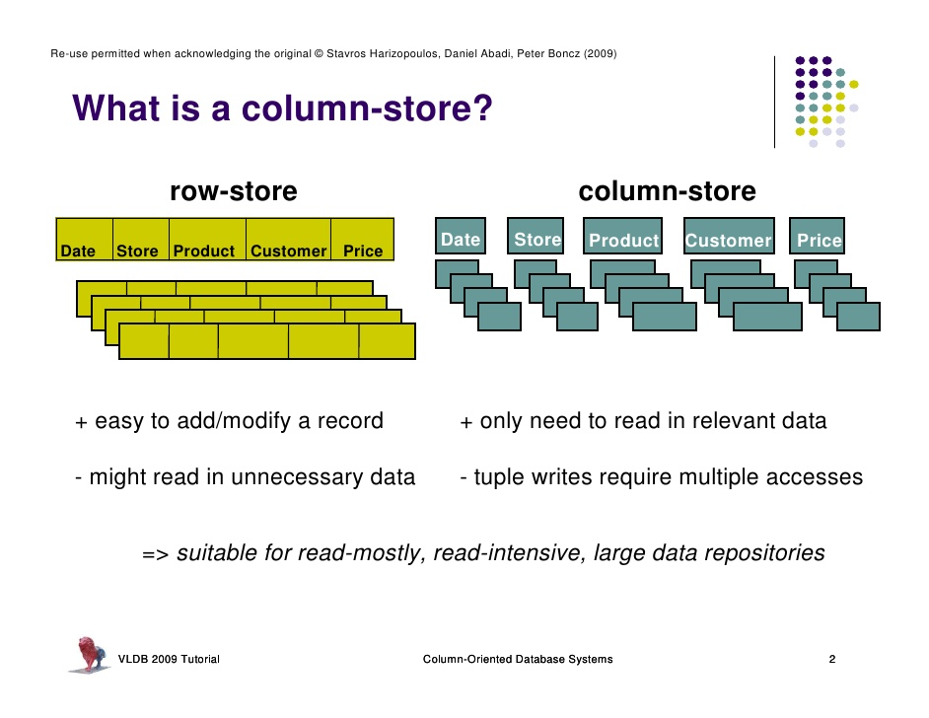
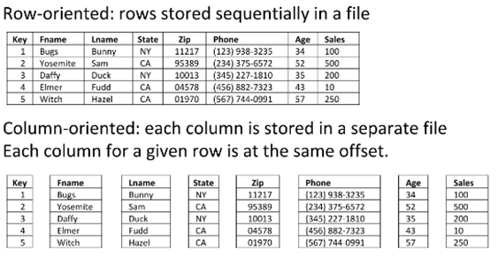
Column Stores

Slide 16
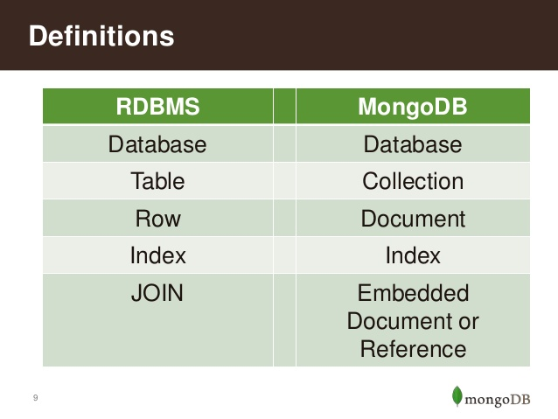
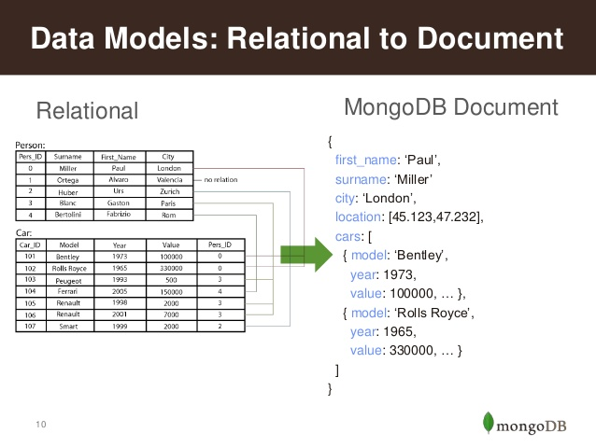
Document Stores
in JSON/BSON

Slide 17
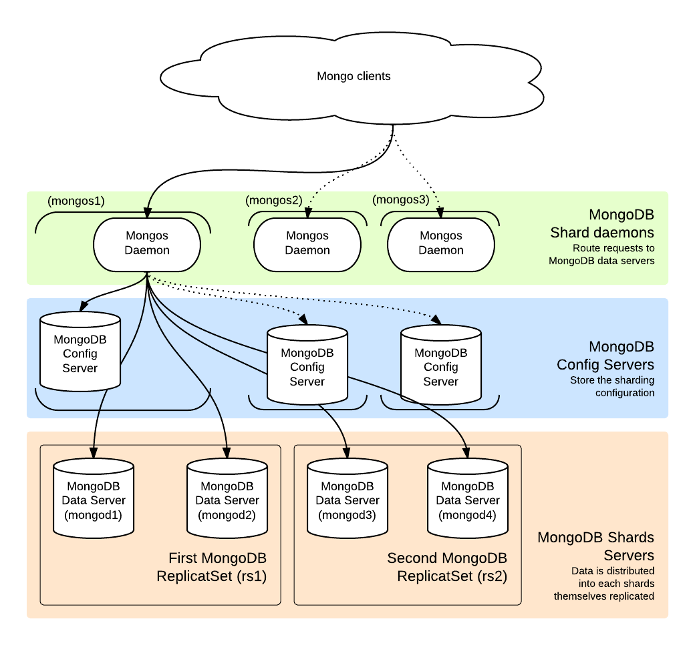
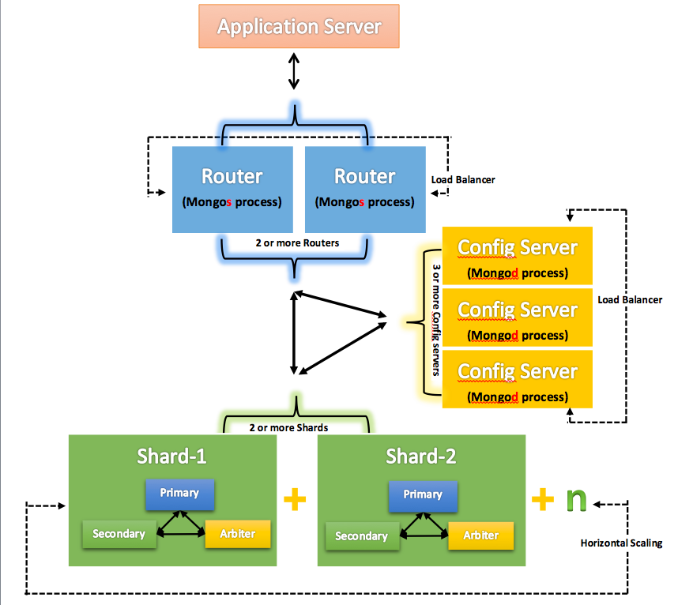
MongoDB Architecture

Slide 18
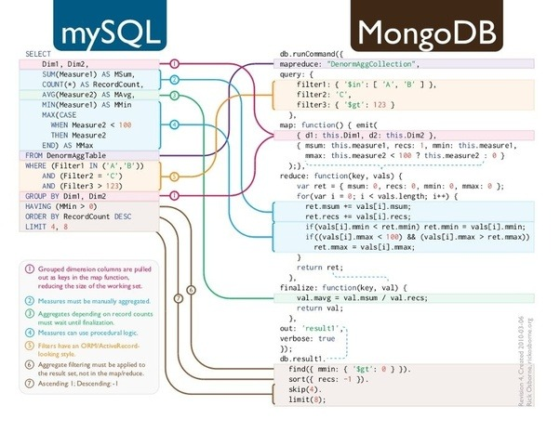
Queries

Slide 19
Graph Stores – neo4j
Graph Stores
vs

Slide 20
Prons/Cons of NoSQL
Advantages :
  High elastic scalability
  Lower cost
  Schema flexibility, semi-structured data
Disadvantages
  No standardization
  Less mature
  Limited query capabilities
  Programming with eventual consistent is counter-intuitive

Slide 21


Slide 22
NewSQL
A DBMS that delivers the scalability and flexibility promised by NoSQL while retaining the support for SQL queries and/or ACID, or to improve performance for appropriate workloads.
NewSQL databases have
  SQL as the primary interface.
  ACID support for transactions
  Non-locking concurrency control.
  High per-node performance.
  Parallel, shared-nothing architecture.
Matt Aslett – “How Will The Database Incumbents Respond To NoSQL And NewSQL?”
https://www.451research.com/report-short?entityId=66963
Properties | Traditional SQL | NoSQL | NewSQL
ACID | Y | N | Y
In-memory DB | N | Y | Y
Big Data | N | Y | Y
RDBMS | Y | N | Y
Michael Stonebraker- “New SQL: An Alternative to NoSQL and Old SQL for New OLTP Apps”
http://cacm.acm.org/blogs/blog-cacm/109710

Slide 23
