Slide 1
Introduction to Data Science
Dr. Kalpakis, Fall 2017

Slide 2
What is Data Science?
Data scientists, "The Sexiest Job of the 21st Century" (Davenport and Patil, Harvard Business Review, 2012)
Much of the data science explosion is coming from the tech-world
What does Data Science mean?
Is it the science of Big Data?
What is Big Data anyway?
Who does Data Science and where?
What existed before Data Science came along?
Is it simply a rebranding of statistics and machine learning?
“Anything that has to call itself a science isn’t.”
Hype increases noise-to-signal ratio in perceiving reality and makes it harder to focus on the gems
Why and how to hire a data scientist? http://goo.gl/F4K4hE

Slide 3
Why now?
massive amounts of data about many aspects of our lives, both online and offline activities, real-time as well as past-time
Datafication=“taking all aspects of life and turning them into data”
“Once we datafy things, we can transform their purpose and turn the information into new forms of value.”
abundance of inexpensive computing power, communication capacity
proliferation of small footprint low-power sensors (IoT)
feedback loop between our behavior, environment, and data products

Slide 4
Data Science take I
“Data science, as it’s practiced, is a blend of Red-Bull-fueled hacking and espresso-inspired statistics.
But data science is not merely hacking—because when hackers finish debugging their Bash one-liners and Pig scripts, few of them care about non-Euclidean distance metrics.
And data science is not merely statistics, because when statisticians finish theorizing the perfect model, few could read a tab-delimited file into R if their job depended on it.
Data science is the civil engineering of data. Its acolytes possess a practical knowledge of tools and materials, coupled with a theoretical understanding of what’s possible.”
Mike Driscoll (CEO of Metamarket)
Drew Conway’s Venn diagram of data science
Many posers “It’s not enough to just know how to run a black box algorithm. You actually need to know how and why it works, so that when it doesn’t work, you can adjust. “ Cathy O’Neil

Slide 5
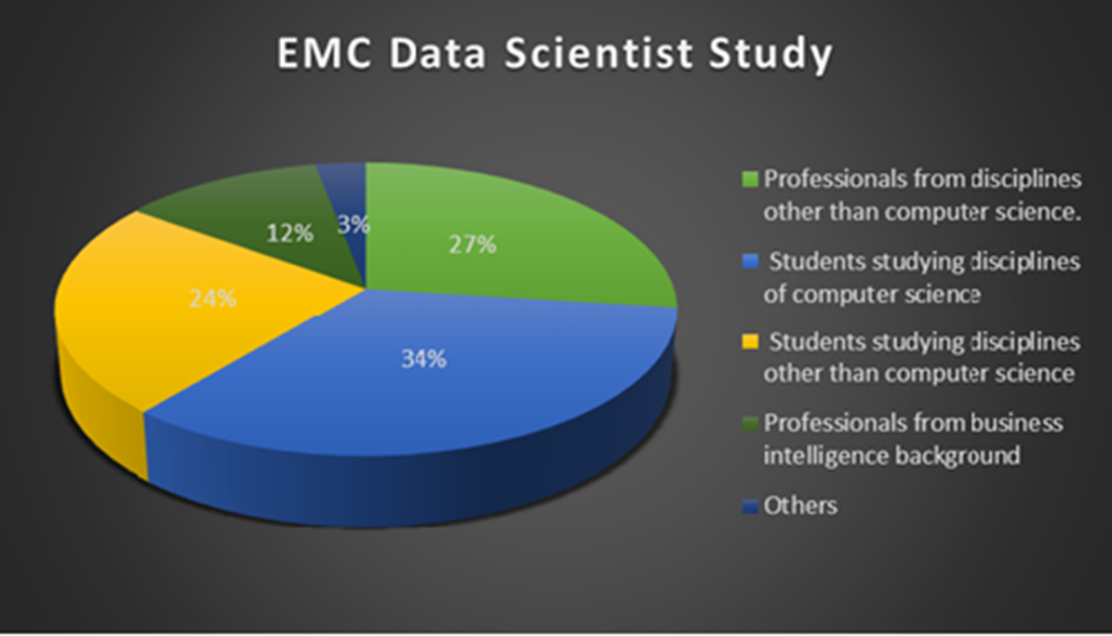
Data Science team
individual data scientist profiles are merged to make a Data science team
team profile should align with the profile of the data problems to tackle

Slide 6
Data science: skills and actors
Clustering and visualization of data science subfields based on a survey of data science practitioners (Analyzing the Analyzers by Harlan Harris, Sean Murphy, and Marck Vaisman, 2012)
Data Businesspeople are the product and profit-focused data scientists. They’re leaders, managers, and entrepreneurs, but with a technical bent. A common educational path is an engineering degree paired with an MBA.
Data Creatives are eclectic jacks-of-all-trades, able to work with a broad range of data and tools. They may think of themselves as artists or hackers, and excel at visualization and open source technologies.
Data Developers are focused on writing software to do analytic, statistical, and machine learning tasks, often in production environments. They often have computer science degrees, and often work with so-called “big data”.
Data Researchers apply their scientific training, and the tools and techniques they learned in academia, to organizational data. They may have PhDs, and their creative applications of mathematical tools yields valuable insights and products.

Slide 7
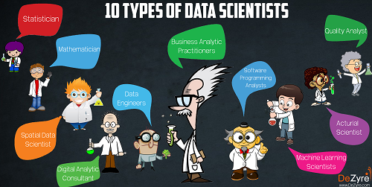
Types of Data Scientists
Machine Learning Scientist
Statistician
Software Programming Analyst
Data Engineer
Actuarial Scientist
Business Analytic Practitioner
Quality Analyst
Spatial Data Scientist
Mathematician
Digital Analytic Consultant

Slide 8
What do data scientists do?
“define what data science is by what data scientists get paid to do” (O’Neil and Schutt)
In academia, a data scientist is trained in some discipline, works with large amounts of data, grapples with computational problems posed by the structure, size, messiness, and the complexity and nature of the data, and solves real-world problems.
In industry, a data scientist
knows how to extract meaning from and interpret data, which requires both tools and methods from statistics and machine learning, as well as being human.
spends a lots of effort in collecting, cleaning, and munging data utilizing statistics and software engineering skills.
performs exploratory data analysis, finds patterns, builds models, and algorithms.
communicates the findings in clear language and with data visualizations so that even if her/his colleagues unfamiliar with the data can understand the implications

Slide 9
Data Science take II
“Data science, also known as data-driven science, is an interdisciplinary field about scientific methods, processes, and systems to extract knowledge or insights from data in various forms, either structured or unstructured, similar to data mining.” (Wikipedia)
The 4th paradigm of science (theoretical, empirical, computational, and data-driven) (Jim Gray)

Slide 10
Data Science Process
CRISP-DM (Cross Industry Standard Process for Data Mining)
Data science process flowchart (O’Neil and Schutt)

Slide 11
CRISP-DM Phases, tasks, outputs
Business Understanding | Data Understanding | Data Preparation | Modeling | Evaluation | Deployment
Determine Business Objectives Background Business Objectives Business Success Criteria | Collect Initial Data Initial Data Collection Report | Data Set Data Set Description | Select Modeling Technique Modeling Technique Modeling Assumptions | Evaluate Results Assessment of Data Mining Results w.r.t. Business Success Criteria Approved Models | Plan Deployment Deployment Plan
Situation Assessment Inventory of Resources Requirements,Assumptions, and Constraints Risks and Contingencies Terminology Costs and Benefits | Describe Data Data Description Report | Select Data Rationale for Inclusion / Exclusion | Generate Test Design Test Design | Review Process Review of Process | Plan Monitoring and Maintenance Monitoring & Maintenance Plan
Determine Data Mining Goal Data Mining Goals Data Mining Success Criteria | Explore Data Data Exploration Report | Clean Data Data Cleaning Report | Build Model Parameter Settings Models Model Description | Determine Next Steps List of Possible Actions Decision | Produce Final Report Final Report Final Presentation
Produce Project Plan Project Plan Initial Asessment of Tools and Techniques | Verify Data Quality Data Quality Report | Construct Data Derived Attributes Generated Records | Assess Model Model Assessment Revised Parameter Settings |  | Review Project Experience Documentation
 |  | Integrate Data Merged Data
 |  | Format Data Reformatted Data

