Slide 1
CSCE3193: Programming Paradigms
Nilanjan Banerjee
University of Arkansas
Fayetteville, AR
nilanb@uark.edu
http://www.csce.uark.edu/~nilanb/3193/S10/
Programming Paradigms

Slide 2
Concurrent Programming
Running tasks in parallel
Multiple processes
Multiple threads in one process?
Advantage: speed if you can decompose a task into parallel independent tasks
Examples
Webserver: multiple requests to cater to.
Web browser: multiple objects loading simultaneously
Assignment 4: quickly cracking a hash of a password?
Encoding multiple blocks simultaneously
Almost everything today can be broken into parallel tasks.

Slide 3
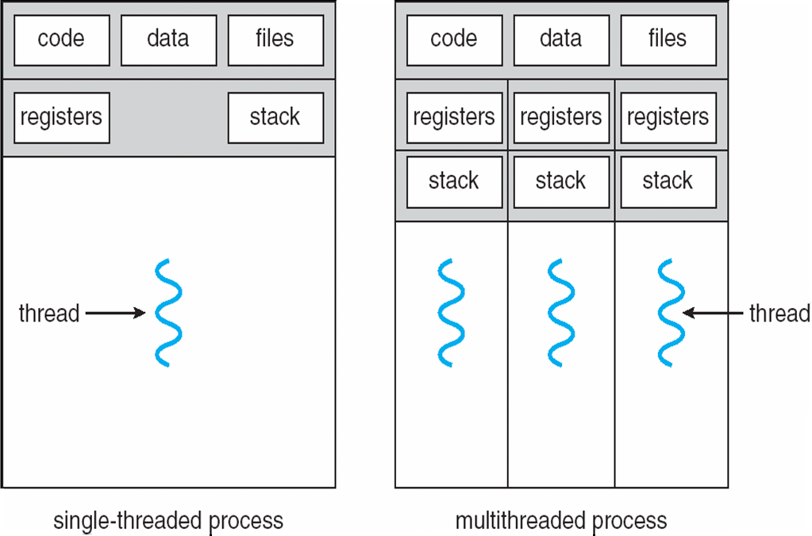
Threads and running processes

Slide 4
Creating Threads: extend the Thread class
Thread is a basic class which provides two methods
void start()
Creates a new thread and makes it runnable
void run()
A new Thread begins its life inside this method
public class A extends Thread {
public A() { … constructor…}
public void run() {…method that will run in the thread….}
}

Slide 5
Lets take a concrete example in eclipse
Application: Provide parallel addition
Input: array of integers a[1,…,k]
Divide array into segments and in parallel add segments of the array
For example:
Thread 1: add a[1:k/2]
Theads 2: add a[k/2:k]
Add both of them together

Slide 6
Thread Creation Diagram
Object A
Object BThread (extends Thread)
Thread t = new BThread();
t.start();
doMoreStuff();
BThread() {
}
void start() {
// create thread
}
void run() {
doSomething();
}

Slide 7
Thread Creation Diagram
Object A
Object BThread (extends Thread)
Thread t = new BThread();
t.start();
doMoreStuff();
BThread() {
}
void start() {
// create thread
}
void run() {
doSomething();
}

Slide 8
Thread Creation Diagram
Object A
Object BThread (extends Thread)
Thread t = new BThread();
t.start();
doMoreStuff();
BThread() {
}
void start() {
// create thread
}
void run() {
doSomething();
}

Slide 9
Thread Creation Diagram
Object A
Object BThread (extends Thread)
Thread t = new BThread();
t.start();
doMoreStuff();
BThread() {
}
void start() {
// create thread
}
void run() {
doSomething();
}

Slide 10
Thread Creation Diagram
Object A
Object BThread (extends Thread)
Thread t = new BThread();
t.start();
doMoreStuff();
BThread() {
}
void start() {
// create thread
}
void run() {
doSomething();
}

Slide 11
Thread Creation Diagram
Object A
Object BThread (extends Thread)
Thread t = new BThread();
t.start();
doMoreStuff();
BThread() {
}
void start() {
// create thread
}
void run() {
doSomething();
}

Slide 12
Thread Creation Diagram
Object A
Object BThread (extends Thread)
Thread t = new BThread();
t.start();
doMoreStuff();
BThread() {
}
void start() {
// create thread
}
void run() {
doSomething();
}

Slide 13
Thread Creation Diagram
Object A
Object BThread (extends Thread)
Thread t = new BThread();
t.start();
doMoreStuff();
BThread() {
}
void start() {
// create thread
}
void run() {
doSomething();
}

Slide 14
Thread Creation Diagram
Object A
Object BThread (extends Thread)
Thread t = new BThread();
t.start();
doMoreStuff();
BThread() {
}
void start() {
// create thread
}
void run() {
doSomething();
}

Slide 15
Another way of creating Threads: Runnable interface
A helper to the thread object
Your class implements the Runnable interface
The Thread object’s start() method calls the Runnable object’s run() method
Allows threads to run inside any object, regardless of inheritance

Slide 16
Example of using the Runnable interface
public class MyRunnable implements Runnable {
String name;
public MyRunnable(String name) {
this.name = name;
}
public void run() {
for(int i; i < 10; i++) {
System.out.println(i + “ “ + name());
try {
sleep((long)(Math.random() * 1000));
} catch(InterruptedException e) {}
}
}
}
public class ThreadTest {
public static void main(String[] args) {
for(int i = 0; i < args.length; i++) {
Thread t = new Thread(new MyRunnable(args[i]), args[i]);
t.start();
}
}
}

Slide 17
Blocking Threads
When reading from a stream, if input is not available, the thread will block
Thread is suspended (“blocked”) until I/O is available
Allows other threads to automatically activate
When I/O available, thread wakes back up again
Becomes “runnable”
Not to be confused with the Runnable interface

Slide 18
Thread Scheduling
In general, the runnable thread with the highest priority is active (running)
Java is priority-preemptive
If a high-priority thread wakes up, and a low-priority thread is running
Then the high-priority thread gets to run immediately
Allows on-demand processing
Efficient use of CPU

Slide 19
Thread Starvation
If a high priority thread never blocks
Then all other threads will starve
Must be clever about thread priority

Slide 20
Thread Priorities: General Strategies
Threads that have more to do should get lower priority
Counterintuitive
Cut to head of line for short tasks
Give your I/O-bound threads high priority
Wake up, immediately process data, go back to waiting for I/O

Slide 21
Thread interruption
Threads execution exits when the run() method returns
Or if it throws an exception that is not handled in the run() method
What if you want to interrupt a running Thread?
Thread.interrupt() --- call interrupts a Thread
Sets a interrupt flag for the Thread object!
How does a Thread check whether the flag is checked?
Thread.currentThread.isInterrupted()?

Slide 22
Example
while (!Thread.currentThread().isInterrupted())
{ …do something ….}
What if the Thread is sleeping or blocked?
Solution: catch InterruptedException?
try { while(!Thread.currentThread.isInterrupted()) { ..do something…}
catch(InterruptedException e) { //thread interrupted during sleep or wait}
When interrupted, interrupt flag is set and the Thread is woken up!

Slide 23
Race Conditions
Two threads are simultaneously modifying a single object
Both threads “race” to store their value
In the end, the last one there “wins the race”
(Actually, both lose)

Slide 24
Race Condition Example
Lets take an example in eclipse to illustrate this

Slide 25
Thread Lifecycle
Active
sleep(500)
Blocked
Born
wake up
JVM
start()
suspend()
Runnable
resume()
stop()
wait
stop()
notify
Dead
block on I/O
I/O available

