Slide 1
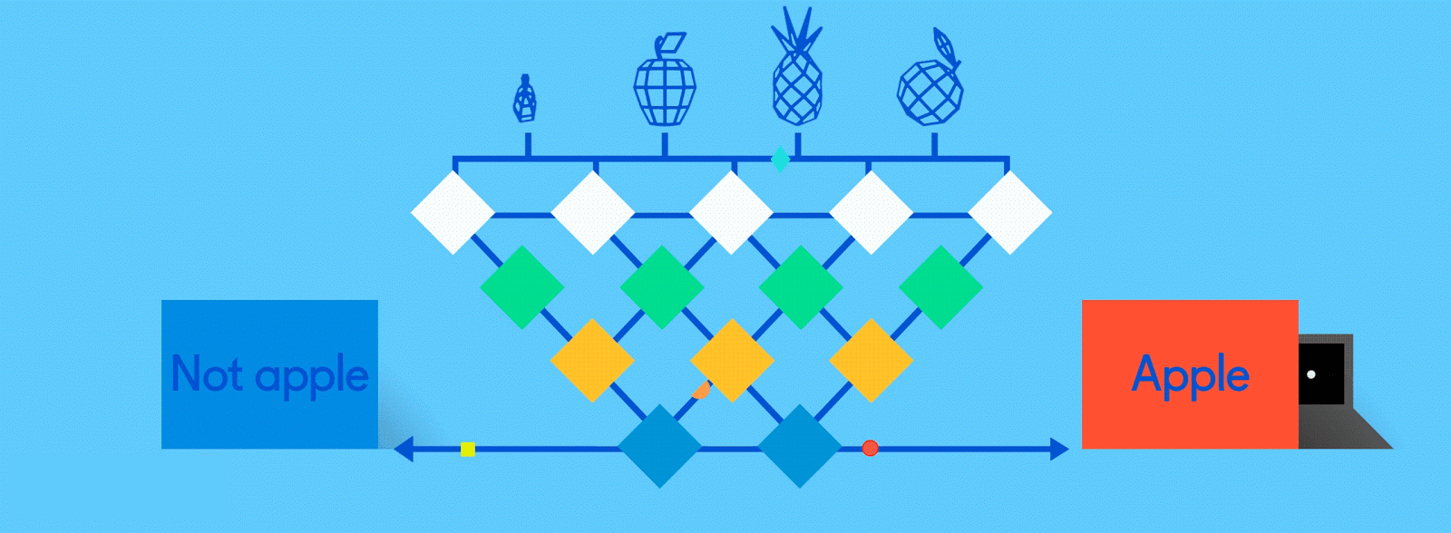
Neural Networks for Machine Learning
History and Concepts

Slide 2
Overview
The neural network computing model has a long history
Evolved over 75 years to solve its inherent problems, becoming the dominant model for machine learning in the 2010s
Neural network models typically give better results than earlier ML models
But they are expensive to train and apply
The field is still evolving rapidly

Slide 3
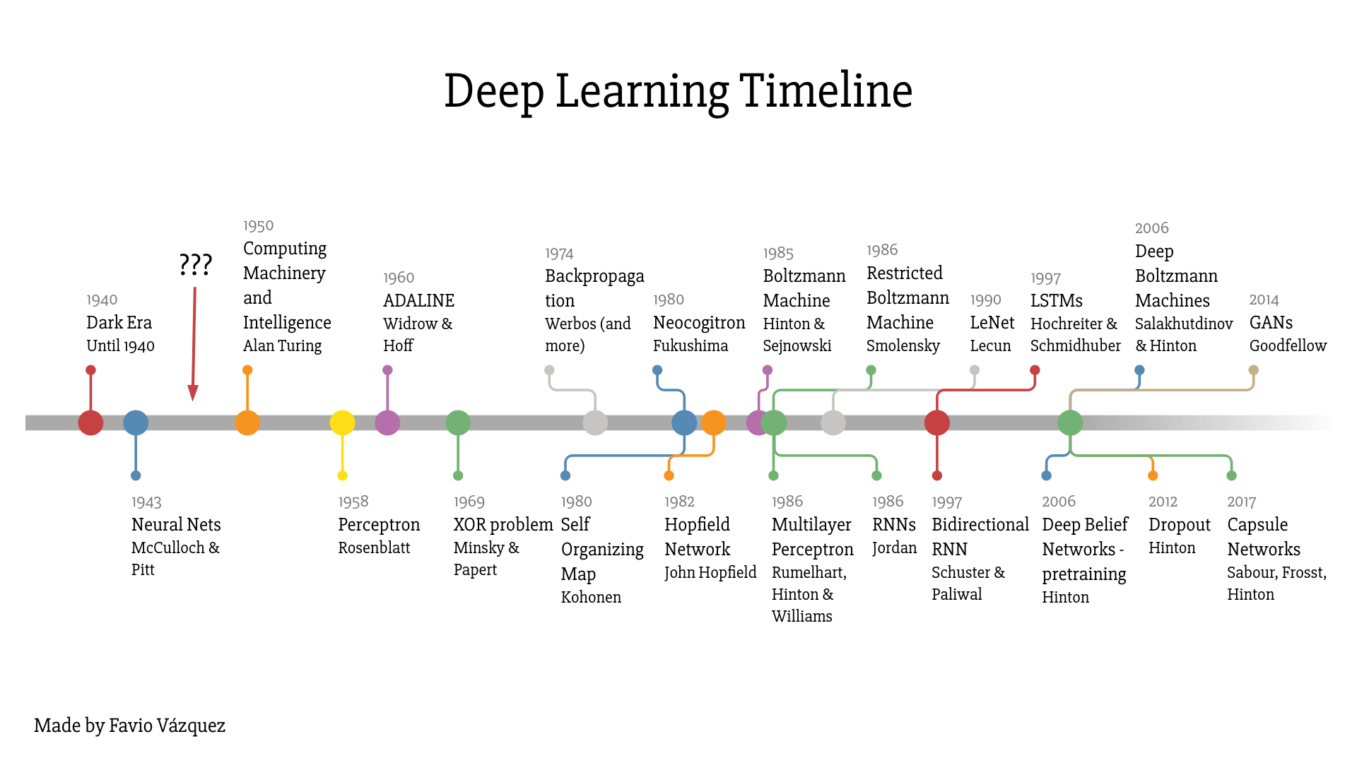

Slide 4
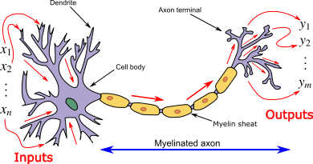
How do animal brains work?
Neuron and myelinated axon, with signal flow from inputs at dendrites to outputs at axon terminals
Neurons have body, axon and many dendrites
  In one of two states: firing and rest
  They fire if total incoming stimulus > threshold
Synapse: thin gap between axon of one neuron and dendrite of another
  Signal exchange

Slide 5
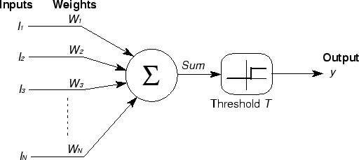
McCulloch & Pitts
First mathematical model of biological neurons, 1943
All Boolean operations can be implemented by these neuron-like nodes
Competitor to Von Neumann model for general purpose computing device
Origin of automata theory

Slide 6
Artificial neural network
Model still used today!
Set of nodes with inputs and outputs
Node performs computation via an activation function
Weighted connections between nodes
Connectivity gives network architecture
NN computations depend on connections, weights, and activation function
Notes:
Set of nodes
Node have inputs and outputs
Nodes performs computation via its activation function
Weighted connections between nodes
Connectivity gives structure/architecture of net
What can be computed by a NN determined by the connections and their weights
Simplified version of networks of neurons in animal nerve systems

Slide 7
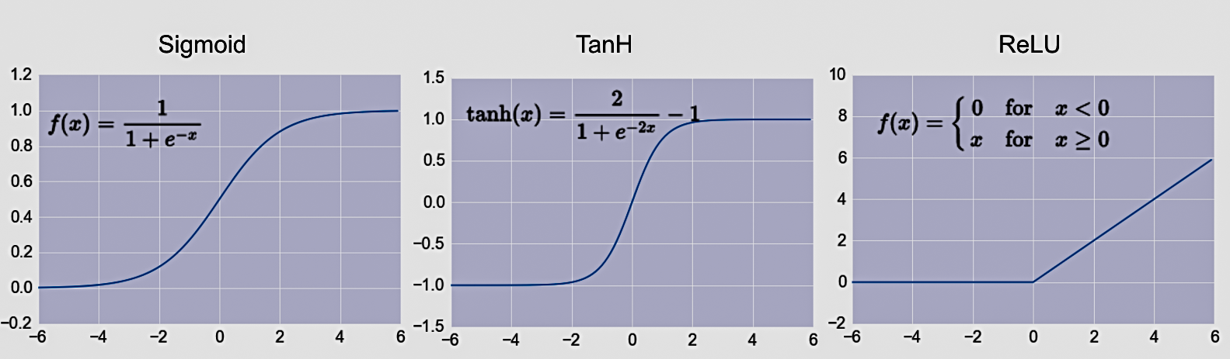
Common Activation Functions
defines the output of that node given an input
Choice of activation function depends on problem and available computational power

Slide 8
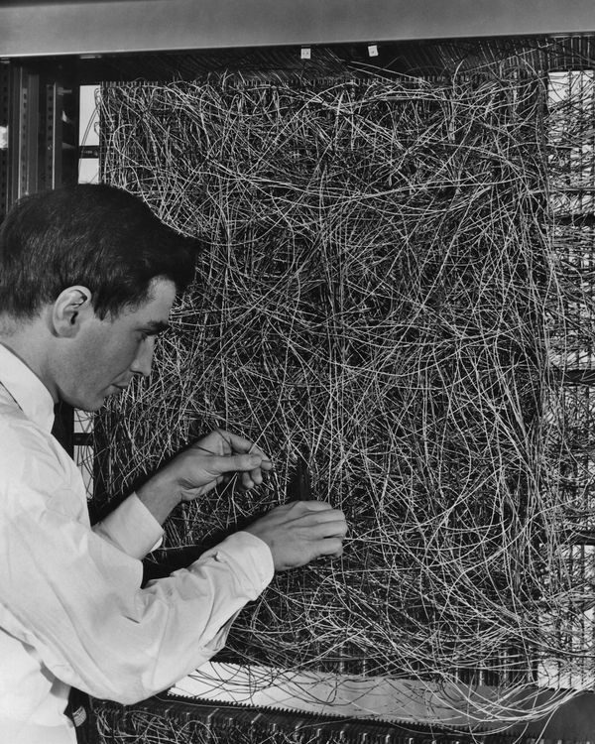
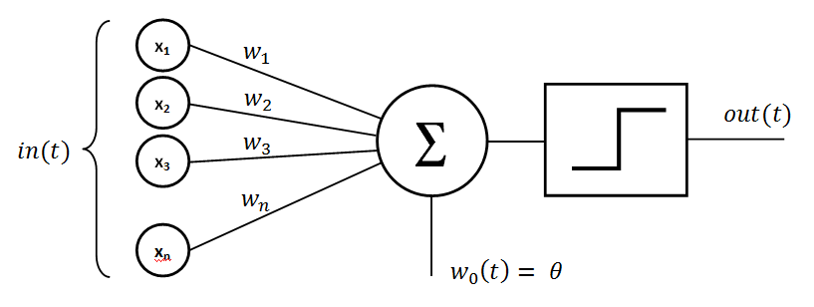
Rosenblatt’s perceptron (1958-60)
Single layer network of nodes
Real valued weights +/-
Supervised learning using a simple learning rule
Essentially a linear classifier
Widrow & Hoff (1960-62) added better learning rule using gradient descent
Mark 1 perceptron computer, Cornell Aeronautical Lab, 1960

Slide 9
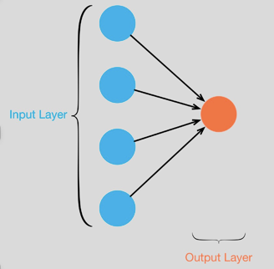
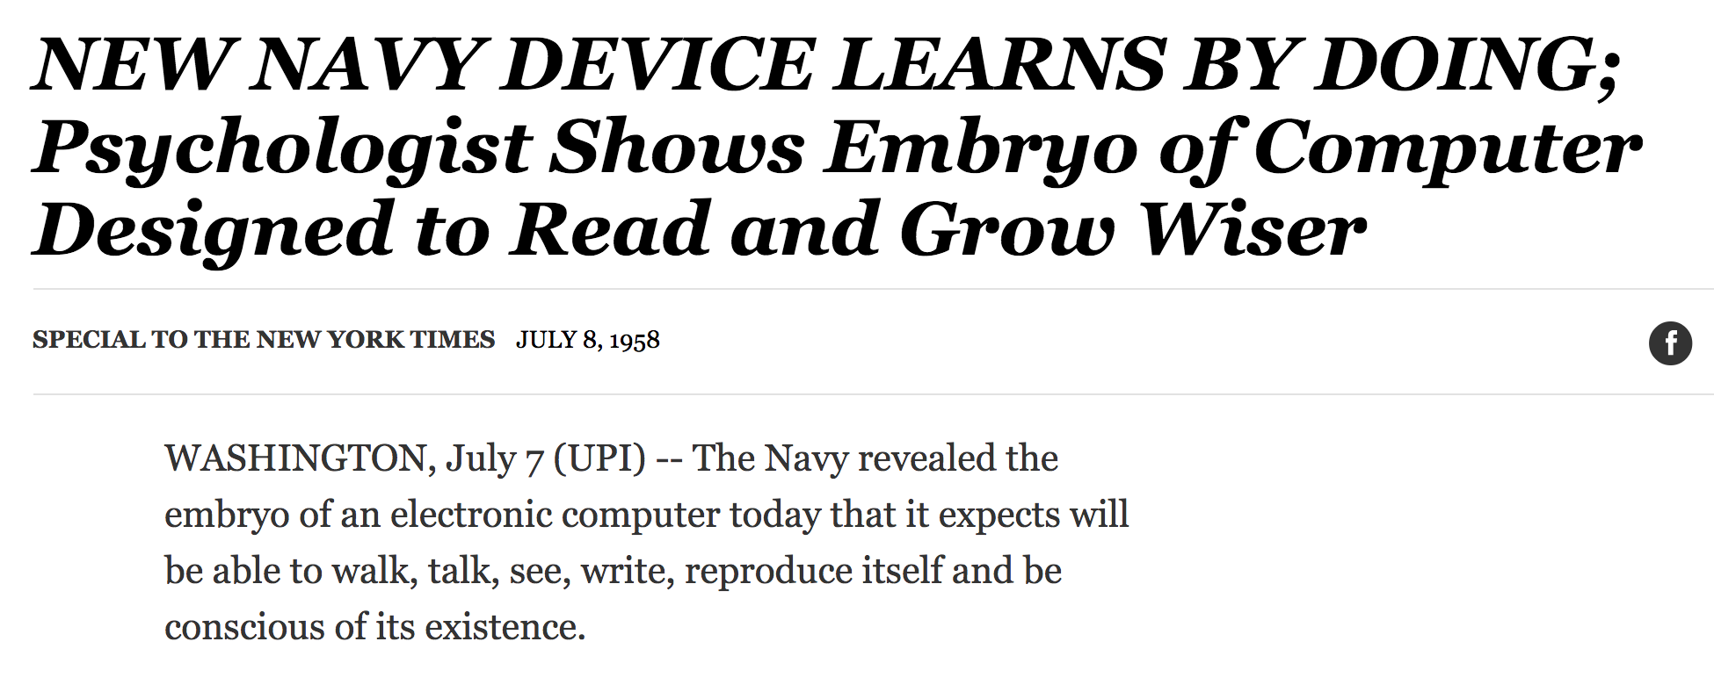
Single Layer Perceptron
See the full 1958 NYT article above here
Rosenblatt: it can learn to compute functions by learning weights on inputs from examples

Slide 10
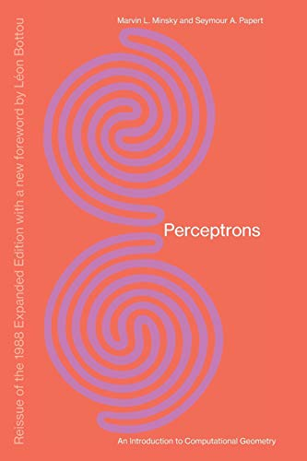
Setback in mid 60s – late 70s
Perceptrons, Minsky and Papert, 1969
Described serious problems with
perceptron model
  Single-layer perceptrons cannot represent (learn) simple functions that are not linearly separable, such as XOR
  Multi-layers of non-linear units may have greater power but there is no learning rule for such nets
  Scaling problem: connection weights may grow infinitely
  First two problems overcame by latter effort in 80s, but scaling problem persists
Death of Rosenblatt (1964)
AI focused on programming intelligent systems on traditional von Neuman computers

Slide 11
Not with a perceptron ☹
Consider Boolean operators (and, or, xor) with four possible inputs: 00 01 10 11
Training examples are not linearly separable for one case: sum=1 iff x1 xor x2

Slide 12
Renewed enthusiasm 1980s
Use multi-layer perceptron
Backpropagation for multi-layer feed forward nets, with non-linear, differentiable node functions
  Rumelhart, Hinton, Williams, Learning representations by back-propagating errors, Nature, 1986.
Other ideas:
  Thermodynamic models (Hopfield net, Boltzmann machine …)
  Unsupervised learning
Applications to character recognition, speech recognition, text-to-speech, etc.

Slide 13
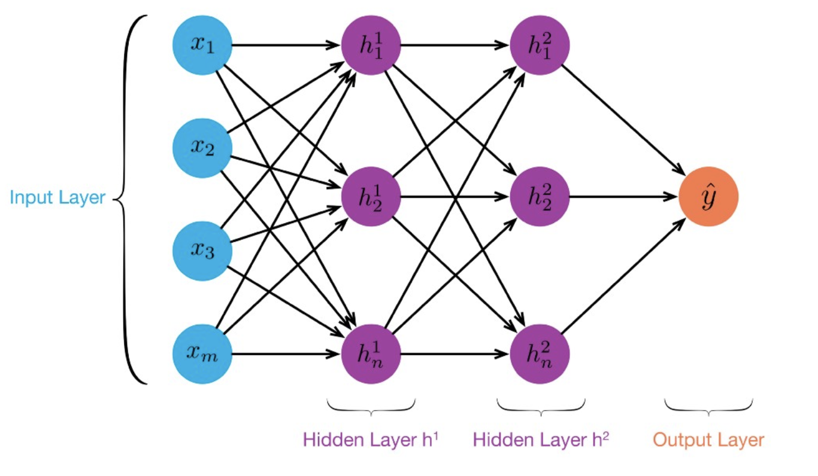
MLP:
Multilayer
Perceptron
≥ 1 “hidden layers” between inputs & output
Can compute non-linear functions (why?)
Training: adjust weights slightly to reduce error between output y and target value t; repeat
Introduced in 1980s, still used today

Slide 14
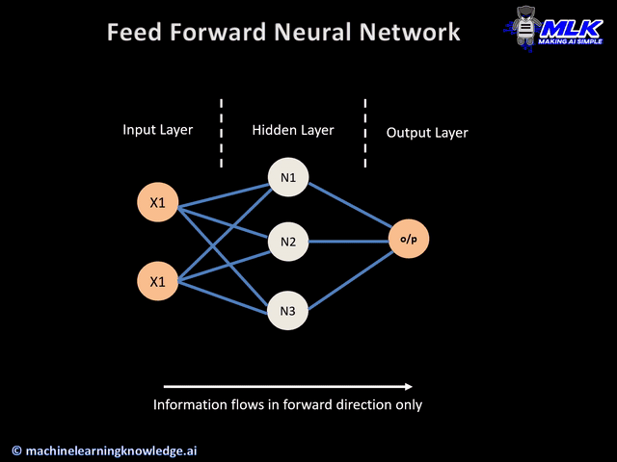

Slide 15
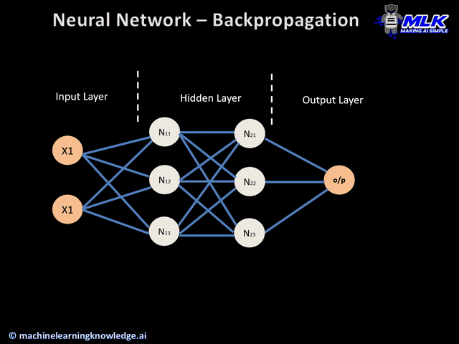

Slide 16
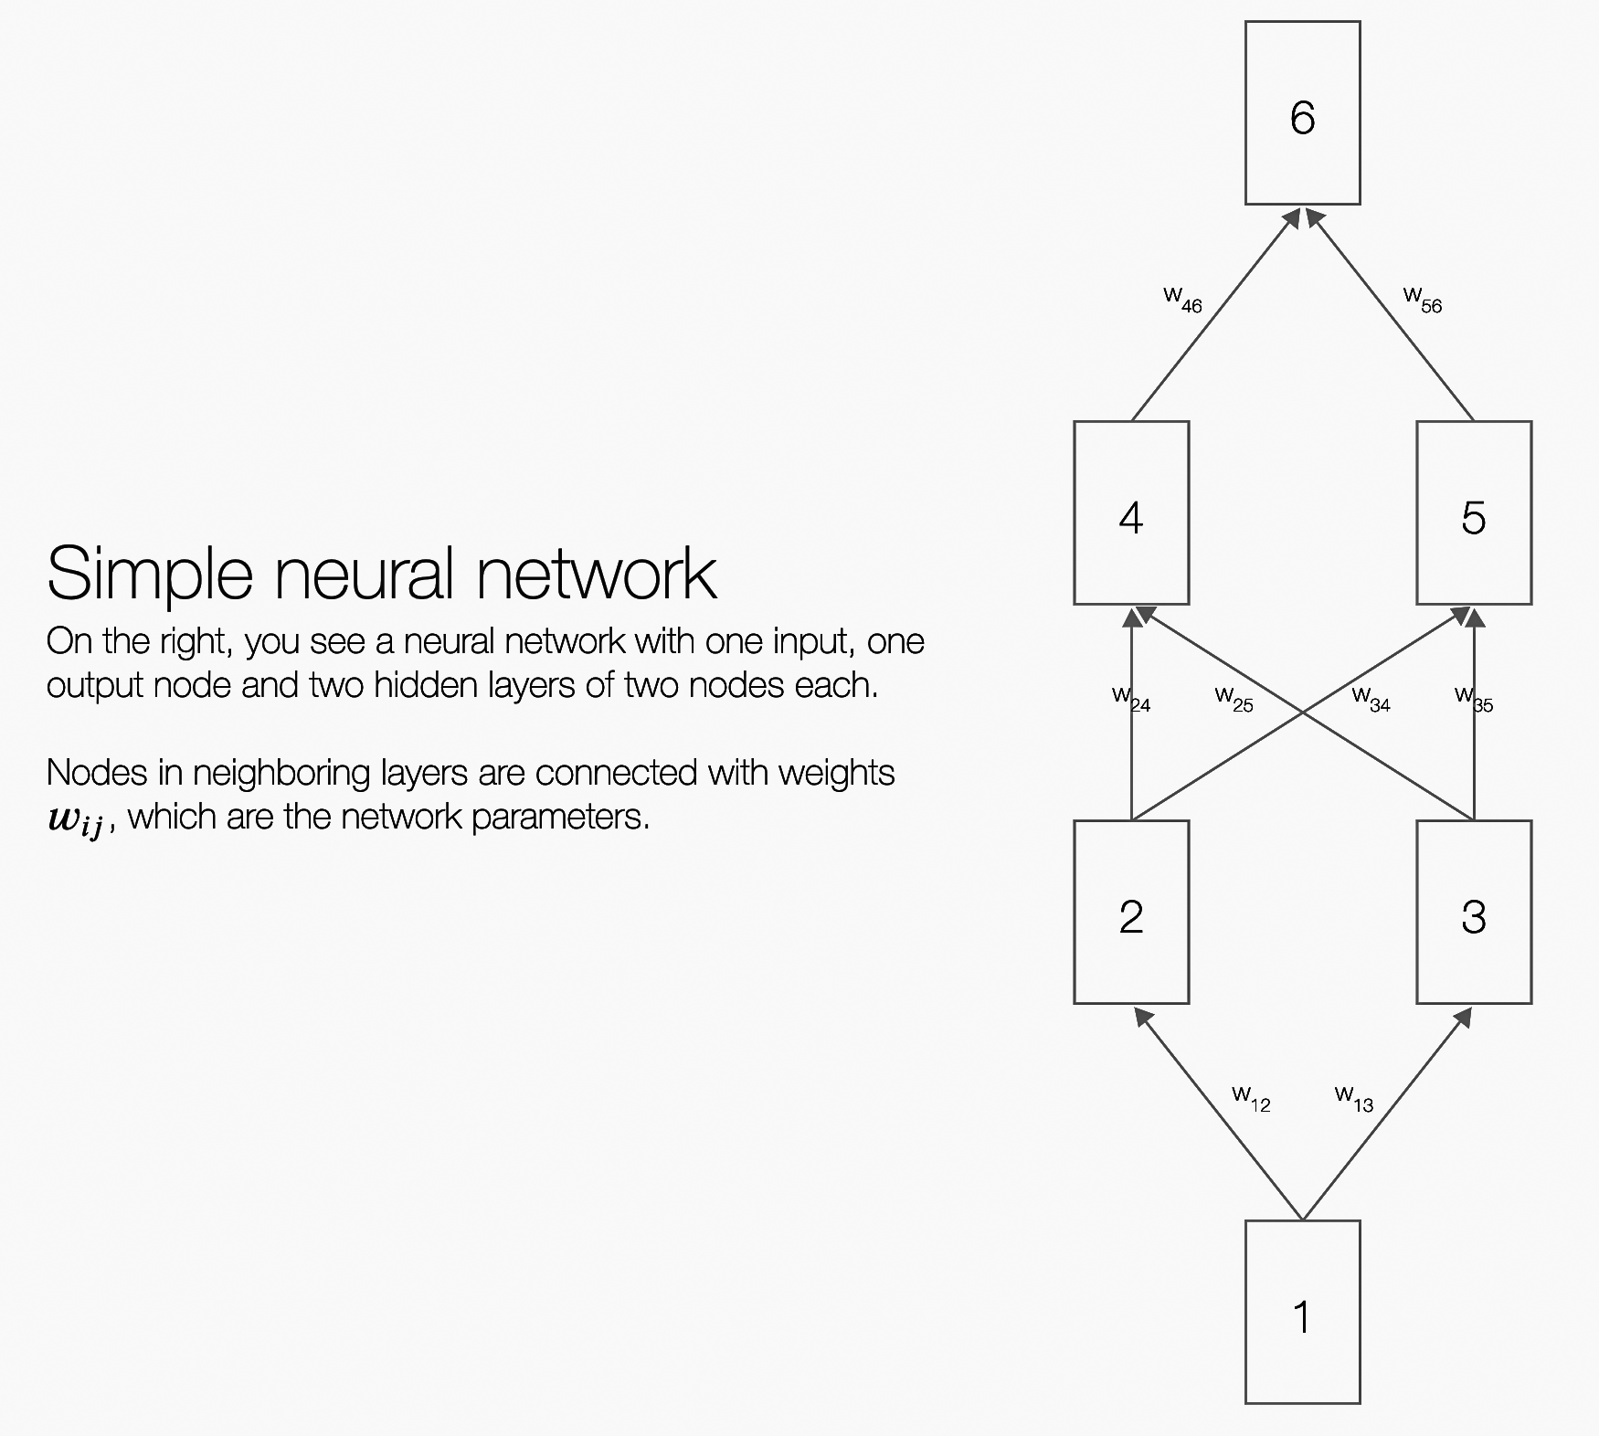
Backpropagation Explained
Click on image (or here) for a simple interactive demo in your browser of how backpropagation updates weights in a neural network to reduce errors when processing training data

Slide 17
But problems remained …
It’s often the case that solving a problem just reveals a new one that needs solving
For a large MLPs, backpropagation takes forever to converge!
Two issues:
  Not enough compute power to train the model
  Not enough labeled data to train the neural net
SVMs are better, since they converge to global optimum in O(n^2)

Slide 18
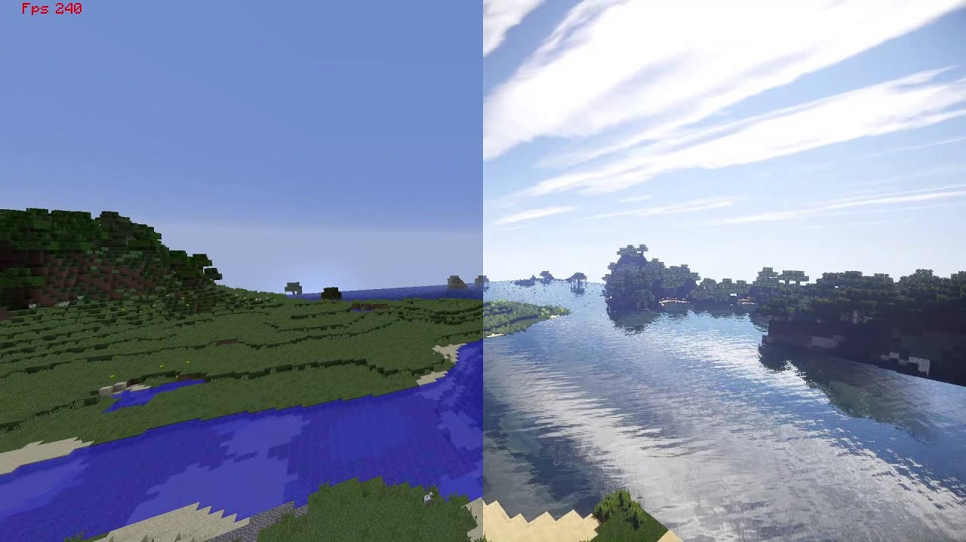
GPUs solve compute power problem
GPUs (Graphical Processing
Units) became popular in
the 1990s to handle computing needed for better computer graphics
GPUs are SIMD (single instruction, multiple data) processors
Cheap, fast, and easy to program
GPUs can do matrix multiplication and other matrix computations very fast

Slide 19
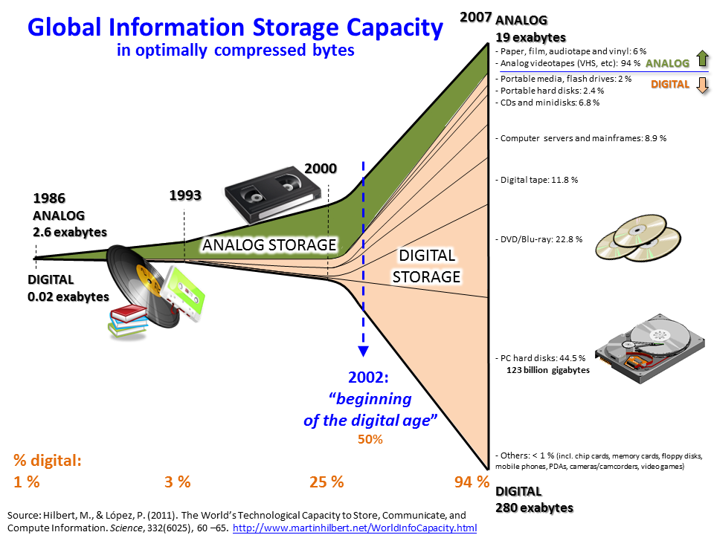
Need lots of data!
2000s introduced big
data
Cheaper storage
Parallel processing
(e.g., MapReduce, Hadoop, Spark)
Data sharing via the Web
  Lots of images, many with captions
  Lots of text, some with labels
Crowdsourcing systems (e.g., Mechanical Turk) provided a way to get more labels

Slide 20
New problems are surfaced
2010s was a decade of domain applications
These came with new problems, e.g.,
  Images are too high dimensional!
  Variable-length problems cause gradient problems
  Training data is rarely labeled
  Neural nets are uninterpretable
  Training complex models required days or weeks
This led to many new “deep learning” neural network models

Slide 21
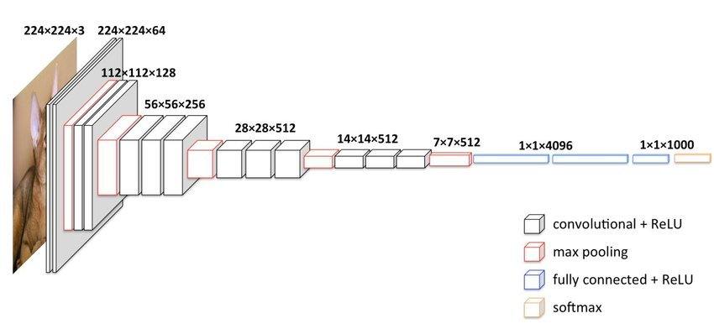
Deep Learning
Deep learning refers to models going beyond simple feed-forward multi-level perceptron
  Though it was used in a ML context as early as 1986
“deep” refers to the models having many layers (e.g., 10-20) that do different things
22 layers!
The VGG16 CNN model for image processing

Slide 22
Neural Network Architectures
Current focus on large networks with different “architectures” suited for different kinds of tasks
Feedforward Neural Network
CNN: Convolutional Neural Network
RNN: Recurrent Neural Network
LSTM: Long Short Term Memory
GAN: Generative Adversarial Network
Transformers: generating output sequence from input sequence

Slide 23
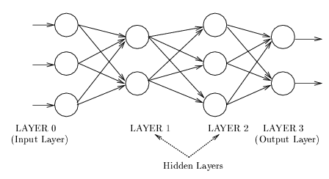
Feedforward Neural Network
Connections allowed from a node in layer i only to nodes in layer i+1
  i.e., no cycles or loops
Simple, widely used architecture, provides a good baseline
downstream nodes tend to successively abstract features from preceding layers

Slide 24
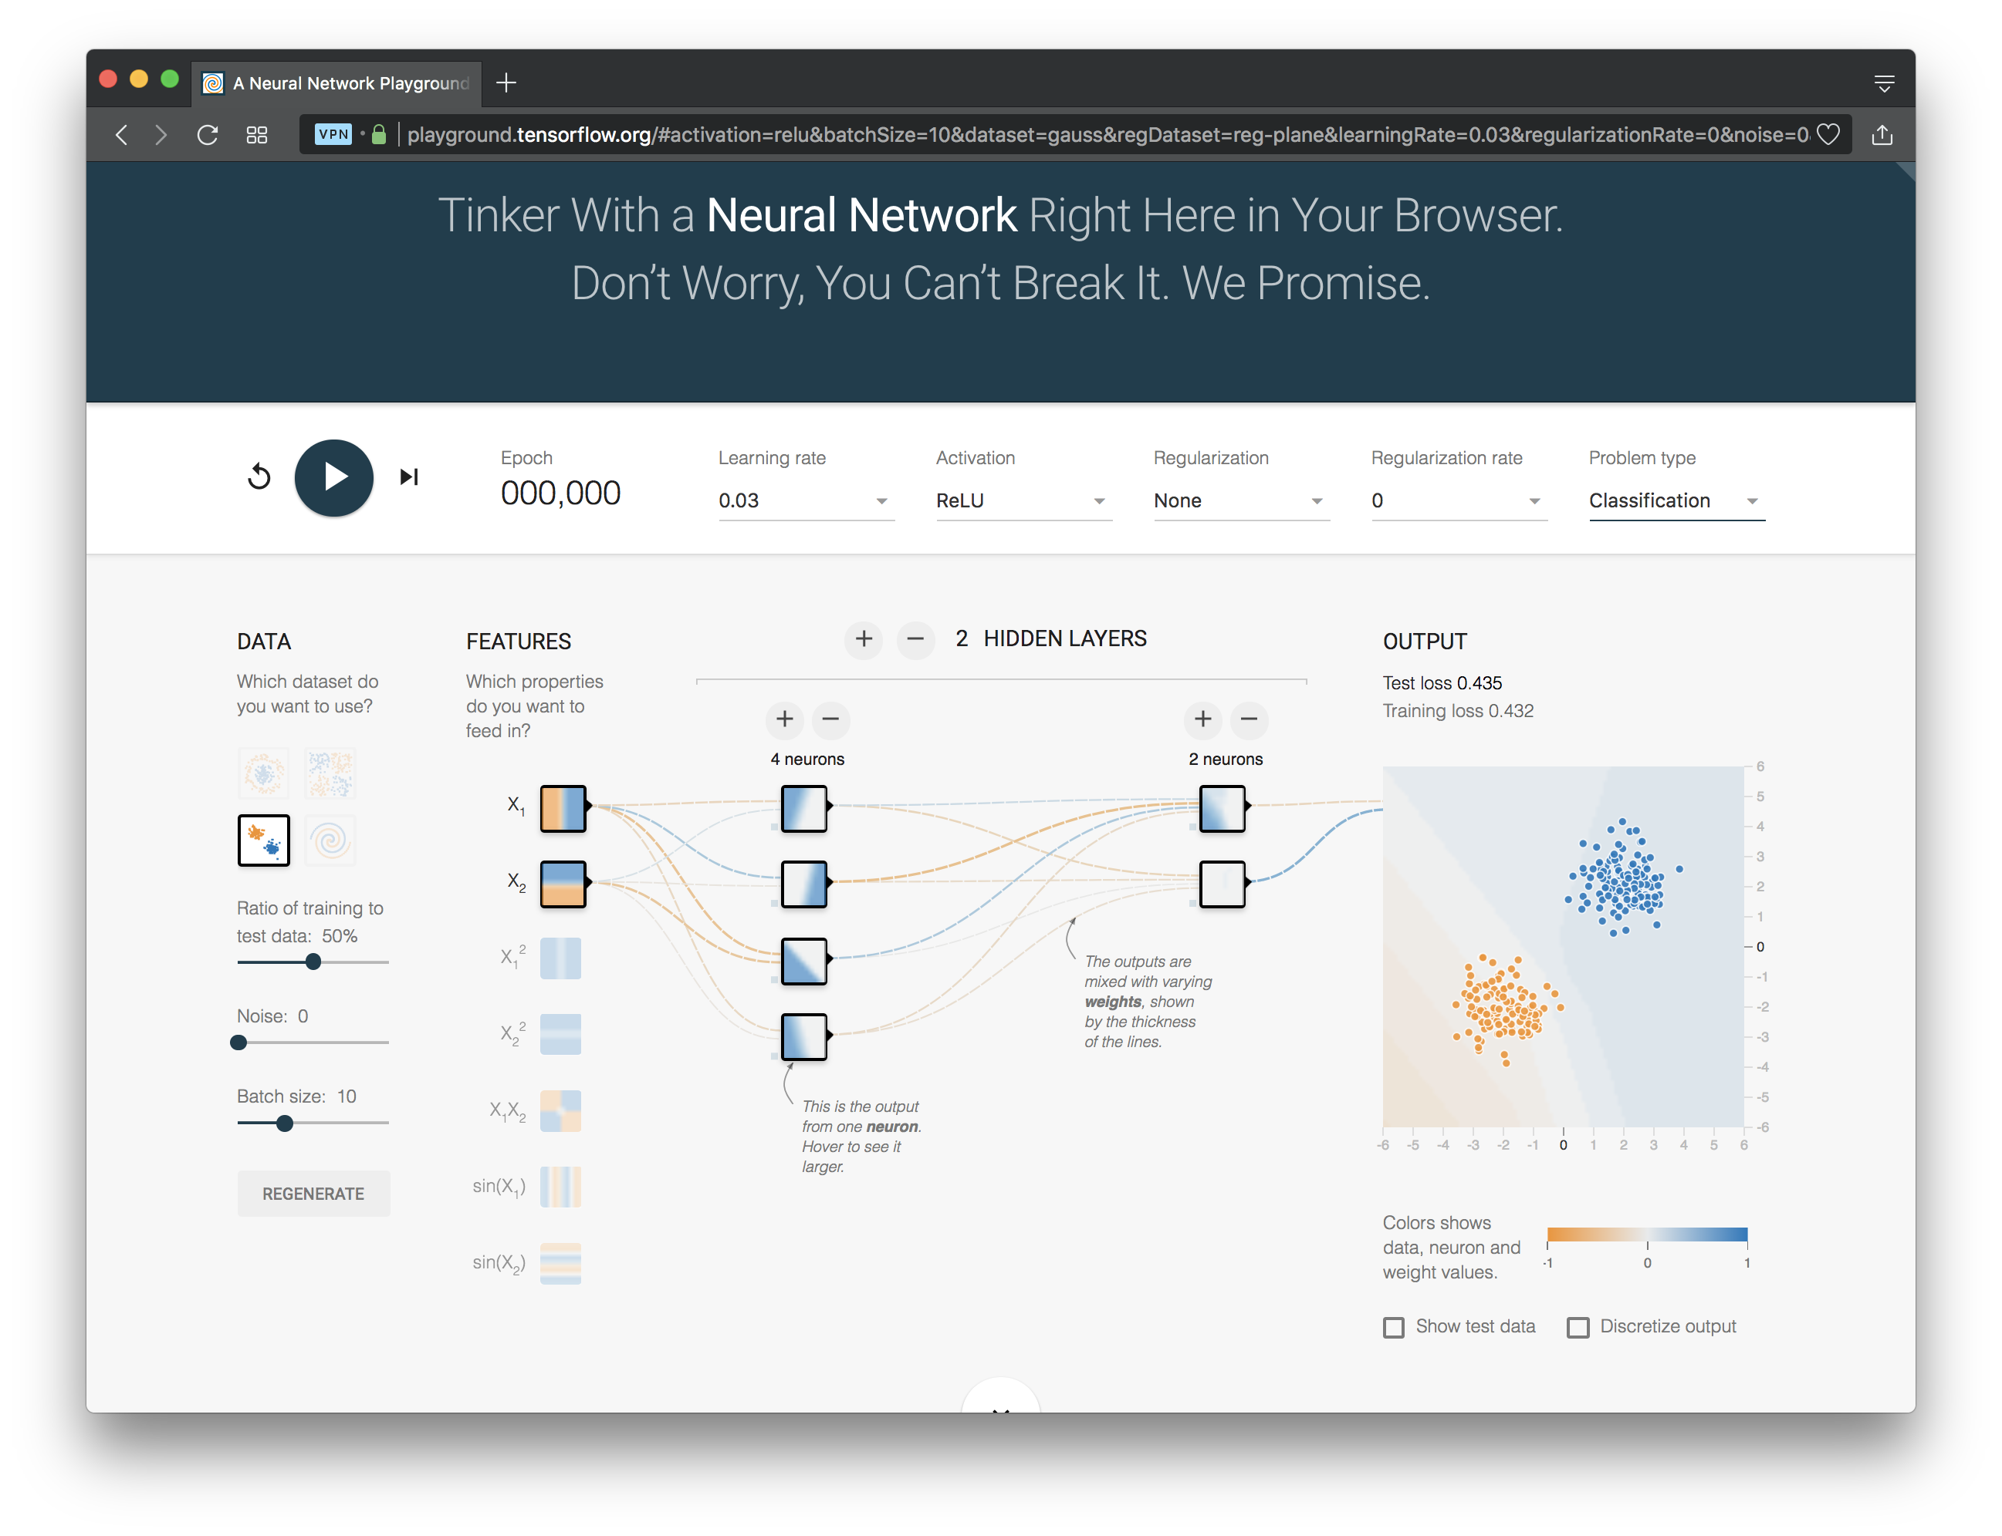
http://playground.tensorflow.org/

Slide 25
1. Select dataset
http://playground.tensorflow.org/

Slide 26
1. Select dataset
2. Choose features
http://playground.tensorflow.org/

Slide 27
1. Select dataset
2. Choose features
3. Add layers
http://playground.tensorflow.org/

Slide 28
1. Select dataset
2. Choose features
3. Add layers
4. Parameters
http://playground.tensorflow.org/

Slide 29
1. Select dataset
2. Choose features
3. Add layers
4. Parameters
5. Task
http://playground.tensorflow.org/

Slide 30
CNN: Convolutional Neural Network
Good for 2D image processing: classification, object recognition, automobile lane tracking, etc.
Successive convolution layers learn higher-level features
Classic demo: learn to recognize hand-written digits from MNIST data with 70K examples

Slide 31
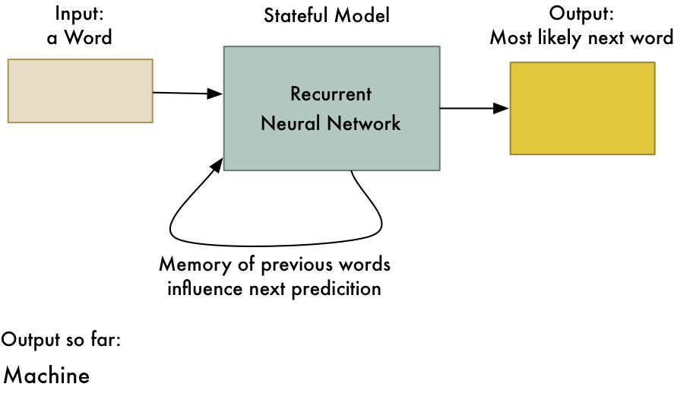
RNN: Recurrent Neural Networks
Good for learning over sequences of data, e.g., a sentence of words
LSTM (Long Short Term Memory) a popular architecture
gif from Adam Geitgey

Slide 32
GAN: Generative Adversarial Network
System of two neural networks competing against each other in a zero-sum game framework
Provides a kind of unsupervised learning that improves the network
Introduced by Ian Goodfellow et al. in 2014
Can learn to draw samples from a model that is similar to data that we give them

Slide 33
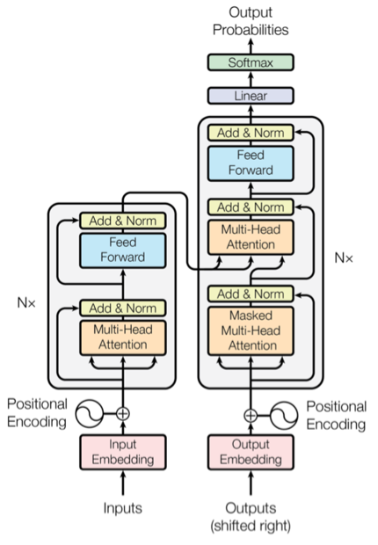
Transformer
Introduced in 2017
Used primarily for natural language
processing tasks
NLP applications ”transform” an
input text into an output text
  E.g., translation, text summarization,
  question answering
Uses encoder-decoder architecture
Popular pretrainted models available,
e.g. BERT and GPT

Slide 34
Deep Learning Frameworks (1)
Popular open-source deep learning frame-works use Python at top-level; C++ in backend
  TensorFlow (via Google)
  PyTorch (via Facebook)
  MxNet (Apache)
  Caffe (Berkeley)
  Keras (Open Source)
TensorFlow and PyTorch now dominate; both make it easy to specify a complicated network
Notes:
Demo: MNIST CNN
Demo: RNN sentiment

Slide 35
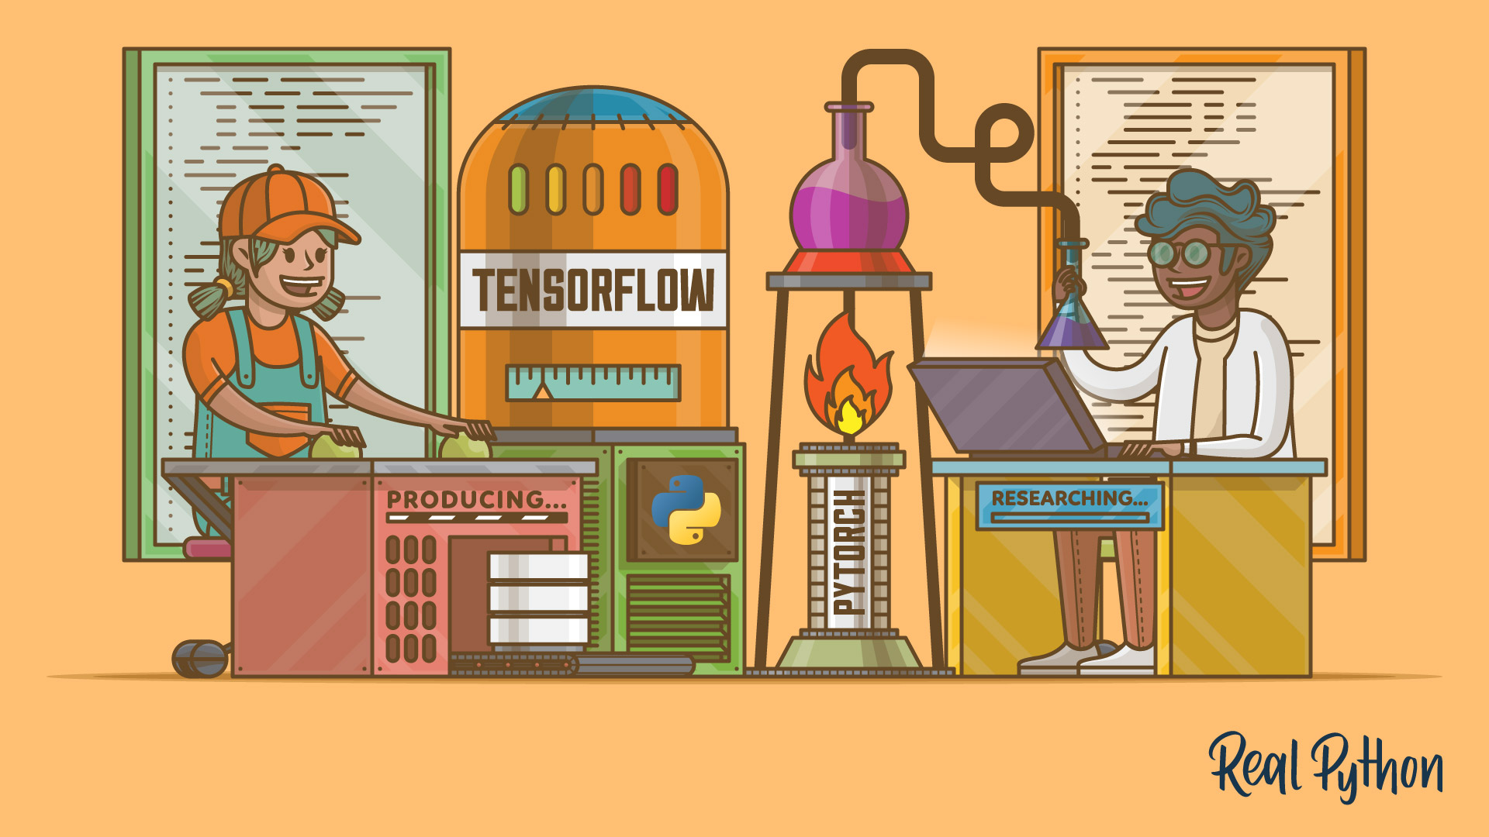
Deep Learning Frameworks (2)
See this article for a good comparison
PyTorch vs TensorFlow for Your Python Deep Learning Project
Notes:
Demo: MNIST CNN
Demo: RNN sentiment

Slide 36

Keras
“Deep learning for humans”
A popular API works with TensorFlow 2.0, provides good support at architecture level
Keras now (v2.4) only supports TensorFLow
Supports CNNs and RNNs and common utility layers like dropout, batch normalization and pooling
Coding neural networks used to be a LOT harder; Keras makes it easy and accessible!
Documentation: https://keras.io/

Slide 37
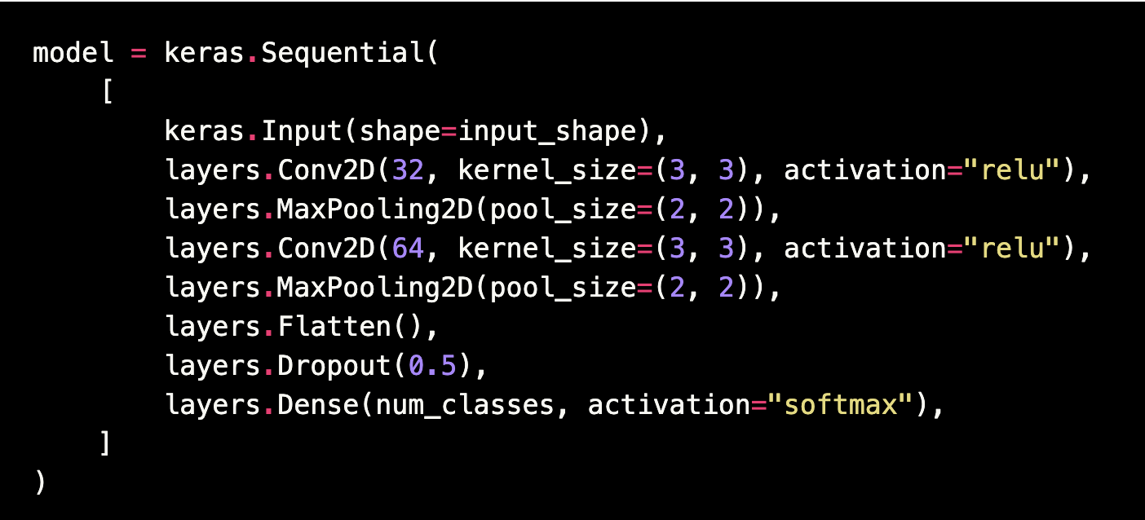
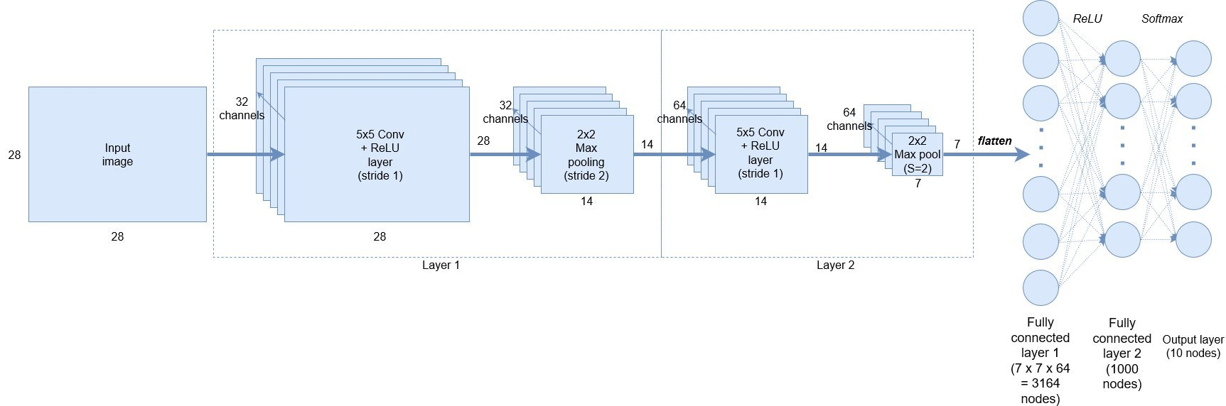
Keras: API works with TensorFlow 2.0
Notes:
Demo: MNIST CNN
Demo: RNN sentiment

Slide 38
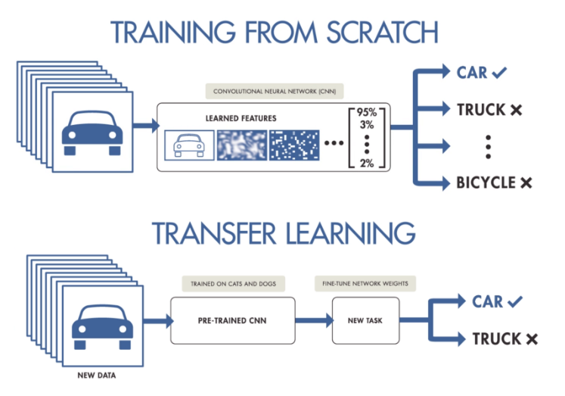
NNs Good at Transfer Learning
Neural networks effective for transfer learning
  Using parts of a model trained on a task as an initial model to train on a different task
Particularly effective for image recognition

Slide 39
Good at Transfer Learning
For images, the initial stages of a model learn high-level visual features (lines, edges) from pixels
Final stages predict task-specific labels
source:http://ruder.io/transfer-learning/

Slide 40
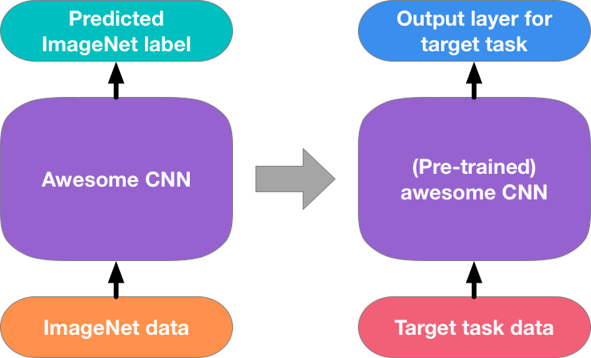
Fine Tuning a NN Model
Special kind of transfer learning
  Start with a pre-trained model
  Replace last output layer with a new one
  One option: Fix all but last layer by marking as trainable:false
Retraining on new task and data very fast
  Only the weights for the last layer are adjusted
Example
  Start: NN to classify animal pix with 100s of categories
  Finetune on new task: classify pix of 10 common pets

Slide 41
Conclusions
Quick intro to neural networks & deep learning
Learn more by
  Take UMBC’s CMSC 478 machine learning class
  Try scikit-learn’s neural network models
  Explore Keras as : https://keras.io/
  Explore Google’s Machine Learning Crash Course
  Work through examples
and then try your own project idea

