Slide 1
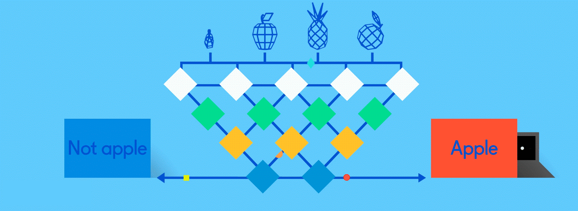
Neural Networks for Machine Learning demonstrations

Slide 2
Neural Network Architectures
Current focus on large networks with different “architectures” suited for different kinds of tasks
Feedforward Neural Network (aka MLP)
CNN: Convolutional Neural Network
RNN: Recurrent Neural Network
LSTM: Long Short Term Memory
Transformer

Slide 3
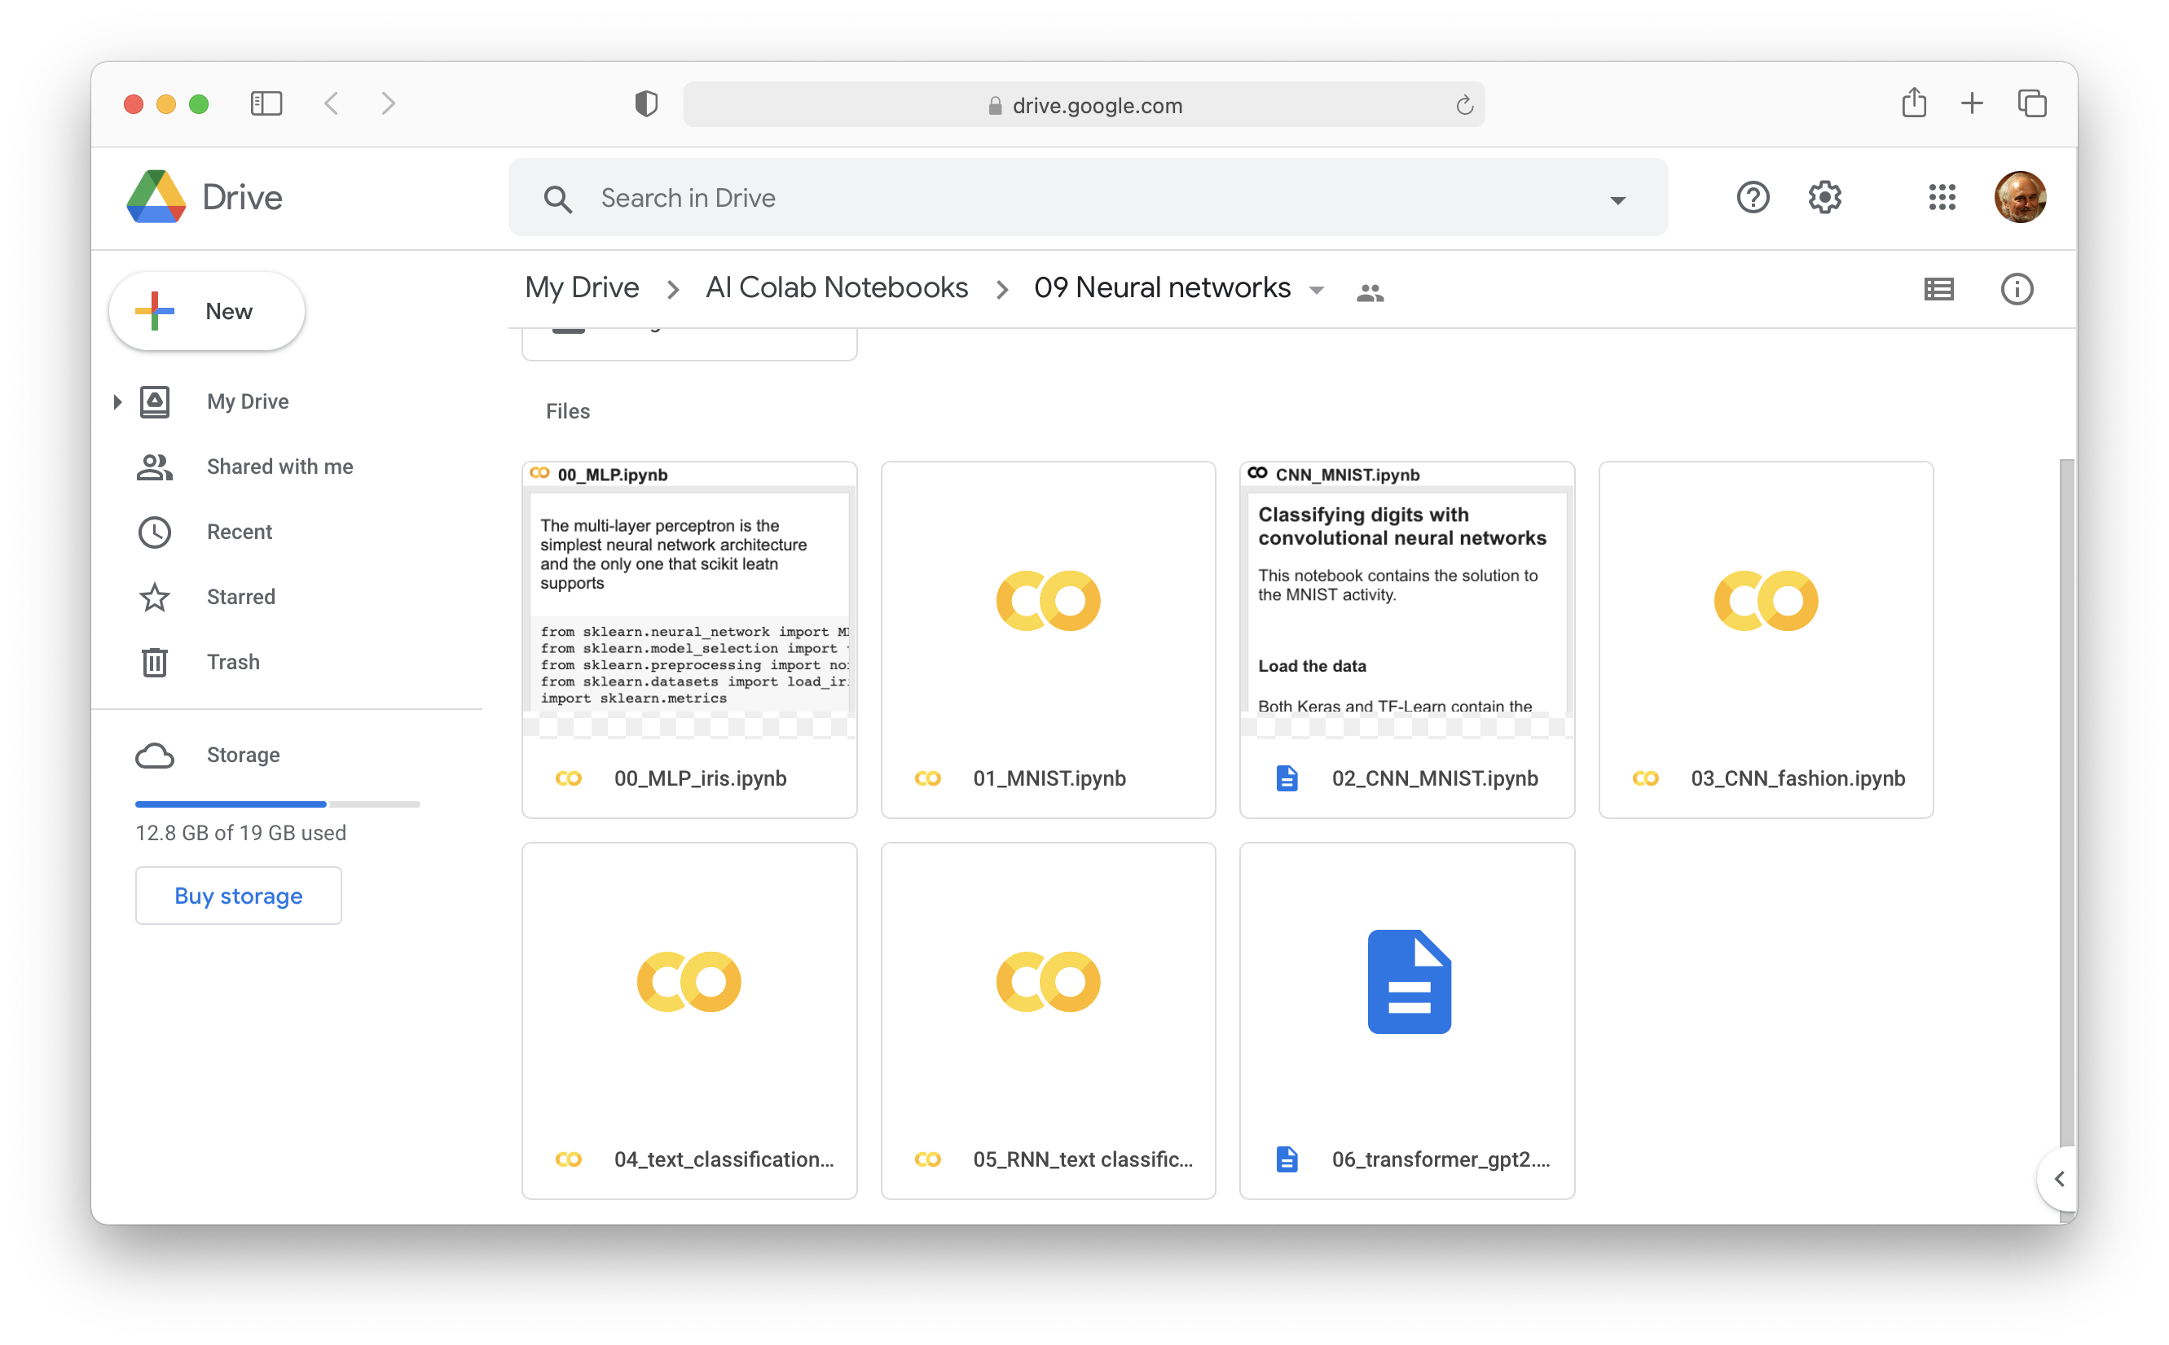
Neural Network Colab Notebooks

