Slide 1
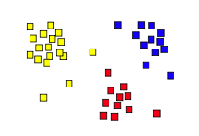
Unsupervised Learning: Clustering Beyond K-means
14.6
Some material adapted from slides by Andrew Moore, CMU

Slide 2
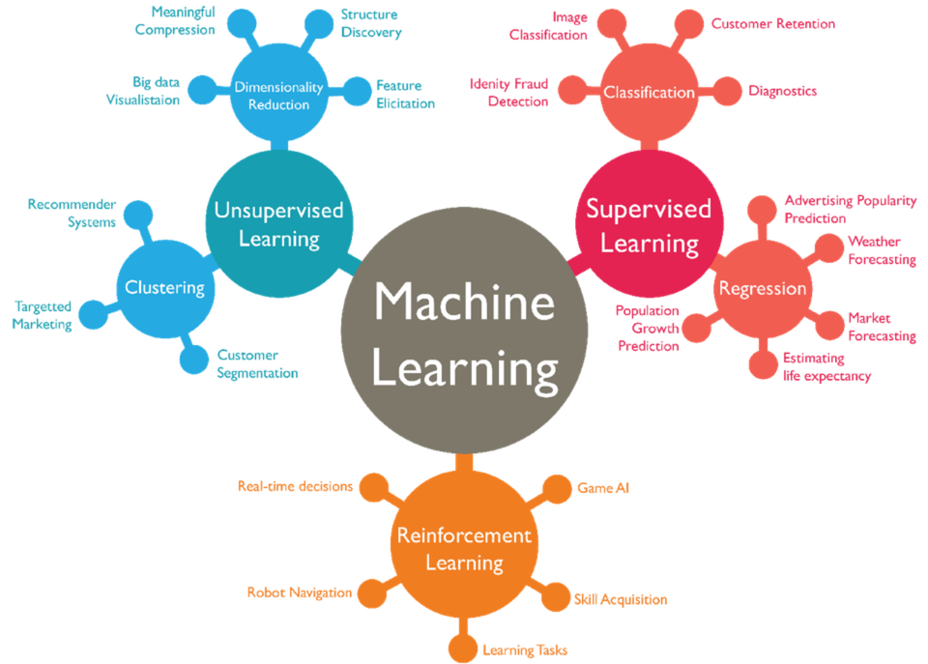

Slide 3
(2) Hierarchical clustering
Agglomerative
Bottom-up approach: elements start as individual clusters & clusters are merged as one moves up the hierarchy
Divisive
Top-down approach: elements start as a single cluster & clusters are split as one moves down the hierarchy

Slide 4
Hierarchical Clustering
Recursive partitioning/merging of a data set
1−clustering
5
2−clustering
1
3−clustering
4
2
4−clustering
3
5−clustering
1 2 3 4 5

Slide 5
Dendogram
Tree structure representing all data partitionings
Constructed as clustering proceeds
Nine items

Slide 6
Dendogram
Tree structure representing all data partitionings
Constructed as clustering proceeds
Get a K-clustering by looking at connected components at any given level
Often binary dendograms, but n-ary ones easy to get with minor algorithm changes
Four clusters at this level

Slide 7
Dendogram
Tree structure representing all data partitionings
Constructed as clustering proceeds
Get a K-clustering by looking at connected components at any given level
Often binary dendograms, but n-ary ones easy to get with minor algorithm changes
Two clusters at this level

Slide 8
Hierarchical clustering advantages
Need not specify number of clusters
Good for data visualization
See how data points interact at many levels
Can view data at multiple granularity levels
Understand how all points interact
Specifies all of the K clusterings/partitions

Slide 9
Divisive hierarchical clustering
Top-down technique to find best partitioning of data, generally exponential in time
Common approach:
Let C be a set of clusters
Initialize C to be a one-clustering of data
While there exists a cluster c in C
remove c from C
partition c into 2 clusters (c₁ and c₂ ) using a flat clustering algorithm (e.g., k-means with k=2)
Add to c₁ and c₂ C

Slide 10
Divisive clustering

Slide 11
Divisive clustering
start with one cluster

Slide 12
Divisive clustering
use flat clustering to split into two clusters (e.g., using K-means with k=2)

Slide 13
Divisive clustering

Slide 14
Divisive clustering
split using flat clustering, e.g., K-means

Slide 15
Divisive clustering
split using flat clustering
split using flat clustering, e.g., K-means

Slide 16
Divisive clustering
Stop when clusters reach some constraint, e.g., all of size 1

Slide 18
Hierarchical Agglomerative Clustering
Let C be a set of clusters
Initialize C to all points/docs as separate clusters
While C contains more than one cluster
find c₁ and c₂ in C that are closest together
remove c₁ and c₂ from C
merge c₁ and c₂ and add resulting cluster to C
Merging history forms a binary tree or hierarchy
Q: How to measure distance between clusters?

Slide 19
Distance between clusters
Single-link: Similarity of the most similar (single-link)
Weka: linkType=SINGLE

Slide 20
Distance between clusters
Complete-link: Similarity of the “furthest” points, the least similar
Weka: linkType=COMPLETE

Slide 21
Distance between clusters
Centroid: Clusters whose centroids (centers of gravity) are the most similar
Weka: linkType=CENTROID

Slide 22
Distance between clusters
Average-link: Average similarity between all pairs of elements
Weka: linkType=AVERAGE

Slide 23
Defaut SINGLE cluster distance gives poor results here

Slide 24
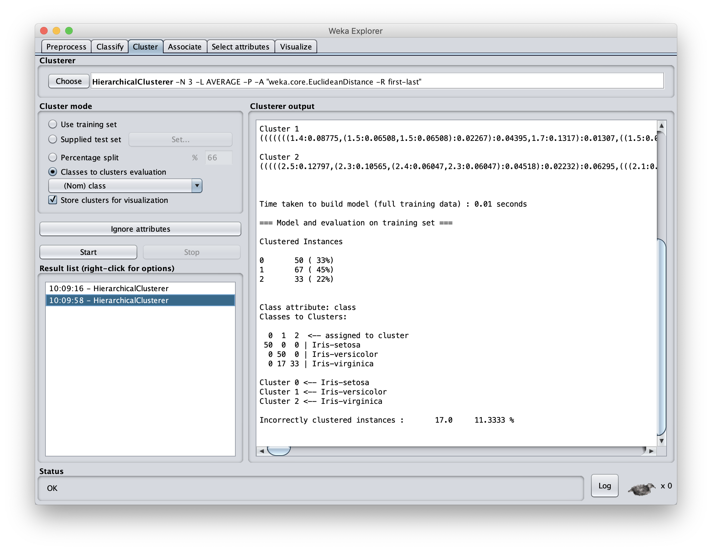
Using AVERAGE cluster distance measure improves results

Slide 25
Knowing when to stop
General issue is knowing when to stop merging/splitting a cluster
We may have a problem specific desired range of clusters (e.g., 3-6)
There are some general metrics for assessing quality of a cluster
There are also domain specific heuristics for cluster quality

Slide 26
(3) DBSCAN Algorithm
Density-Based Spatial Clustering of Applications with Noise
It clusters close points based on a distance and a minimum number of points
Key parameters: eps=maximum distance between two points; minPoints= minimal cluster size
Marks as outliers points in low-density regions
Needn’t specify number of clusters expected
Fast

Slide 28
DBSCAN Example
This gif (in ppt) shows how DBSCAN grows four clusters and identifies the remaining points as outliers

Slide 29
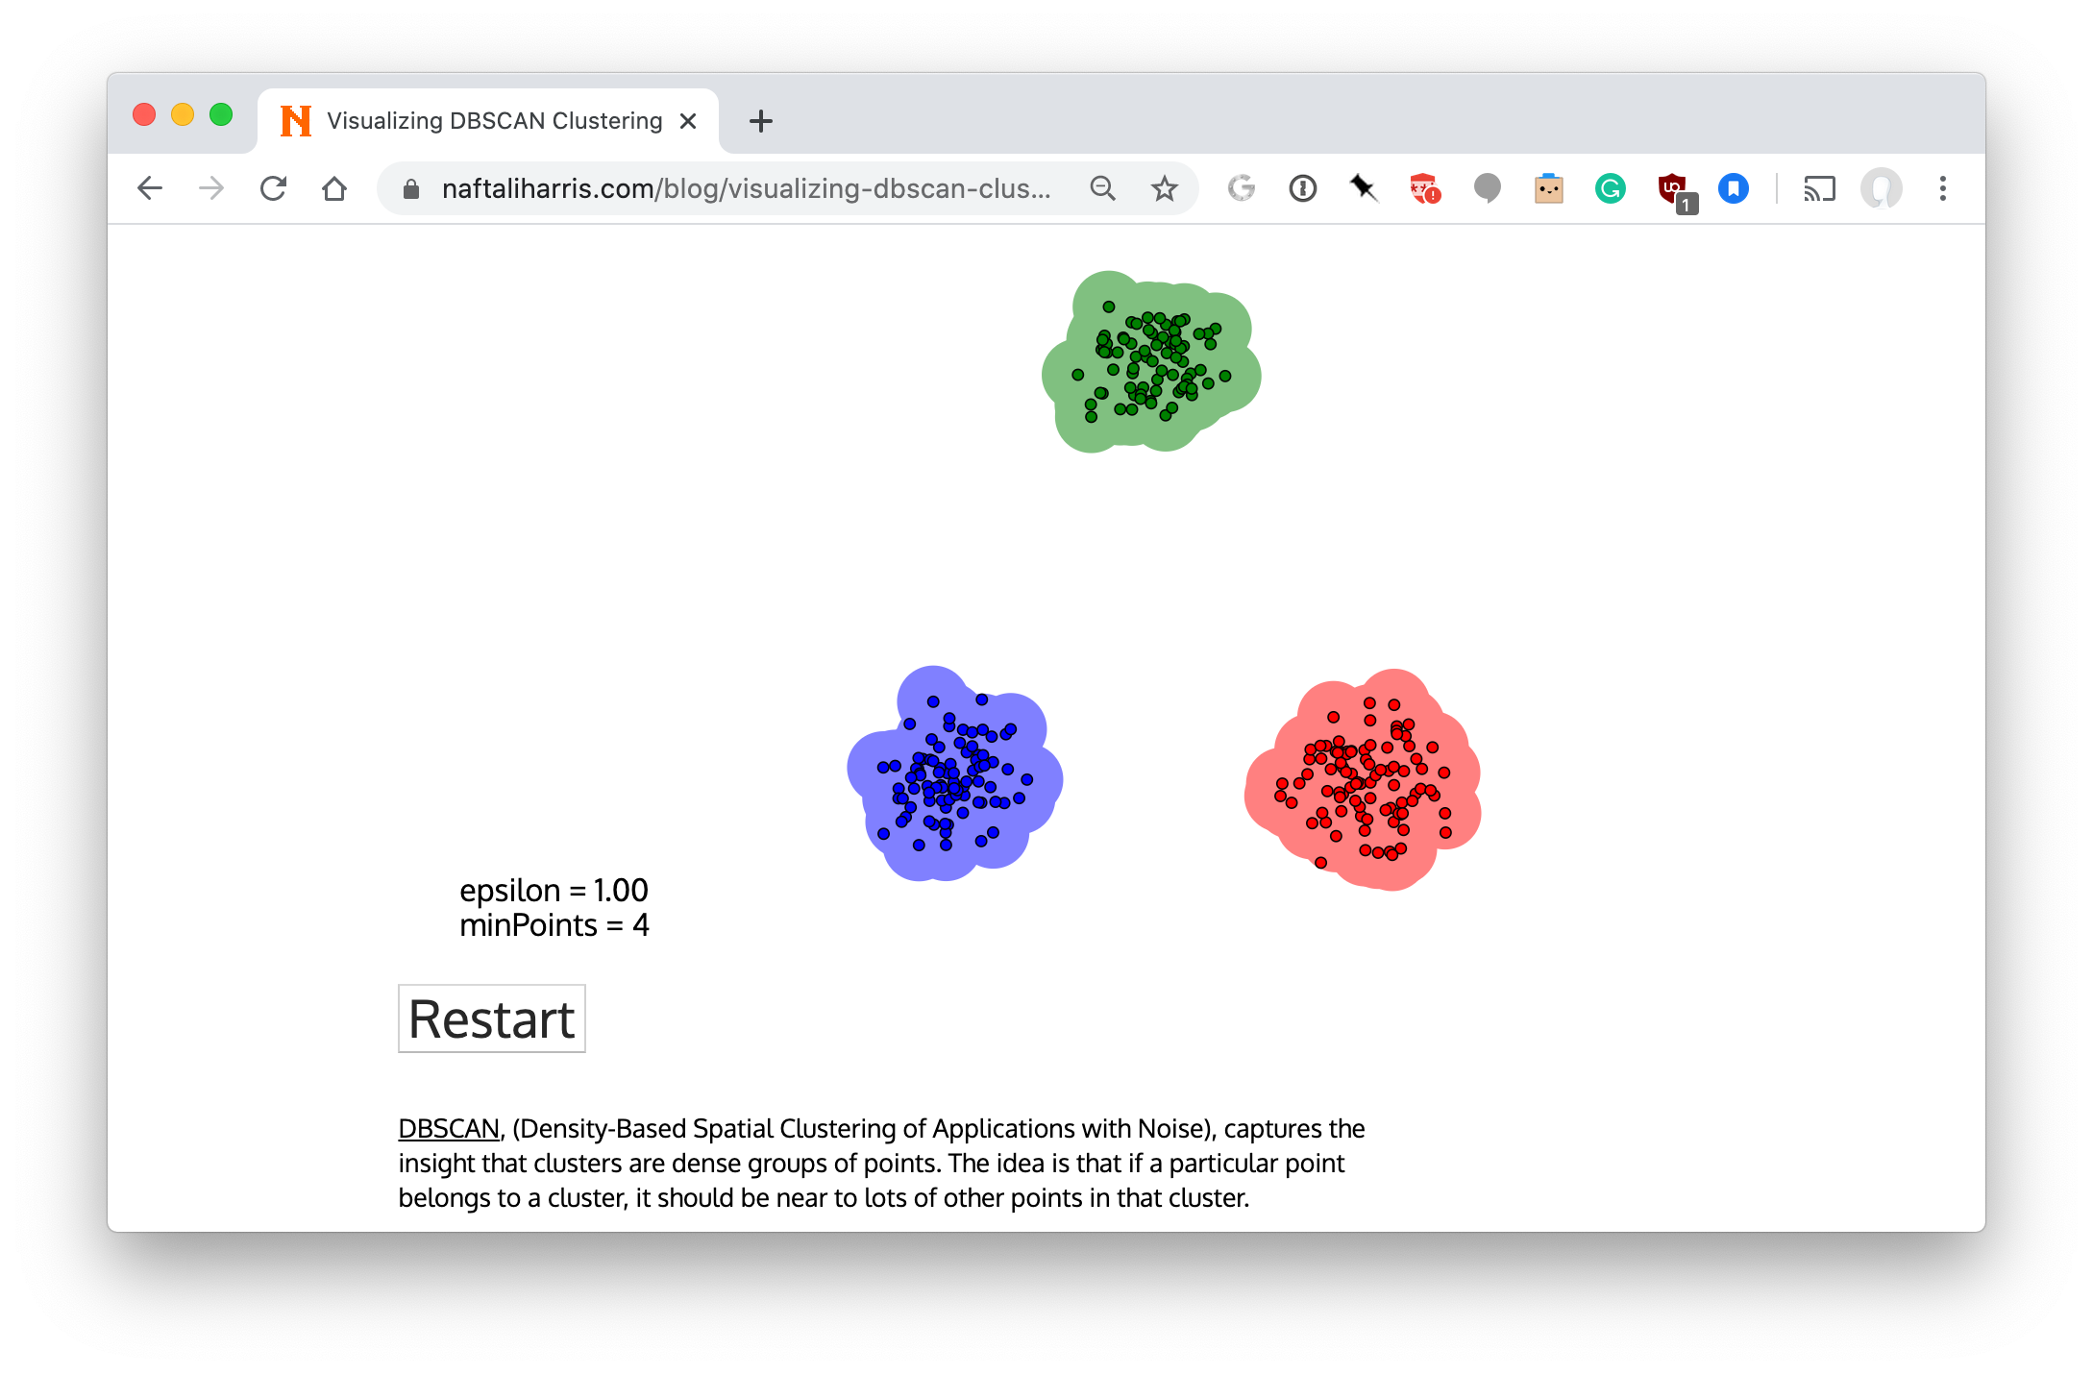
Visualizing DBSCAN https://bit.ly/471dbscan

Slide 30
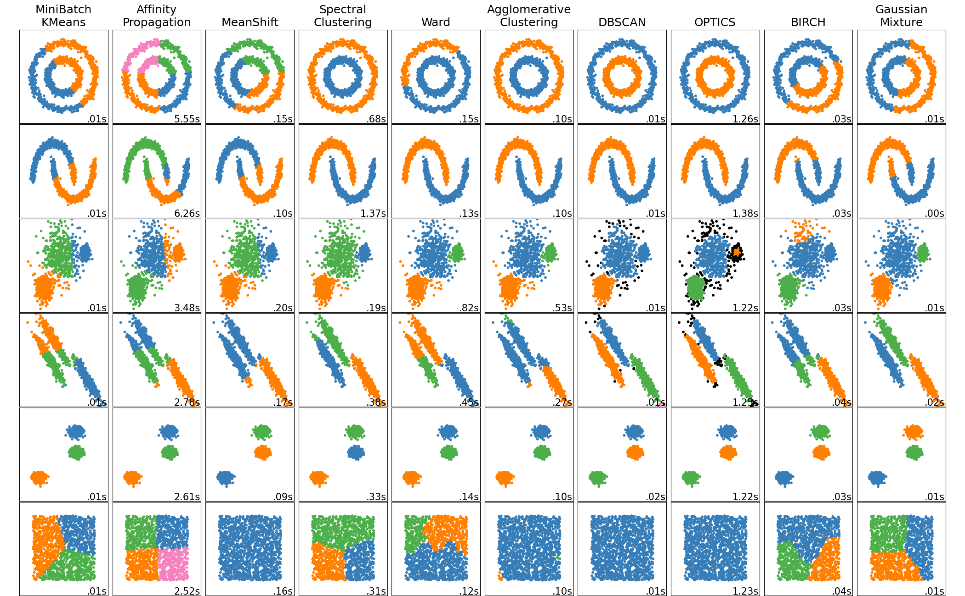
Comparing clustering algorithms via Scikit Learn

Slide 31
Clustering Summary
Clustering useful & effective for many tasks
K-means clustering one of simplest & fastest techniques, but
Requires knowing how many clusters is right
Doesn’t handle outliers well
Hierarchical clustering slower and more general, but needs a metric to know when to stop
There are many other clustering options

